Slide 1
Big Data
What’s the big deal?
David J. DeWitt
dewitt@microsoft.com
Rimma Nehme
rimman@microsoft.com
Microsoft Jim Gray Systems Lab
Madison, Wisconsin

Slide 2
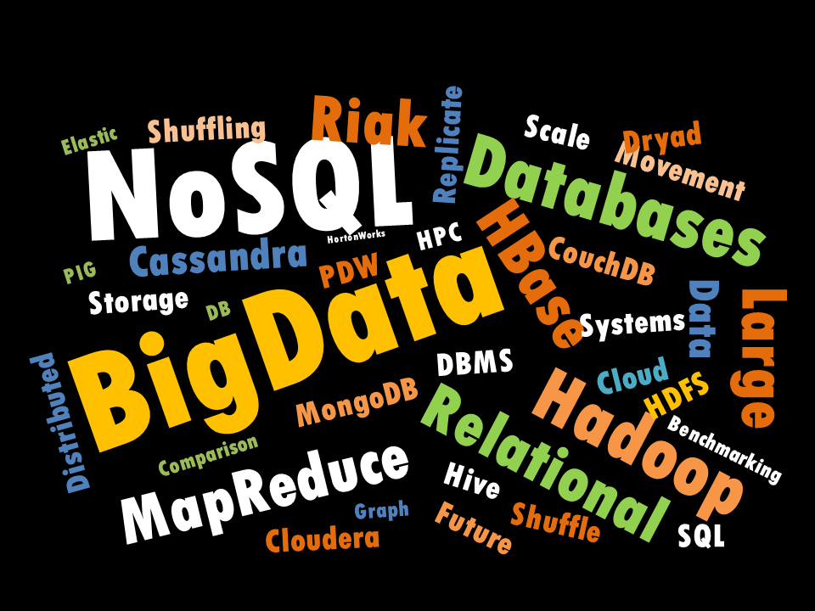


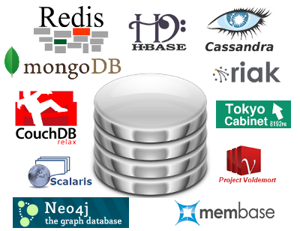



What Exactly Does “Big Data” Mean?
Massive collections of records – think 10’s of PBs
?
To some, “Big Data” means using a NoSQL system or Parallel relational DBMS like
Typically housed on large clusters of low-cost processors
  Facebook has 2700 nodes in their cluster with 60PB of storage!!
  Truly stunning.
Notes:
To some, “Big Data” means using:
A NoSQL system like
Hadoop and MapReduce
A parallel relational DBMS such as
…

Slide 3
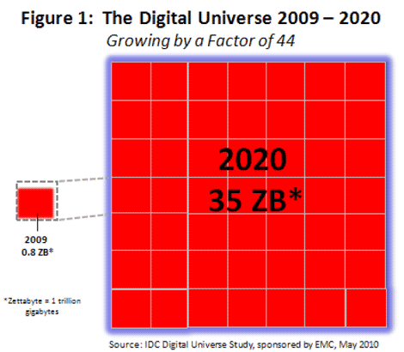


Some Big Data Stats
If you like analogies…
35ZB = enough data
to fill a stack of DVDs
reaching halfway to Mars
Petabytes
Mars
1 zettabyte?
= 1 million petabytes
= 1 billion terabytes
= 1 trillion gigabytes
Earth
Sources:
"Big Data: The Next Frontier for Innovation, Competition and Productivity."
US Bureau of Labor Statistics | McKinsley Global Institute Analysis

Slide 4







Why the Sudden Explosion of Interest?
An increased number and variety of data sources that generate large quantities of data
  Sensors (e.g. location, acoustical, …)
  Web 2.0 (e.g. twitter, wikis, … )
  Web clicks
Realization that data was “too valuable” to delete
Dramatic decline in the cost of hardware, especially storage
  If storage was still $100/GB there would be no big data revolution underway
1
0
1
0
0
1
0
0
1
0
1
1
1
1
0
0
1
1
0
0
1
0
1
1
1
1
1
1
1
1
0
1
1
0
0
0
0
1
0
1
1
0
0
1
0
0
0
1
0

Slide 5


Managing “Big Data”
Use a parallel
database system
  eBay – 10PB on 256 nodes
Old
guard
Young
turks
Use a NoSQL system
  Facebook - 20PB on 2700 nodes
  Bing – 150PB on 40K nodes
Notes:
Today, Facebook manages 20PB with a 2700 node cluster

Slide 6
NOSQL
What’s in the name...

Slide 7
NO to SQL
It’s not about saying that
SQL should never be used,
or that SQL is dead...

Slide 8
NOT Only SQL
It’s about recognizing
that for some problems
other storage solutions
are better suited!

Slide 9

NOSQL?
More data model flexibility
  JSON as a data model
  No “schema first” requirement
Relaxed consistency models such as eventual consistency
  Willing to trade consistency for availability
Low upfront software costs
Never learned anything but C/Java in school
  Hate declarative languages like SQL
Faster time to insight from data acquisition

Slide 10
Reducing time to insight
SQL:
Data
Arrives
Cleanse
the data
Transform
the data
Load
the data
3
4
5
1
Sometimes termed “Schema First”
Derive a
schema
RDBMS
SQL
Queries
6
2
NoSQL:
Data
Arrives
NOSQL
System
Application
Program
1
2
No cleansing!
No ETL!
No load!
Analyze data where it lands!
Sometimes termed “Schema Later”

Slide 11
Two Major Types of NOSQL Systems
Key/Value Stores
  Examples: MongoDB, CouchBase, Cassandra, Windows Azure, …
  Flexible data model such as JSON
  Records “sharded” across nodes in a cluster by hashing on key
  Single record retrievals based on key
Hadoop
  Scalable fault tolerant framework for storing and processing MASSIVE data sets
  Typically no data model
  Records stored in distributed file system
  Think NOSQL
  OLTP
  Think NOSQL
  data warehousing

Slide 12


Two Universes Are the New Reality
Structured
&
Unstructured
Relational DB Systems
NoSQL Systems
Structured data w/ known schema
(Un)(Semi)structured data w/o schema
ACID
No ACID
Transactions
No transactions
SQL
No SQL
Rigid Consistency Model
Eventual consistency
ETL
No ETL
Longer time to insight
Faster time to insight
Maturity, stability, efficiency
Flexibility

Slide 13




Why This Talk?
I believe the world has truly changed
Relational DB systems no longer the only game in town
As SQL “guys” we must accept this new reality and understand how best to deploy technologies like Hadoop
This is NOT a paradigm shift
RDBMS will continue to dominate transaction processing and ALL small to medium sized data warehouses
But many businesses will end up with data in both universes
This talk will focus on Hadoop + its ecosystem

Slide 14



It All Started at Google
2003
2006
MR/GFS
Hadoop
Massive amounts of click stream data that had to be stored and analyzed
Two key components:
Store
Process
Requirements:
  Scalable to PBs and 1000s of nodes
  Highly fault tolerant
  Simple to program against
Store
Process
Hadoop = HDFS + MapReduce
GFS + MapReduce
distributed $
fault-tolerant
“new” programming
paradigm

Slide 15





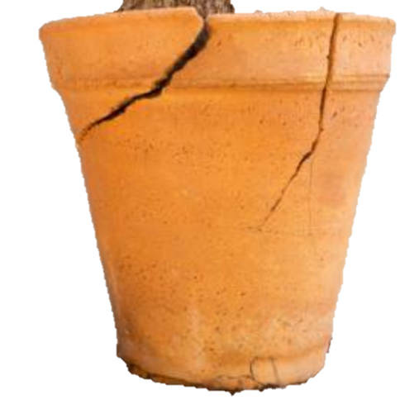


What Does Hadoop Offer?
Hadoop and MapReduce offer:
Scalability and a high degree of fault tolerance
Ability to quickly analyze massive collections of records without forcing data to first be modeled, cleansed, and loaded
Easy to use programming paradigm for writing and executing analysis programs that scale to 1000s of nodes and PBs of data
Think data warehousing for Big Data
Low, up front software and hardware costs

Slide 16

The Hadoop Ecosystem
HDFS – distributed, fault tolerant file system
MapReduce – framework for writing/executing distributed, fault tolerant algorithms
Hive & Pig – SQL-like declarative languages
Sqoop – package for moving data between HDFS and relational DB systems
+ Others…
BI
Reporting
ETL
Tools
RDBMS
Hive & Pig
Sqoop
Map/
Reduce
Zookeeper
Avro (Serialization)
HBase
HDFS

Slide 17
Talk Outline
(Visually…)
3
Hive & Pig
Sqoop
4
Relational
Databases
Map/
Reduce
2
5
HDFS
1

Slide 18
HDFS – Hadoop Distributed File System
Underpinnings of the entire Hadoop ecosystem
HDFS design goals:
  Scalable to 1000s of nodes
  Assume failures (hardware and software) are common
  Targeted towards small numbers of very large files
  Write once, read multiple times
Traditional hierarchical file organization of directories and files
Highly portable
Hive & Pig
Sqoop
Map/
Reduce
HDFS

Slide 19
File Splits
Example:
Large File
1100101010011100101010011100101010011100101010011100110010101001110010101001110010101001110010101001110010101001
1100101010011100101010011100101010011100101010011100110010101001110010101001110010101001110010101001110010101001
1100101010011100101010011100101010011100101010011100110010101001110010101001110010101001110010101001110010101001
1100101010011100101010011100101010011100101010011100110010101001110010101001110010101001110010101001110010101001
1100101010011100101010011100101010011100101010011100110010101001110010101001110010101001110010101001110010101001
1100101010011100101010011100101010011100101010011100110010101001110010101001110010101001110010101001110010101001
1100101010011100101010011100101010011100101010011100110010101001110010101001110010101001110010101001110010101001
1100101010011100101010011100101010011100101010011100110010101001110010101001110010101001110010101001110010101001
…
6440MB
Let’s color-code them
Block
1
Block
1
Block
2
Block
2
Block
3
Block
3
Block
4
Block
4
Block
5
Block
5
Block
6
Block
6
…
Block
100
Block
100
Block
101
Block
101
64MB
64MB
64MB
64MB
64MB
64MB
64MB
40MB
Files are composed of set of blocks
  Typically 64MB in size
  Each block is stored as a separate file in the local file system (e.g. NTFS)
e.g., Block Size = 64MB

Slide 20
Block Placement
Example:
Block
1
Block
2
Block
3
Block
2
Block
2
Block
3
Block
1
Block
3
Block
1
Node 1
Node 2
Node 3
Node 4
Node 5
e.g., Replication factor = 3
Default placement policy:
  First copy is written to the node creating the file (write affinity)
  Second copy is written to a data node within the same rack
  (to minimize cross-rack network traffic)
  Third copy is written to a data node in a different rack
  (to tolerate switch failures)
  Objectives: load balancing, fast access, fault tolerance

Slide 21
HDFS Node Types
NameNode – one instance per cluster
  Responsible for filesystem metadata operations on cluster, replication and locations of file blocks
Backup Node – responsible for backup of NameNode
DataNodes – one instance on each node of the cluster
  Responsible for storage of file blocks
  Serving actual file data to client
NameNode
Master
CheckpointNode
or
BackupNode
(backups)
DataNode
DataNode
DataNode
DataNode
Slaves

Slide 22
HDFS Architecture
NameNode
BackupNode
namespace backups
(heartbeat, balancing, replication, etc.)
DataNode
DataNode
DataNode
DataNode
DataNode
nodes write to local disk

Slide 23
Putting Files On HDFS
Giant File
110010101001
010100101010
011001010100
101010010101
001100101010
010101001010
100110010101
001010100101
{node1, node2, node 3}
{node2, node4, node 5}
{node2, node3, node 4}
{node1, node3, node 5}
HDFS
Client
(based on “replication factor”) (3 by default)
Name node tells client where to store each block of the file
NameNode
BackupNode
Client transfers block directly
to assigned data nodes
and so on…
DataNode
DataNode
DataNode
DataNode
DataNode

Slide 24
Getting Files From HDFS
Giant File
110010101001
010100101010
011001010100
101010010101
001100101010
010101001010
100110010101
001010100101
HDFS
Client
return locations
of blocks of file
NameNode
BackupNode
stream blocks from data nodes
DataNode
DataNode
DataNode
DataNode
DataNode

Slide 25
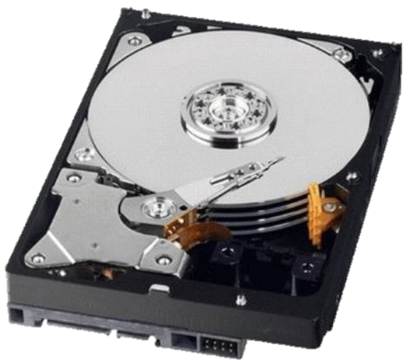
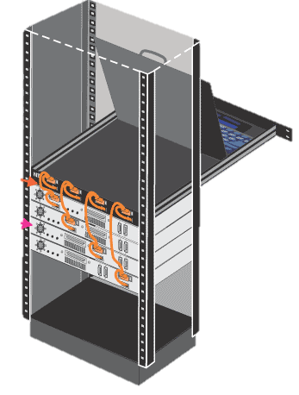
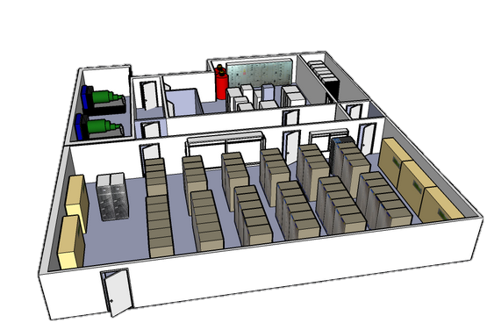
Failures, Failures, Failures
HDFS was designed with the expectation that failures (both hardware and software) would occur frequently
Failure types:
  Disk errors and failures
  DataNode failures
  Switch/Rack failures
  NameNode failures
  Datacenter failures
DataNode
NameNode

Slide 26
Fault Tolerance (DataNode Failure)
NameNode
BackupNode
Blocks are auto-replicated on remaining
nodes to satisfy replication factor
NameNode detects DataNode loss
DataNode
DataNode
DataNode
DataNode
DataNode
DataNode
DataNode
DataNode

Slide 27
Fault Tolerance (NameNode Failure)
NameNode loss requires
manual intervention
Automatic failover is
in the works
NameNode
BackupNode
Not an epic failure, because you
have the BackupNode
DataNode
DataNode
DataNode
DataNode
DataNode

Slide 28
Live Horizontal Scaling and Rebalancing
NameNode
BackupNode
Blocks are re-balanced
and re-distributed
NameNode detects new DataNode
is added to cluster
DataNode
DataNode
DataNode
DataNode
DataNode
DataNode
DataNode
DataNode

Slide 29




HDFS Summary
Highly scalable
  1000s of nodes and massive (100s of TB) files
  Large block sizes to maximize sequential I/O performance
No use of mirroring or RAID.
  Reduce cost
  Use one mechanism (triply replicated blocks) to deal with a wide variety of failure types rather than multiple different mechanisms
Negatives
  Block locations and record placement is invisible to higher level software
    → Makes it impossible to employ many optimizations successfully employed by parallel DB systems
Why?

Slide 30
Talk Outline
(Visually…)
3
Hive & Pig
Sqoop
4
Relational
Databases
Map/
Reduce
2
5
HDFS
1

Slide 31
Hadoop MapReduce (MR)
Programming framework (library and runtime) for analyzing data sets stored in HDFS
MapReduce jobs are composed of two functions:
User only writes the Map and Reduce functions
MR framework provides all the “glue” and coordinates the execution of the Map and Reduce jobs on the cluster.
  Fault tolerant
  Scalable
map() → reduce()
sub-divide &
conquer
combine & reduce
cardinality

Slide 32
MapReduce 101
Essentially, it’s…
Take a large problem and divide it into sub-problems
Perform the same function on all sub-problems
Combine the output from all sub-problems
…
MAP
…
DoWork()
DoWork()
DoWork()
REDUCE
…
Output

Slide 33
MapReduce Visualized (in More Detail)
<key_{A}, value_{a}>
<key_{B}, value_{b}>
<key_{C}, value_{c}>
…
<key_{i}, value_{i}>
Mapper
DataNode
<key_{A}, list(value_{a}, value_{b}, value_{c}, …)>
Reducer
Sort
and
group
by
key
<key_{A}, value_{a}>
<key_{B}, value_{b}>
<key_{C}, value_{c}>
…
<key_{i}, value_{i}>
Mapper
DataNode
<key_{B}, list(value_{a}, value_{b}, value_{c}, …)>
Reducer
Output
<key_{A}, value_{a}>
<key_{B}, value_{b}>
<key_{C}, value_{c}>
…
<key_{i}, value_{i}>
Mapper
DataNode
<key_{C}, list(value_{a}, value_{b}, value_{c}, …)>
Reducer
<key_{A}, value_{a}>
<key_{B}, value_{b}>
<key_{C}, value_{c}>
…
<key_{i}, value_{i}>
Mapper

Slide 34
MapReduce Components
How Does This All Fit With HDFS?
Master
hadoop-namenode
- Coordinates all M/R tasks & events
- Manages job queues and scheduling
- Maintains and Controls TaskTrackers
- Moves/restarts map/reduce tasks if needed
- Uses “checkpointing” to combat single points
of failure
JobTracker
MapReduce
Layer
NameNode
HDFS
Layer
JobTracker controls and
heartbeats TaskTracker nodes
hadoop-
datanode1
hadoop-
datanode2
hadoop-
datanode3
hadoop-
datanode4
Execute individual map and reduce tasks as assigned by JobTracker (in separate JVM)
Slaves
TaskTracker
TaskTracker
TaskTracker
TaskTracker
MapReduce
Layer
HDFS
Layer
TaskTrackers store temp data
DataNode
DataNode
DataNode
DataNode
Temporary data stored to local file system

Slide 35
Job Submission
MR
Client
Submit jobs to JobTracker
JobTracker
jobs get queued
map()’s are assigned to TaskTrackers (HDFS DataNode locality aware)
reduce phase begins
TaskTracker
TaskTracker
TaskTracker
TaskTracker
mappers spawned in separate JVM and execute
Mapper
Mapper
Mapper
Mapper
Reducer
Reducer
Reducer
Reducer
mappers store temp results
Temporary data stored to local file system

Slide 36
MapReduce Visualized: Map Phase
Get sum sales grouped by zipCode
(custId, zipCode, amount)
54235
$75
4
54235
$75
54235
$22
Blocks
of the
Sales
file in
HDFS
7
10025
$60
DataNode3
10025
$60
2
53705
$30
4
54235
$75
10025
$95
5
53705
$65
1
02115
$15
7
10025
$60
44313
$55
3
0
54235
$22
10025
$95
Group
By
Mapper
53705
$65
8
44313
$55
5
53705
$65
One output bucket per reduce task
0
54235
$22
DataNode2
2
53705
$30
5
53705
$15
53705
$30
6
44313
$10
1
02115
$15
53705
$15
Mapper
Group
By
02115
$15
3
10025
$95
5
53705
$15
02115
$15
6
44313
6
44313
$25
8
44313
$55
$10
DataNode1
9
02115
$15
44313
$10
6
44313
$25
9
02115
$15
Map tasks
44313
$25

Slide 37
Reduce Phase
Reducer
53705
$65
53705
$65
54235
$75
53705
$30
Sort
53705
$30
SUM
53705
$110
54235
$22
53705
$15
53705
$15
Mapper
10025
$60
10025
$95
Reducer
  Done!
44313
$55
44313
$10
10025
$60
53705
$65
10025
$95
44313
$25
10025
$60
Sort
44313
$10
SUM
10025
$155
Shuffle
10025
$95
44313
$25
44313
$90
44313
$55
44313
$55
53705
$30
53705
$15
Reduce tasks
Reducer
Mapper
02115
$15
54235
$75
02115
$15
02115
$15
54235
$22
Sort
02115
$15
02115
$30
44313
$10
SUM
02115
$15
54235
$75
54235
$97
44313
$25
02115
$15
54235
$22

Slide 38
What About More Complicated Jobs?
(e.g., Join of Two Datasets)

Slide 39
Joining Two Large Datasets
Dataset A
Dataset B
Different join keys
Reducers perform the actual join
Reducer 1
Reducer 2
Reducer N
Shuffling and sorting over the network
Shuffling and Sorting
- Each mapper produces the join key and the record pairs
- Each mapper processes one block (split)
Mapper 1
Mapper 2
Mapper 3
Mapper M+N
HDFS stores data blocks
(Replicas are not shown)

Slide 40

A Few More Details
Actual number of Map tasks M is generally made much larger than the number of nodes used.
Why?
  Helps deal with data skew and failure
  Example:
      Say M = 10,000 and
      W = 100 (W is number of Map workers)
        Each worker does (10,000 / 100) = 100 Map tasks
      If it suffers from skew or fails the uncompleted work can
      easily be shifted to another worker
Skew with Reducers is still a problem
  Example: In a query = “get sales by zipcodes”, some zipCodes (e.g. 10025) may have many more sales records than others

Slide 41
Dealing With Failures
Like HDFS, MapReduce framework designed to be highly fault tolerant
Worker (Map or Reduce) failures
  Detected by periodic Master pings
  Map or Reduce jobs that fail are reset and then given to a different node
  If a node failure occurs after the Map job has completed, the job is redone and all Reduce jobs are notified
Master failure
  If the master fails for any reason the entire computation is redone

Slide 42

MapReduce Summary
Highly fault tolerant
Relatively easy to write “arbitrary” distributed computations over very large amounts of data
MR framework removes burden of dealing with failures from programmer
Schema embedded in application code
A lack of shared schema
  Makes sharing data between applications difficult
  Makes lots of DBMS “goodies” such as indices, integrity constraints, views, … impossible
No declarative query language

Slide 43
Talk Outline
(Visually…)
3
Hive & Pig
Sqoop
4
Relational
Databases
Map/
Reduce
2
5
HDFS
1

Slide 44


Hive and Pig
and reached a different conclusion about the value of declarative languages like SQL
than Google
  Facebook produced a SQL-like language called HIVE
  Yahoo produced a slightly more procedural language PIG
Aren’t engineers great
at picking names???
Both use Hadoop MapReduce as a target language for execution
  Hive and Pig queries get compiled into a sequence of MapReduce jobs

Slide 45
An Example
Consider two data sets:
UserVisits
(
sourceIP STRING,
destURL STRING
visitDate DATE,
adRevenue FLOAT,
.. // fields omitted
);
Rankings
(
pageURL STRING,
pageRank INT,
avgDuration INT
);
Join required
Query:
Find the sourceIP address
that generated the most adRevenue along with its average pageRank

Slide 46
In MapReduce
package edu.brown.cs.mapreduce.benchmarks;
import java.util.*;
import org.apache.hadoop.conf.*;
import org.apache.hadoop.io.*;
import org.apache.hadoop.mapred.*;
import org.apache.hadoop.util.*;
import org.apache.hadoop.mapred.lib.*;
import org.apache.hadoop.fs.*;
import edu.brown.cs.mapreduce.BenchmarkBase;
public class Benchmark3 extends Configured implements Tool {
public static String getTypeString(int type) {
if (type == 1) {
return ("UserVisits");
} else if (type == 2) {
return ("Rankings");
}
return ("INVALID");
}
/* (non-Javadoc)
* @see org.apache.hadoop.util.Tool#run(java.lang.String[])
*/
public int run(String[] args) throws Exception {
BenchmarkBase base = new BenchmarkBase(this.getConf(), this.getClass(), args);
Date startTime = new Date();
System.out.println("Job started: " + startTime);
// Phase #1
// -------------------------------------------
JobConf p1_job = base.getJobConf();
p1_job.setJobName(p1_job.getJobName() + ".Phase1");
Path p1_output = new Path(base.getOutputPath().toString() + "/phase1");
FileOutputFormat.setOutputPath(p1_job, p1_output);
//
// Make sure we have our properties
//
String required[] = { BenchmarkBase.PROPERTY_START_DATE, BenchmarkBase.PROPERTY_STOP_DATE };
for (String req : required) {
if (!base.getOptions().containsKey(req)) {
System.err.println("ERROR: The property '" + req + "' is not set");
System.exit(1);
}
} // FOR
p1_job.setInputFormat(base.getSequenceFile() ? SequenceFileInputFormat.class : KeyValueTextInputFormat.class);
if (base.getSequenceFile()) p1_job.setOutputFormat(SequenceFileOutputFormat.class);
p1_job.setOutputKeyClass(Text.class);
p1_job.setOutputValueClass(Text.class);
p1_job.setMapperClass(base.getTupleData() ? edu.brown.cs.mapreduce.benchmarks.benchmark3.phase1.TupleWritableMap.class : edu.brown.cs.mapreduce.benchmarks.benchmark3.phase1.TextMap.class);
p1_job.setReducerClass(base.getTupleData() ? edu.brown.cs.mapreduce.benchmarks.benchmark3.phase1.TupleWritableReduce.class : edu.brown.cs.mapreduce.benchmarks.benchmark3.phase1.TextReduce.class);
p1_job.setCompressMapOutput(base.getCompress());
Query takes 3 MapReduce jobs since joins
in MR framework are not easy to write
Don’t even try to read it!
1
2
// Phase #2
// -------------------------------------------
JobConf p2_job = base.getJobConf();
p2_job.setJobName(p2_job.getJobName() + ".Phase2");
p2_job.setInputFormat(base.getSequenceFile() ? SequenceFileInputFormat.class : KeyValueTextInputFormat.class);
if (base.getSequenceFile()) p2_job.setOutputFormat(SequenceFileOutputFormat.class);
p2_job.setOutputKeyClass(Text.class);
p2_job.setOutputValueClass(Text.class);
p2_job.setMapperClass(IdentityMapper.class);
p2_job.setReducerClass(base.getTupleData() ? edu.brown.cs.mapreduce.benchmarks.benchmark3.phase2.TupleWritableReduce.class : edu.brown.cs.mapreduce.benchmarks.benchmark3.phase2.TextReduce.class);
p2_job.setCompressMapOutput(base.getCompress());
// Phase #3
// -------------------------------------------
JobConf p3_job = base.getJobConf();
p3_job.setJobName(p3_job.getJobName() + ".Phase3");
p3_job.setNumReduceTasks(1);
p3_job.setInputFormat(base.getSequenceFile() ? SequenceFileInputFormat.class : KeyValueTextInputFormat.class);
p3_job.setOutputKeyClass(Text.class);
p3_job.setOutputValueClass(Text.class);
//p3_job.setMapperClass(Phase3Map.class);
p3_job.setMapperClass(IdentityMapper.class);
p3_job.setReducerClass(base.getTupleData() ? edu.brown.cs.mapreduce.benchmarks.benchmark3.phase3.TupleWritableReduce.class : edu.brown.cs.mapreduce.benchmarks.benchmark3.phase3.TextReduce.class);
//
// Execute #1
//
base.runJob(p1_job);
//
// Execute #2
//
Path p2_output = new Path(base.getOutputPath().toString() + "/phase2");
FileOutputFormat.setOutputPath(p2_job, p2_output);
FileInputFormat.setInputPaths(p2_job, p1_output);
base.runJob(p2_job);
//
// Execute #3
//
Path p3_output = new Path(base.getOutputPath().toString() + "/phase3");
FileOutputFormat.setOutputPath(p3_job, p3_output);
FileInputFormat.setInputPaths(p3_job, p2_output);
base.runJob(p3_job);
// There does need to be a combine if (base.getCombine()) base.runCombine();
return 0;
}
}
4 pages of 5 pt font!!!
3
4

Slide 47
In HiveQL
SELECT sourceIP, totalRevenue, avgPageRank
FROM
SELECT sourceIP, sum(adRevenue) as totalRevenue,
avg(pageRank)as avgPageRank
FROM Rankings as R, Uservisits as UV
WHERE R.pageURL = UV.destURL and UV.visitDate
between Date (‘2000-01-15’) and Date (‘2000-01-22’)
GROUP BY UV.sourceIP
ORDER BY totalRevenue DESC limit 1;
Of the 150K jobs Facebook runs daily, only 500 are MapReduce jobs. The rest are in HiveQL!! Go SQL!!!
Facebook concluded:
“… MapReduce was not easy for end users … “
“… users ended up spending hours (if not days) to write programs for even simple analyses”
Only ½ page in 20 pt font!

Slide 48

Goals of Hive and HiveQL
Fault tolerant system
Declarative
Queries
Massive
Data Sets
(leveraging Hadoop stack)
HIVE
HiveQL = Best Features(SQL) + MapReduce
Notes:
Leverage Hadoop stack (HDFS and MR) to build a scalable, fault tolerant system for executing declarative queries against massive data sets
The query language HiveQL was designed to combine the best features of SQL with the key ideas provided by the MapReduce framework

Slide 49
Tables in Hive
Like a relational DBMS, data stored in tables
Richer column types than SQL
  Primitive types: ints, floats, strings, date
  Complex types: associative arrays, lists, structs
Example:
  CREATE Table Employees
  (
    Name string,
    Salary integer,
  Children List <Struct <firstName: string, DOB:date>>
  )

Slide 50
Hive Data Storage
Like a parallel DBMS, Hive tables can be partitioned
Example data file:
  Sales(custID, zipCode, date, amount)
  partitioned by state
Hive DDL:
Sales
HDFS Directory
Create Table Sales(
custID INT,
zipCode STRING,
date DATE,
amount FLOAT)
Partitioned By
(state STRING)
custID | zipCode | …
201 | 12345 | …
105 | 12345 | …
933 | 12345 | …
custID | zipCode | …
13 | 54321 | …
67 | 54321 | …
45 | 74321 | …
custID | zipCode | …
78 | 99221 | …
345 | 99221 | …
821 | 99221 | …
…
Alabama
Alaska
Wyoming
Remember that each HDFS file is itself partitioned into big blocks, replicated, and spread around the cluster
1 HDFS file per state
Records in file do not contain the state name!

Slide 51
HiveQL Example #1
Sales(custID, zipCode, date, amount) partitioned by state
HDFS Directory
Sales
custID | zipCode | …
201 | 12345 | …
105 | 12345 | …
933 | 12345 | …
custID | zipCode | …
13 | 54321 | …
67 | 54321 | …
45 | 74321 | …
custID | zipCode | …
78 | 99221 | …
345 | 99221 | …
821 | 99221 | …
HDFS files
…
Alabama
Alaska
Wyoming
Query 1: For the last 30 days obtain total sales by zipCode:
SELECT zipCode, sum(amount)
FROM Sales
WHERE getDate()-30 < date < getDate()
GROUP BY zipCode
Query will be executed against all 50 partitions of Sales

Slide 52
HiveQL Example #2
Sales(custID, zipCode, date, amount) partitioned by state
HDFS Directory
Sales
custID | zipCode | …
201 | 12345 | …
105 | 12345 | …
933 | 12345 | …
custID | zipCode | …
13 | 54321 | …
67 | 54321 | …
45 | 74321 | …
custID | zipCode | …
78 | 99221 | …
345 | 99221 | …
821 | 99221 | …
…
Query will be executed only against the HDFS file containing rows for the state of Alabama
HDFS files
Alabama
Alaska
Wyoming
Query 2: For the last 30 days obtain total sales by zipCode for Alabama:
SELECT zipCode, sum(amount)
FROM Sales
WHERE State = ‘Alabama’ and
getDate()-30 < date < getDate()
GROUP BY zipCode

Slide 53
MapReduce in HiveQL
Sales(custID, zipCode, date, amount) partitioned by state
HDFS Directory
Sales
custID | zipCode | …
201 | 12345 | …
105 | 12345 | …
933 | 12345 | …
custID | zipCode | …
13 | 54321 | …
67 | 54321 | …
45 | 74321 | …
custID | zipCode | …
78 | 99221 | …
345 | 99221 | …
821 | 99221 | …
…
HDFS files
Alabama
Alaska
Wyoming
CD_mapper.py converts a zipCode to a congressional district (cd)
MapReduce without Java!!!
Query 3: For the last 30 days obtain total sales by congressional district
FROM
(
MAP zipcode using ‘python CD_mapper.py’ as (cd, amount)
FROM Sales
CLUSTER by cd
)
REDUCE(cd, amount) USING ‘python cd_sumsales.py’
CLUSTER verb specifies what to repartition on

Slide 54

HiveQL Optimization and Execution
Query Optimization
  Limited statistics (file sizes only) make cost-based QO essentially impossible
  Uses simple heuristics of pushing selections below joins, early column elimination
  Output of QO is a DAG of MapReduce jobs in Java
Heuristics
I give up
Optimizer
Query execution handled by standard MR scheduler
  Fine-grained fault tolerance comes for free
    Can survive node/disk/switch failures in the middle of a query
  Plans are more complicated than absolutely necessary since both Map and Reduce jobs can consume a single HDFS file as input
Plans are… complicated

Slide 55
PDW vs. Hive Benchmark Results
Hardware
  Cluster of 9 HP servers, dual CPU, quad core, 16GB memory, 4 SAS drives for data
Software
  SQL Server PDW Version “next”
    1 control node, 8 compute nodes
  Windows Hadoop Version 0.20.203,
  Hive Version 0.7.1
    1 name node, 8 data nodes
  Windows Server 2008
Test tables from TPC-H (SF 800)
  lineitem: 612GB, 4.8B rows
  orders: 140GB, 1.2B rows

Slide 56
Hive vs. PDW
Query 1: SELECT count(*) FROM lineitem
Query 2: SELECT max(l_quantity)
FROM lineitem
WHERE l_orderkey > 1000 and l_orderkey < 100000
GROUP BY l_linestatus
Secs.

Slide 57
Hive vs. PDW
Query 3: SELECT max(l_orderkey)
FROM orders, lineitem
where l_orderkey = o_orderkey
2 PDW cases:
i) PDW-U: orders partitioned on c_custkey
lineitem partitioned on l_partkey
ii) PDW-P: orders partitioned on o_orderkey
lineitem partitioned on l_orderkey
Partitioning the Hive tables on the join attributes provides no benefit, as there is no way to control where HDFS places the blocks of each table
Demonstrates the advantage that a parallel DBMS has w.r.t partitioning tables in order to minimize data movement
(here tables’ partitions are co-located)
Secs.

Slide 58
Talk Outline
(Visually…)
3
Hive & Pig
Sqoop
4
Relational
Databases
Map/
Reduce
2
5
HDFS
1

Slide 59
Connecting the Universes
(Reason #1)
Unstructured
(Hadoop)
Structured
(RDBMS)
Sqoop
Why?
Increasingly data first lands in the unstructured universe
MapReduce is an excellent big data ETL tool
How?
Sqoop provides command line load utility

Slide 60

Connecting the Universes
(Reason #2)
Unstructured
(Hadoop)
Structured
(RDBMS)
Sqoop
Why?
Some analyses are easier to do in a procedural language or a language like HiveQL with MapReduce constructs
How?
As we will see the performance of this is not very good
Sqoop provides:
  Command line unload utility
  Query capability for Map tasks to “pull” data from the RDBMS using SQL

Slide 61
Connecting the Universes
(Reason #3)
Unstructured
(Hadoop)
Structured
(RDBMS)
Sqoop
Why?
Some applications need data from both universes
Where?
Only option is unstructured universe as unstructured data cannot be loaded into RDBMS
Again performance of this is not very good
How?
Use Sqoop unload utility or query capability in Map tasks

Slide 62
Sqoop Limitations
Map tasks wants the results of the query:
Q: SELECT a,b,c FROM T WHERE P
X is different for each Map task.
Example, assume Cnt is 100 and
3 Map instances are to be used
For Map 1
For Map 2
For Map 3
X=0
Each map() must see a distinct subset of the result
L=33
Map 1
Map 2
Map 3
X=33
L=33
Sqoop
Sqoop
Sqoop
X=66
L=34
RDBMS
  Step (2): Sqoop generates unique query Q’
  for each Map task:
  SELECT a,b,c
  FROM T WHERE P
  ORDER BY a,b,c
  Limit L, Offset X
T
Performance is bound to be pretty bad as table T gets scanned 4 times!
Cnt
  Step (1): Sqoop library runs
  SELECT count(*)
  FROM T WHERE P
  to obtain Cnt, the number of
  tuples Q will return
In general, with M Map tasks, table T would be scanned M + 1 times!!!!!!
  Step (3): Each of the 3 Map tasks runs its query Q’

Slide 63
There Has to be a Better Way!
Unstructured Universe
(Hadoop)
Structured Universe
(RDBMS)
Enterprise Data Manager
Moving data is so 20th century!
Why not build a data management system that:
  Can execute queries across both universes w/o moving data unnecessarily
  Has the expressive power of a language like HiveQL
I term such a system an Enterprise Data Manager
We are going to try and build one of these in my lab. So stay tuned!
Folks in my lab think I am not
great at picking names either!!

Slide 64
HadoopDB/Hadapt (Yale startup)
First to attempt to produce an
“Enterprise Data Manager”
Like Hive
  Use HDFS for “unstructured” data
  Uses MR framework as underpinnings of its query engine for fault tolerance and scalability
  Supports HiveQL-like query language
Unlike Hive
  Employs a relational DBMS on every node
  Implements a novel split query execution paradigm

Slide 65
Hadapt System Architecture Overview
MapReduce
Job
SQL
Query
Relational tables are partitioned using hash partitioning
“Unstructured” data lives in HDFS
SQL queries get compiled into set of MapReduce jobs
Novel split execution paradigm is employed in which the DBMS is used as much as possible
Consider a join of tables A and B
Parser
Catalogs
Query Optimizer
MapReduce Master
Case 2: A is in RDBMS and B is in HDFS.
If B is “small” it will be loaded into RDBMS and the join will be performed there
If A is “small” and B is “large”, join will be performed as a MapReduce job
MapReduce
MapReduce
MapReduce
MapReduce
HDFS
MapReduce
RDBMS
HDFS
MapReduce
HDFS
RDBMS
RDBMS
HDFS
RDBMS
Case 1: Both A & B are stored in RDBMS
Join is performed entirely by RDBMS
HDFS
RDBMS
HDFS
RDBMS

Slide 66



I assert that
ADDING
w/o
having
to load it
Improved
Scalability
Fault
Tolerance
Unstructured
Data
Ever getting
competitive performance
SQL Server PDW
Hadoop-based system
is MUCH easier
than
Notes:
I assert that it is MUCH easier to add support to SQL Server PDW for unstructured data (w/o having to load it), improved scalability, and fault tolerance than it is to ever get competitive performance from a Hadoop-based system

Slide 67

Hopefully, you are not

Slide 68
A Quick Summary
 | Parallel DB Systems | Hadoop
Computing Model | Notion of transactions Transaction is the unit of work ACID enforced | Notion of jobs Job is the unit of work No concurrency control
Data Model | Structured data with known schema Read/Write mode | Any data will fit in any format (un)(semi)structured Read/Only mode
Hardware configuration | Purchased as an appliance | “User assembled” from commodity machines
Fault Tolerance | Failures assumed to be rare No query level fault tolerance | Failures assumed to be common Simple yet efficient fault tolerance
Key Characteristics | Efficiency, optimizations, fine-tuning | - Scalability, flexibility

Slide 69
Summary
Relational Databases vs. Hadoop?
(what’s the future?)
Wrong Question!
  Relational databases and Hadoop
  are designed to meet different needs

Slide 70
Summary
  RDBMS-only or Hadoop-only is NOT going to be the default
Are “Enterprise Data Managers” the silver bullet?

Slide 71
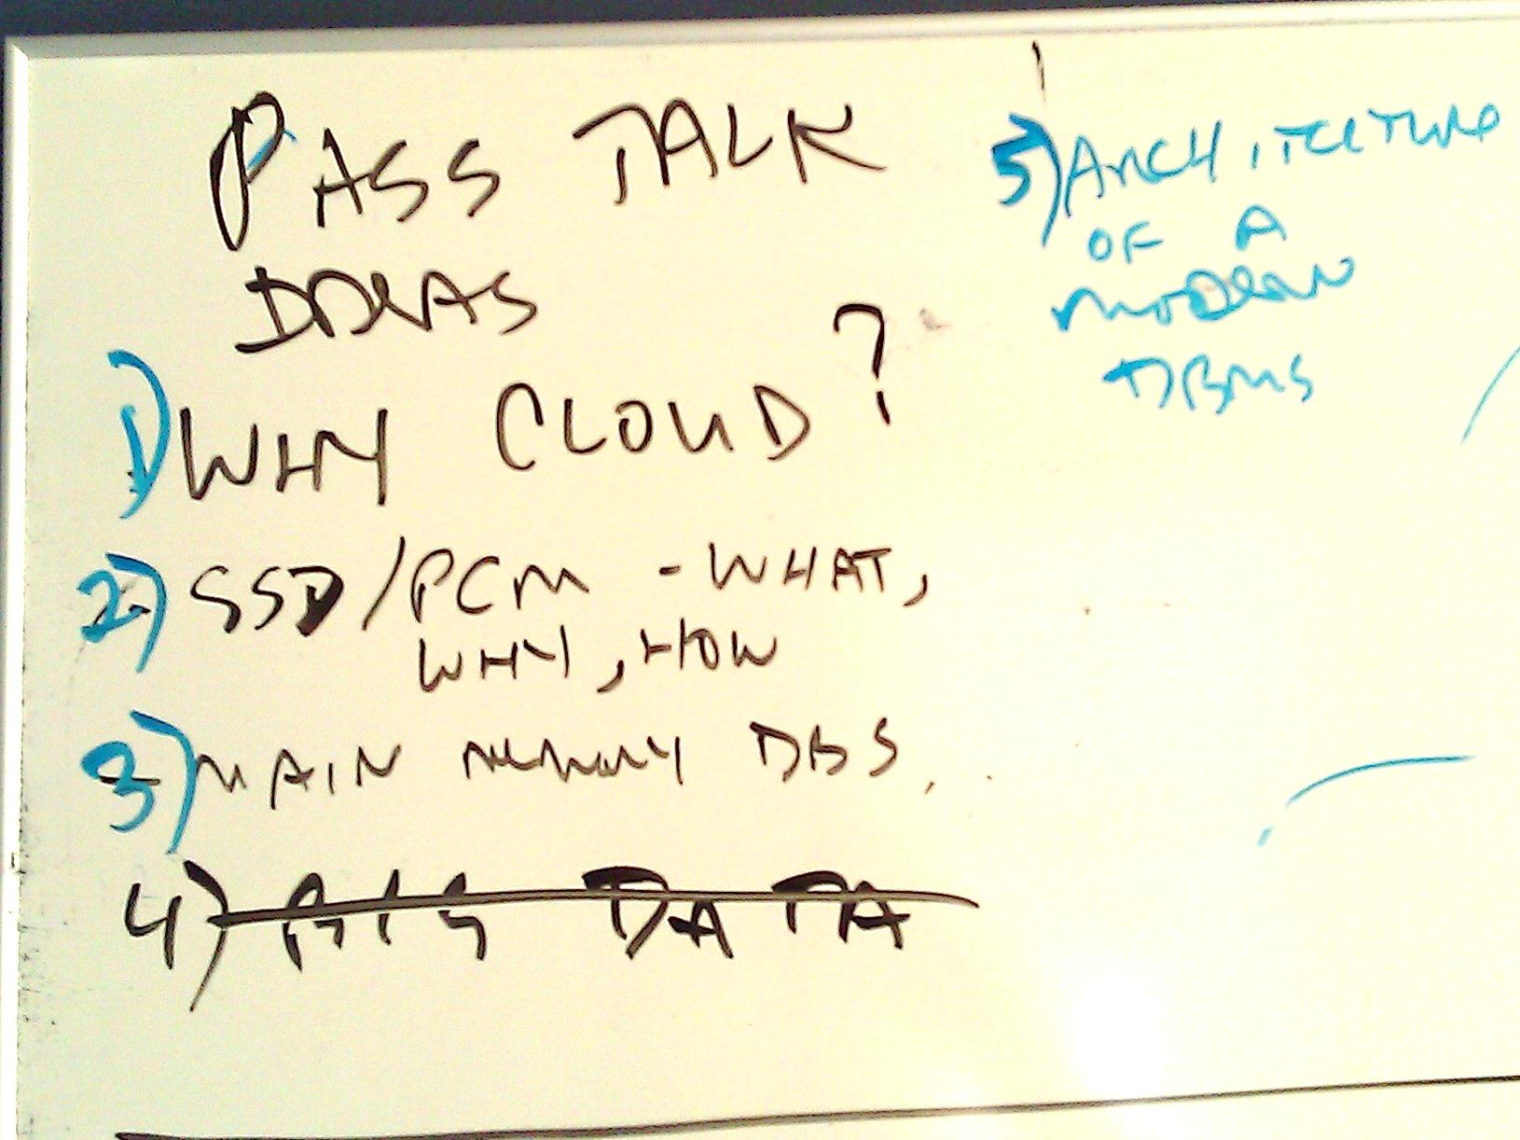
Next Year?
Send your ideas to dewitt@microsoft.com

Slide 72
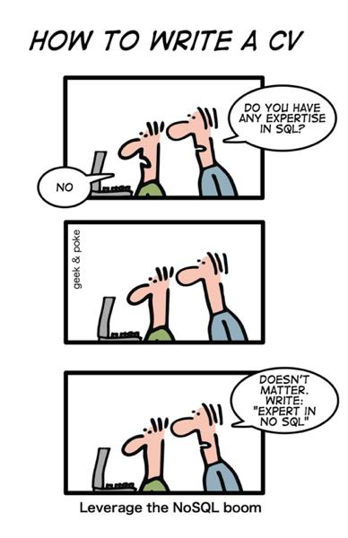

Acknowledgements
Avrilia Floratou and Nikhil Teletia for the Hive and PDW numbers
Quentin Clark, Il-Sung Lee, Sam Madden, Jeff Naughton, Jignesh Patel, and Jennifer Widom for their comments on earlier drafts of this talk
The PASS organizers for inviting me back
All of you for the nice reception and all those over-the-top tweets

