Slide 1
Lecture 1
Population and Sample

Slide 2
Lecture Summary
We have a population to conduct our study.
Often, we can’t gather information from every member of the population. Therefore, we sample!
From the sample, we investigate various features of the population, called parameters
We do this by creating statistics based on the sample

Slide 3
Population
Population: A collection of objects for study
Example 1:
  Goal: Study the efficacy of a new malaria vaccine
  Population: Individuals prone to malarial infection
  Why not just have all individuals as the population?
Example 2:
  Goal: Study the pattern of spam mail in Gmail
  Population: All the possible spam mail that are (and will be in Google’s servers)
  Note: objects in the population may not exist!

Slide 4
See any Patterns?
Weekend
“It’s Friday, Friday, Gotta get down on Friday…”

Slide 5
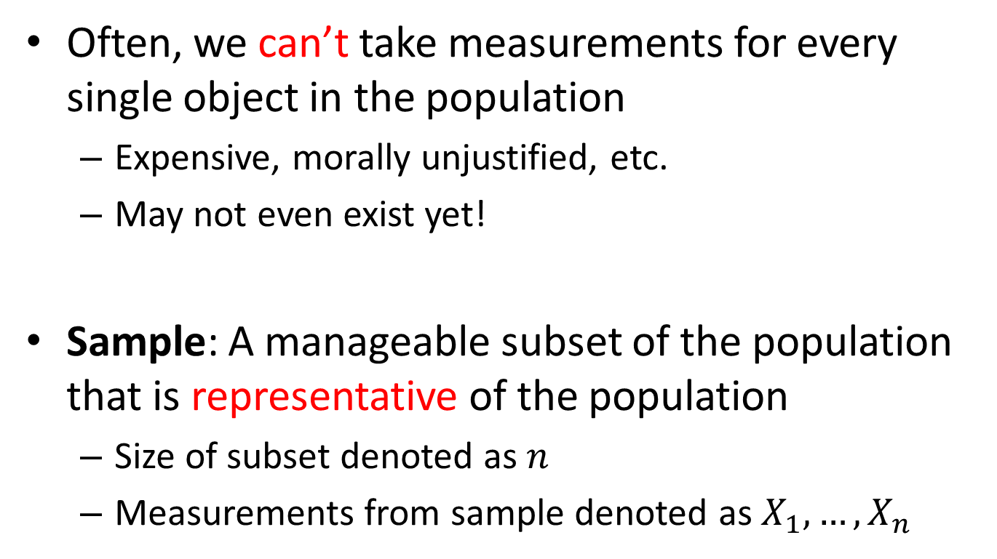
Sample
Often, we can’t take measurements for every single object in the population
  Expensive, morally unjustified, etc.
  May not even exist yet!
Sample: A manageable subset of the population that is representative of the population
  Size of subset denoted as $n$
  Measurements from sample denoted as $X_{1},…,X_{n}$

Slide 6
Parameters
Parameters: numerical features/descriptions/characteristics of the population, usually unknown
  From example 1 (malaria vaccine efficacy):
    Distribution of body temperature for all individuals after vaccination
    Average difference in parasite levels for all individuals before and after vaccination
  From example 2 (Gmail spam pattern):
    Average word count in spam
    Frequency of spam for each day of the week

Slide 7
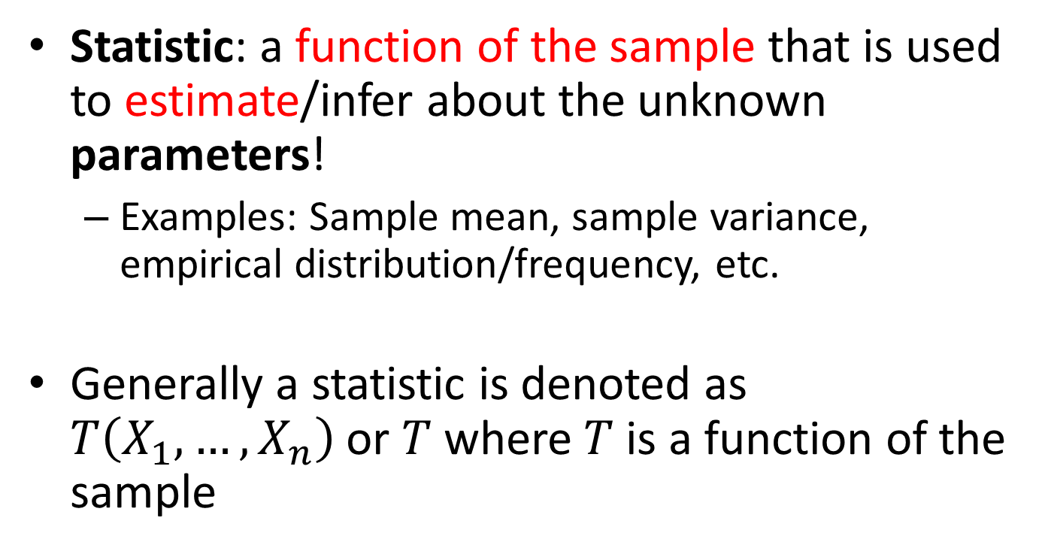
Statistic
Statistic: a function of the sample that is used to estimate/infer about the unknown parameters!
  Examples: Sample mean, sample variance, empirical distribution/frequency, etc.
Generally a statistic is denoted as $T\left(X_{1},…,X_{n}\right)$ or $T$where $T$ is a function of the sample

Slide 8

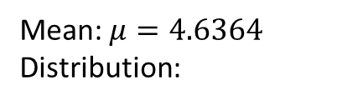
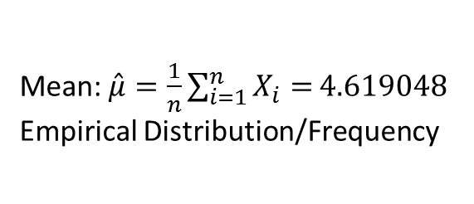
Population/Parameter and Sample/Statistic
7
7
7
7
5
5
4
2
5
4
2
1
6
1
6
1
6
1
0
5
9
4
5
9
9
8
1
7
3
8
1
9
2
3
6
9
2
3
0
1
3
9
0
1
4
8
8
4
8
3
5
3
5
Features of the population (parameters)
Estimates of the features (statistics)
Population
Sample
Mean: $μ=4.6364$
Distribution:
Mean: $\hat{μ}=\frac{1}{n}\sum_{i=1}^{n}{X_{i}=}4.619048$
Empirical Distribution/Frequency
Red | DBlue | LBlue | Green | Purple
6 | 9 | 8 | 5 | 5
Red | DBlue | LBlue | Green | Purple
5 | 7 | 1 | 2 | 5

Slide 9
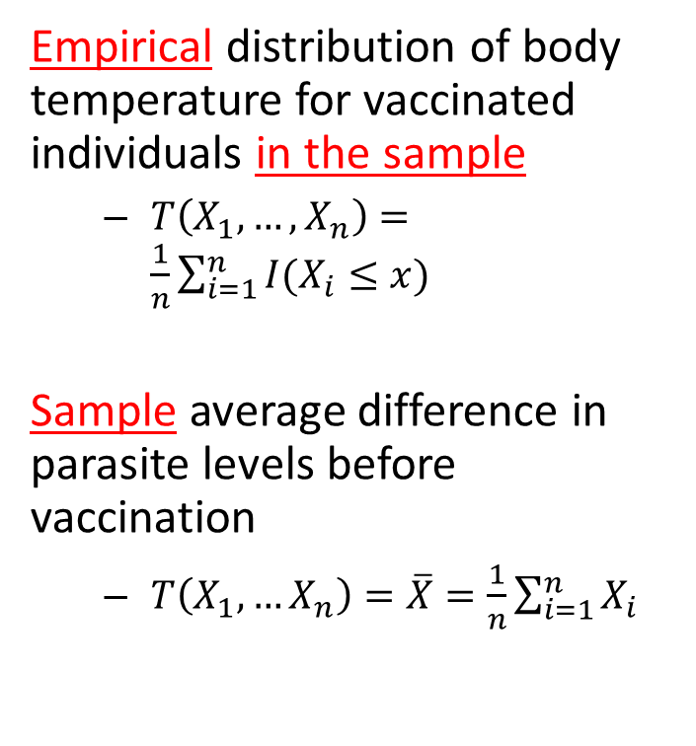
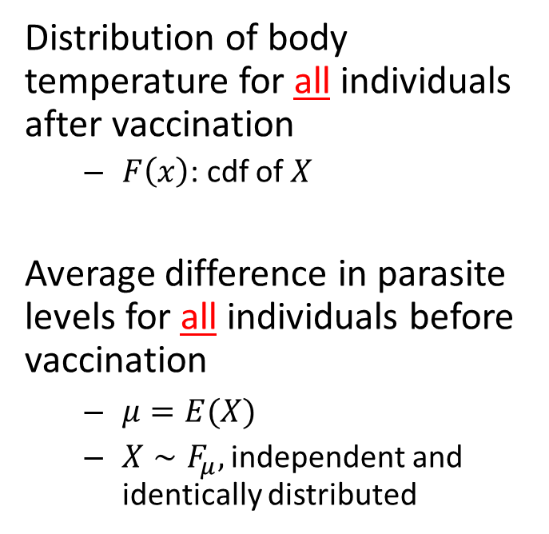
Population/Sample with Malaria
Parameter
Statistic
Distribution of body temperature for all individuals after vaccination
  $F\left(x\right)$: cdf of $X$
Average difference in parasite levels for all individuals before vaccination
  $μ=E(X)$
  $X∼F_{μ},$ independent and identically distributed
Empirical distribution of body temperature for vaccinated individuals in the sample
  $T\left(X_{1},…,X_{n}\right)=\frac{1}{n}\sum_{i=1}^{n}{I(X_{i}≤x)}$
Sample average difference in parasite levels before vaccination
  $T\left(X_{1},…X_{n}\right)=\overline{X}=\frac{1}{n}\sum_{i=1}^{n}{X_{i}}$

Slide 10
How old am I?
What is the population
What is my sample
What parameters am I interested in
What statistics should I use to estimate the parameters?

Slide 11
Summary
Population: a collection of units
  Parameters: numerical description of the collection
    E.g. Mean, variance, cumulative distribution function, etc.
Sample: a manageable and representative collection of units
  We derive statistics that estimate the parameters
    E.g. Sample mean, sample variance, empirical distribution function, etc.

Slide 12
Extra Slides

Slide 13
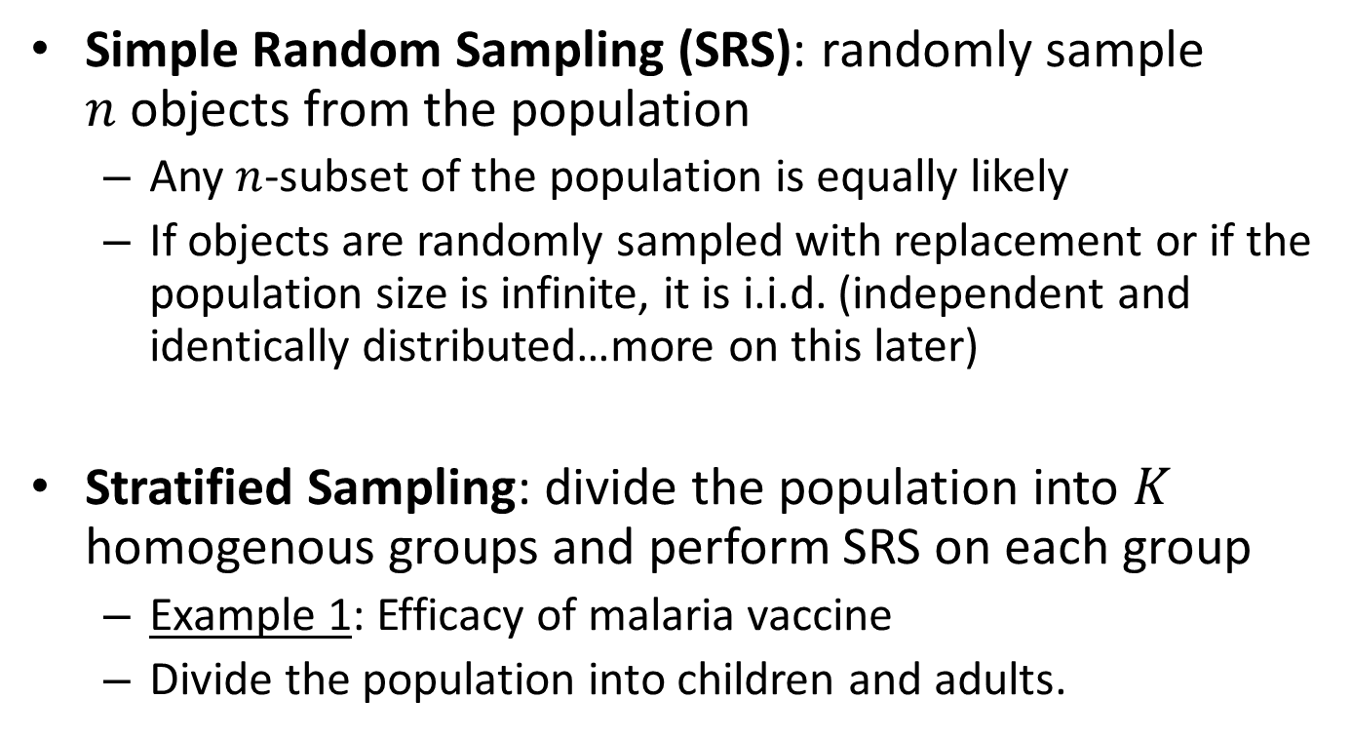
Representative Sampling Strategies
Simple Random Sampling (SRS): randomly sample $n$objects from the population
  Any $n$-subset of the population is equally likely
  If objects are randomly sampled with replacement or if the population size is infinite, it is i.i.d. (independent and identically distributed…more on this later)
Stratified Sampling: divide the population into $K$ homogenous groups and perform SRS on each group
  Example 1: Efficacy of malaria vaccine
  Divide the population into children and adults.

