Slide 1
Lecture 3
Properties of Summary Statistics: Sampling Distribution

Slide 2
Main Theme
How can we use math to justify that our numerical summaries from the sample are good summaries of the population?

Slide 3
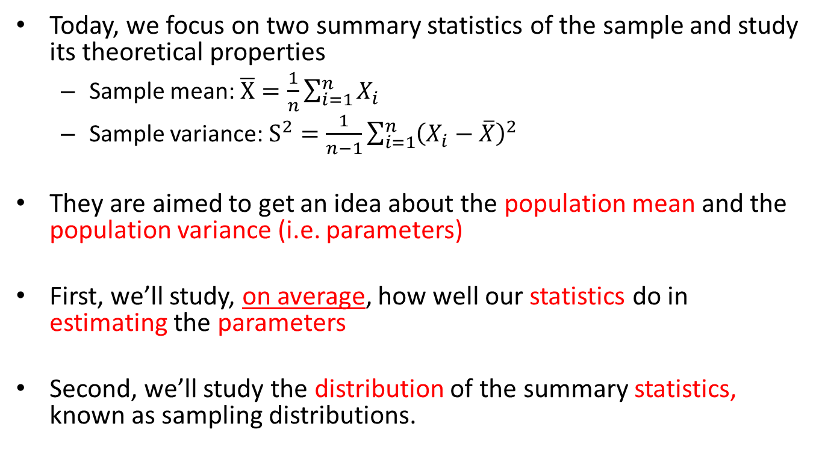
Lecture Summary
Today, we focus on two summary statistics of the sample and study its theoretical properties
  Sample mean: $\overline{X}=\frac{1}{n}\sum_{i=1}^{n}{X_{i}}$
  Sample variance: $S^{2}=\frac{1}{n−1}\sum_{i=1}^{n}{{\left(X_{i}−\overline{X}\right)}^{2}}$
They are aimed to get an idea about the population mean and the population variance (i.e. parameters)
First, we’ll study, on average, how well our statistics do in estimating the parameters
Second, we’ll study the distribution of the summary statistics, known as sampling distributions.

Slide 4
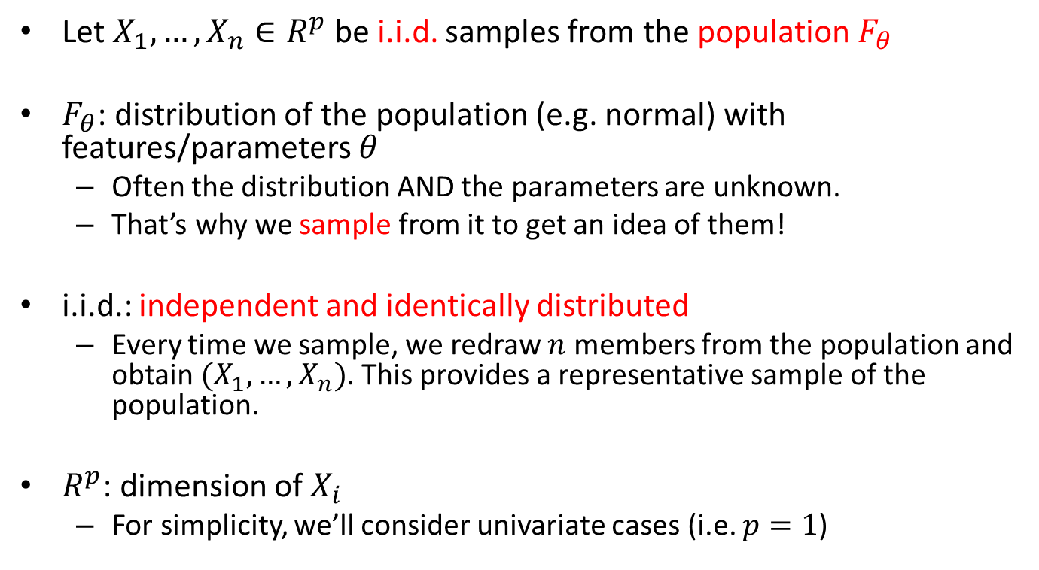
Setup
Let $X_{1},…,X_{n}∈R^{p}$ be i.i.d. samples from the population $F_{θ}$
$F_{θ}$: distribution of the population (e.g. normal) with features/parameters $θ$
  Often the distribution AND the parameters are unknown.
  That’s why we sample from it to get an idea of them!
i.i.d.: independent and identically distributed
  Every time we sample, we redraw $n$ members from the population and obtain $(X_{1},…,X_{n})$. This provides a representative sample of the population.
$R^{p}$: dimension of $X_{i}$
  For simplicity, we’ll consider univariate cases (i.e. $p=1$)

Slide 5
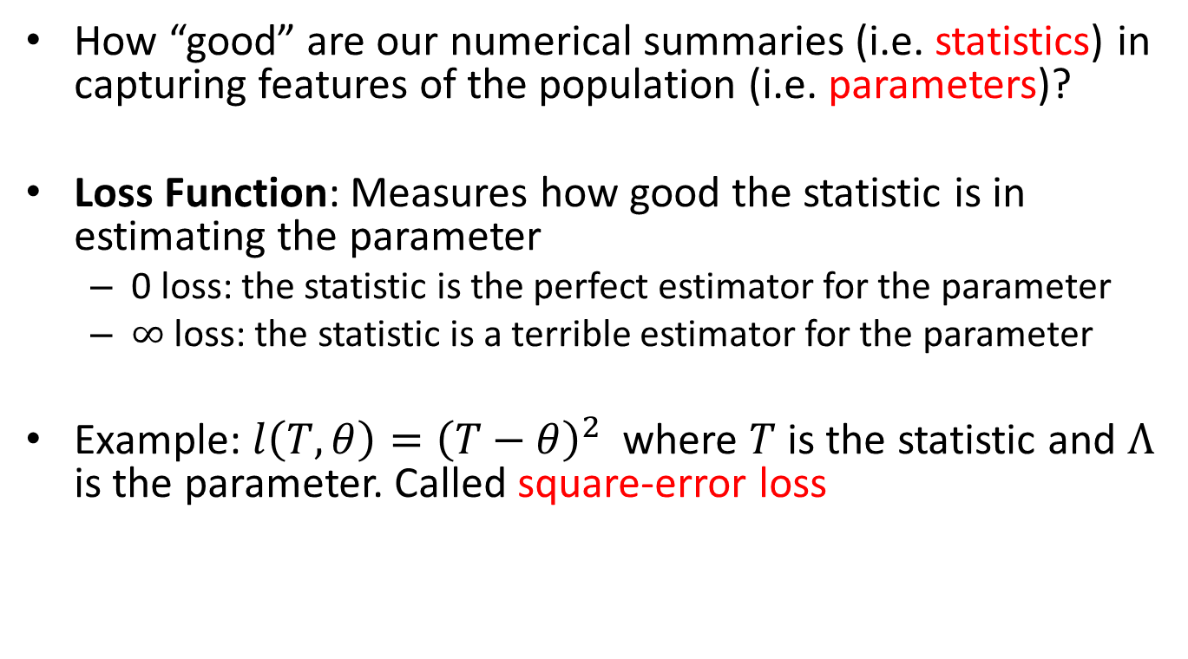
Loss Function
How “good” are our numerical summaries (i.e. statistics) in capturing features of the population (i.e. parameters)?
Loss Function: Measures how good the statistic is in estimating the parameter
  0 loss: the statistic is the perfect estimator for the parameter
  $∞$loss: the statistic is a terrible estimator for the parameter
Example: $l\left(T,θ\right)={\left(T−θ\right)}^{2}$ where $T$ is the statistic and $Λ$ is the parameter. Called square-error loss

Slide 6
Sadly…
It is impossible to compute the values for the loss function
Why? We don’t know what the parameter is! (since it’s an unknown feature of the population and we’re trying to study it!)
More importantly, the statistic is random! It changes every time we take a different sample from the population. Thus, the value of our loss function changes per sample

Slide 7
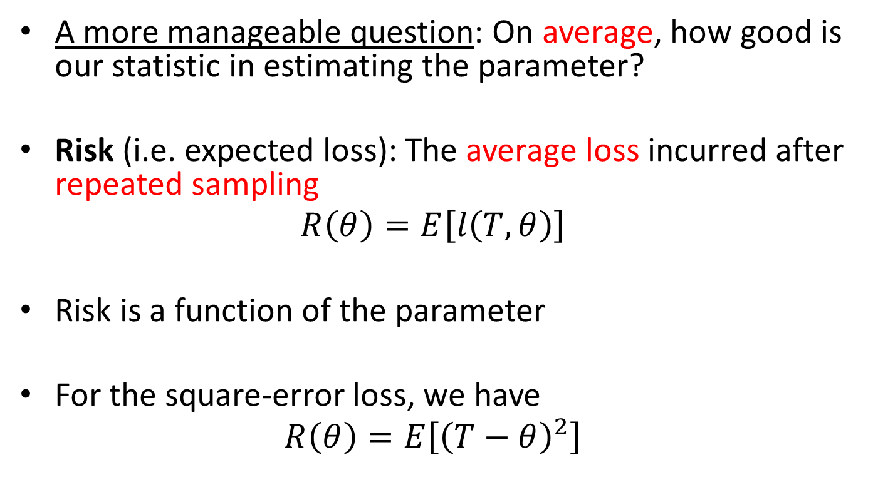
A Remedy
A more manageable question: On average, how good is our statistic in estimating the parameter?
Risk (i.e. expected loss): The average loss incurred after repeated sampling
$$R\left(θ\right)=E\left[l\left(T,θ\right)\right]$$
Risk is a function of the parameter
For the square-error loss, we have
$$R\left(θ\right)=E\left[{\left(T−θ\right)}^{2}\right]$$

Slide 8
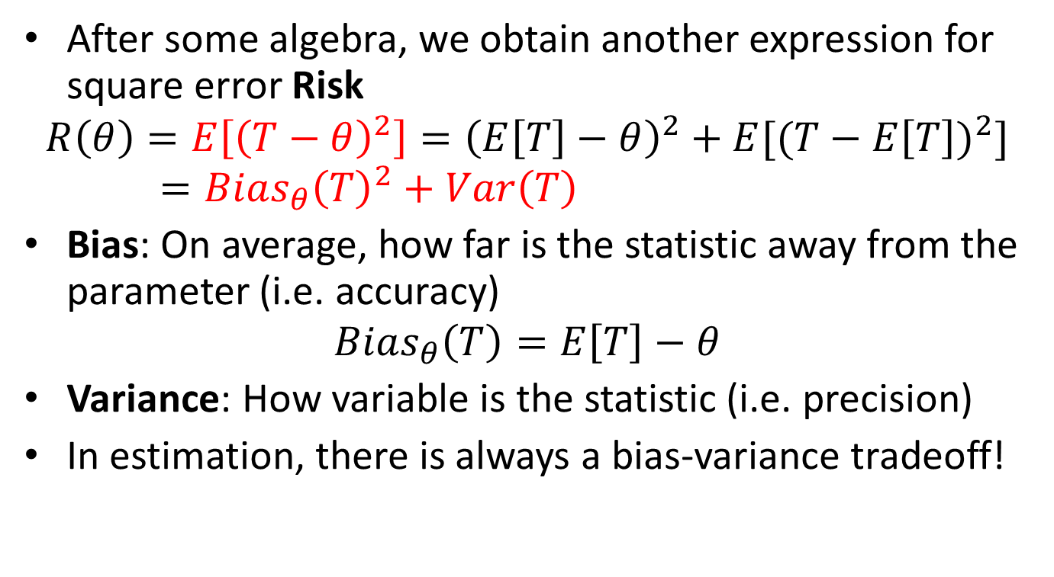
Bias-Variance Trade-Off: Square Error Risk
After some algebra, we obtain another expression for square error Risk
$$R\left(θ\right)=E\left[{\left(T−θ\right)}^{2}\right]={\left(E\left[T\right]−θ\right)}^{2}+E{[(T−E\left[T\right])}^{2}]=Bias_{θ}{\left(T\right)}^{2}+Var\left(T\right)$$
Bias: On average, how far is the statistic away from the parameter (i.e. accuracy)
$$Bias_{θ}\left(T\right)=E\left[T\right]−θ$$
Variance: How variable is the statistic (i.e. precision)
In estimation, there is always a bias-variance tradeoff!

Slide 9
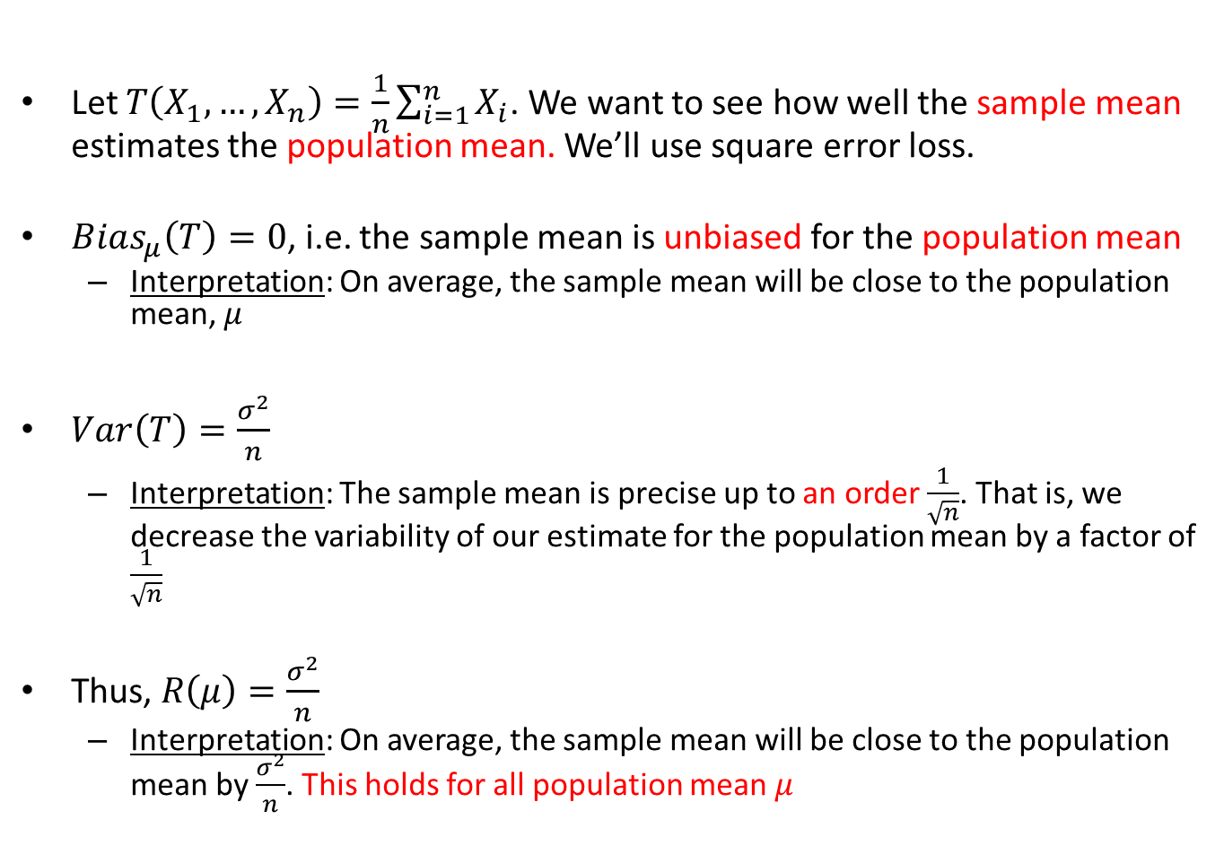
Sample Mean, Bias, Variance, and Risk
Let $T\left(X_{1},…,X_{n}\right)=\frac{1}{n}\sum_{i=1}^{n}{X_{i}}$. We want to see how well the sample mean estimates the population mean. We’ll use square error loss.
$Bias_{μ}\left(T\right)=0$, i.e. the sample mean is unbiased for the population mean
  Interpretation: On average, the sample mean will be close to the population mean, $μ$
$Var\left(T\right)=\frac{σ^{2}}{n}$
  Interpretation: The sample mean is precise up to an order $\frac{1}{\sqrt{n}}$. That is, we decrease the variability of our estimate for the population mean by a factor of $\frac{1}{\sqrt{n}}$
Thus, $R\left(μ\right)=\frac{σ^{2}}{n}$
  Interpretation: On average, the sample mean will be close to the population mean by $\frac{σ^{2}}{n}$. This holds for all population mean $μ$

Slide 10
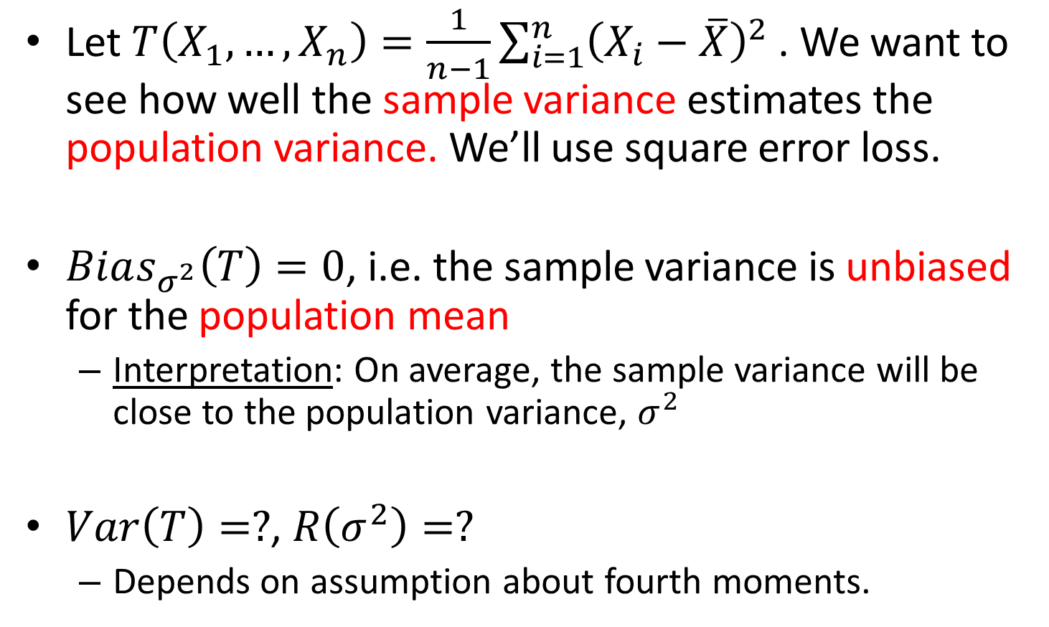
Sample Variance and Bias
Let $T\left(X_{1},…,X_{n}\right)=\frac{1}{n−1}\sum_{i=1}^{n}{{\left(X_{i}−\overline{X}\right)}^{2} }$. We want to see how well the sample variance estimates the population variance. We’ll use square error loss.
$Bias_{σ^{2}}\left(T\right)=0$, i.e. the sample variance is unbiased for the population mean
  Interpretation: On average, the sample variance will be close to the population variance, $σ^{2}$
$Var\left(T\right)=?$, $R\left(σ^{2}\right)=?$
  Depends on assumption about fourth moments.

Slide 11
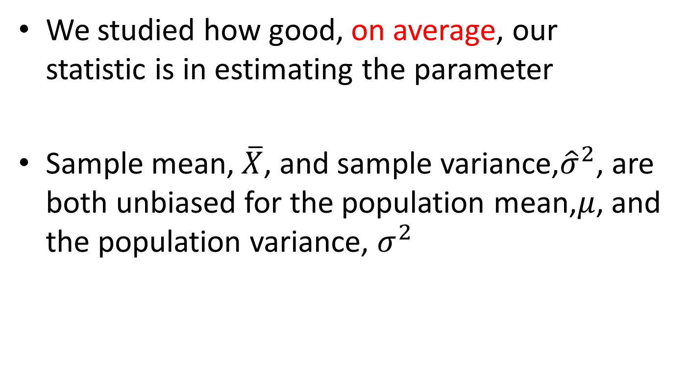
In Summary…
We studied how good, on average, our statistic is in estimating the parameter
Sample mean, $\overline{X}$, and sample variance,${\hat{σ}}^{2}$, are both unbiased for the population mean,$μ$, and the population variance, $σ^{2}$

Slide 12
But…
But, what about the distribution of our summary statistics?
So far, we only studied the statistics “average” behavior.
Sampling distribution!

Slide 13
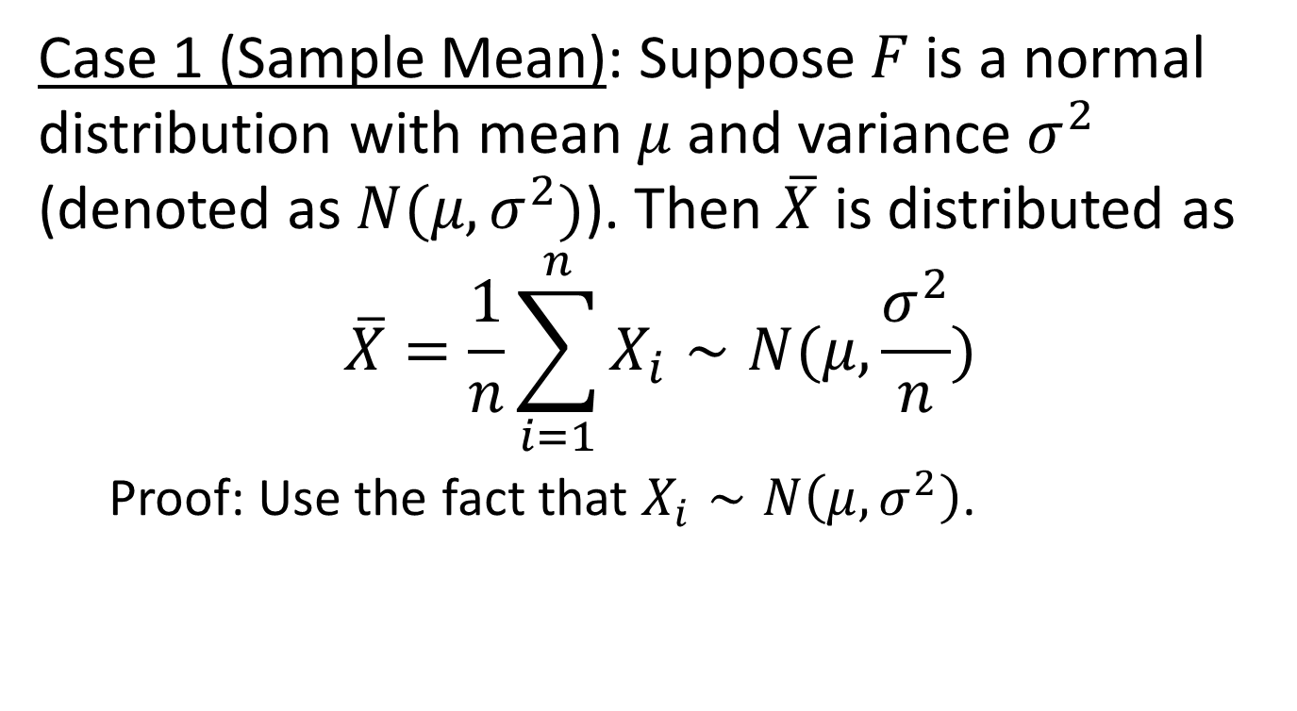
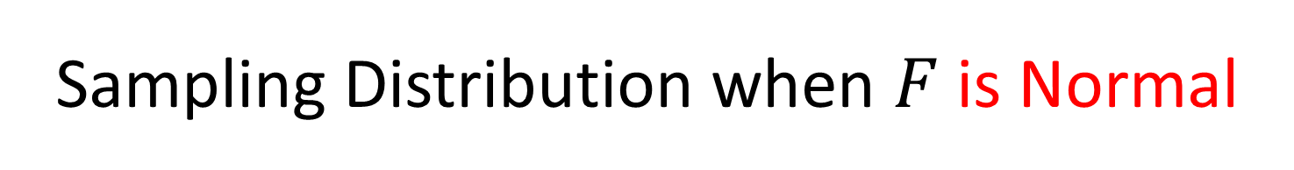
Sampling Distribution when $F$is Normal
Case 1 (Sample Mean): Suppose $F$ is a normal distribution with mean $μ$ and variance $σ^{2}$ (denoted as $N(μ,σ^{2})$). Then $\overline{X}$ is distributed as
$$\overline{X}=\frac{1}{n}\sum_{i=1}^{n}{X_{i}}∼N(μ,\frac{σ^{2}}{n})$$
  Proof: Use the fact that $X_{i}∼N\left(μ,σ^{2}\right)$.

Slide 14
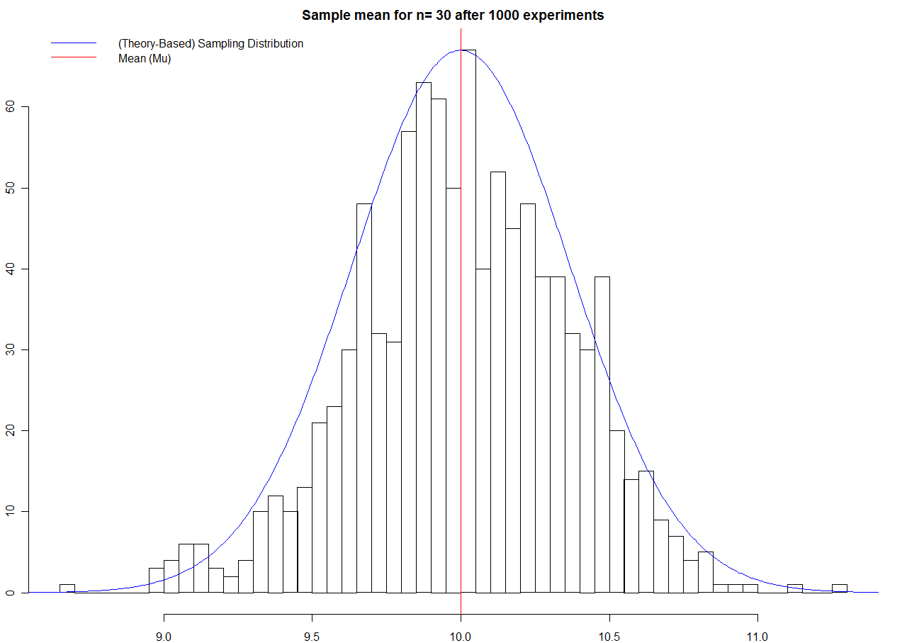

Slide 15
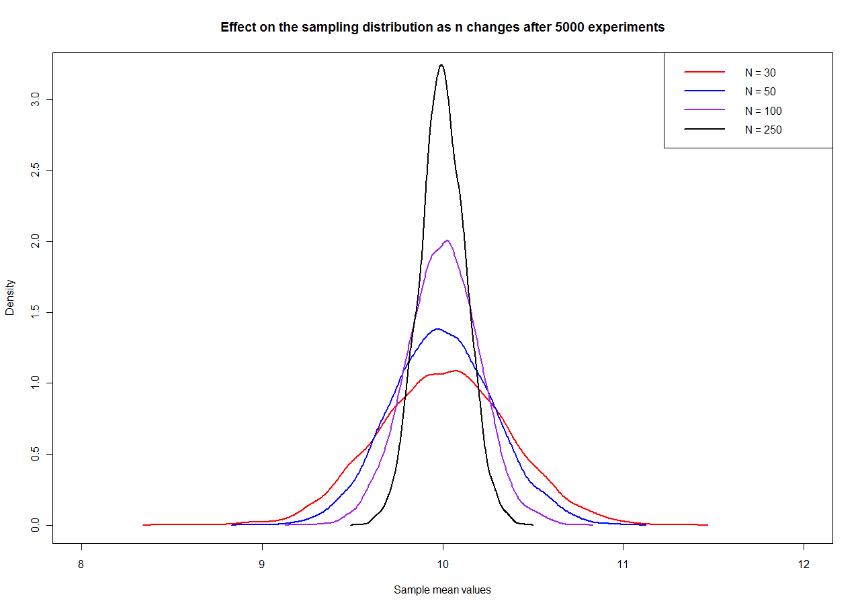

Slide 16
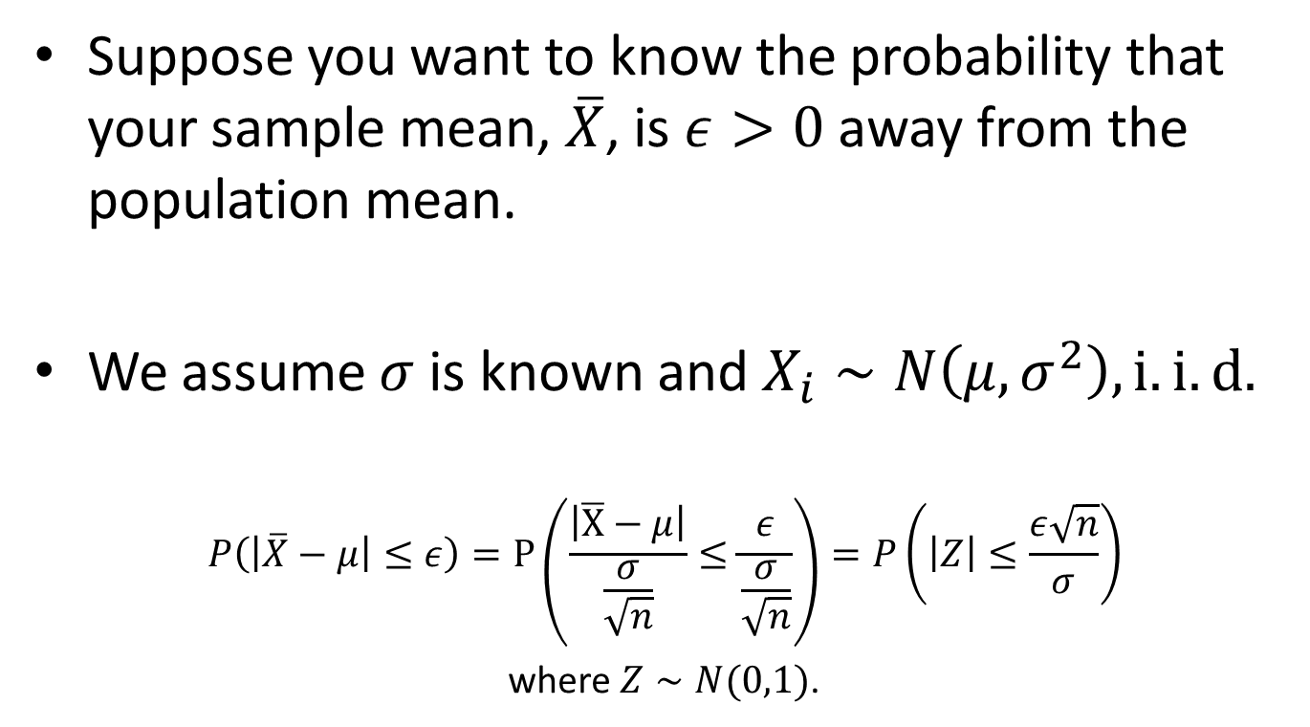
Sampling Distribution Example
Suppose you want to know the probability that your sample mean, $\overline{X}$, is $ε>0$ away from the population mean.
We assume $σ$ is known and $X_{i}∼N\left(μ,σ^{2}\right), i.i.d.$
$$P\left(\left|\overline{X}−μ\right|≤ε\right)=P\left(\frac{\left|\overline{X}−μ\right|}{\frac{σ}{\sqrt{n}}}≤\frac{ε}{\frac{σ}{\sqrt{n}}}\right)=P\left(\left|Z\right|≤\frac{ε\sqrt{n}}{σ}\right)$$
where $Z∼N(0,1)$.

Slide 17
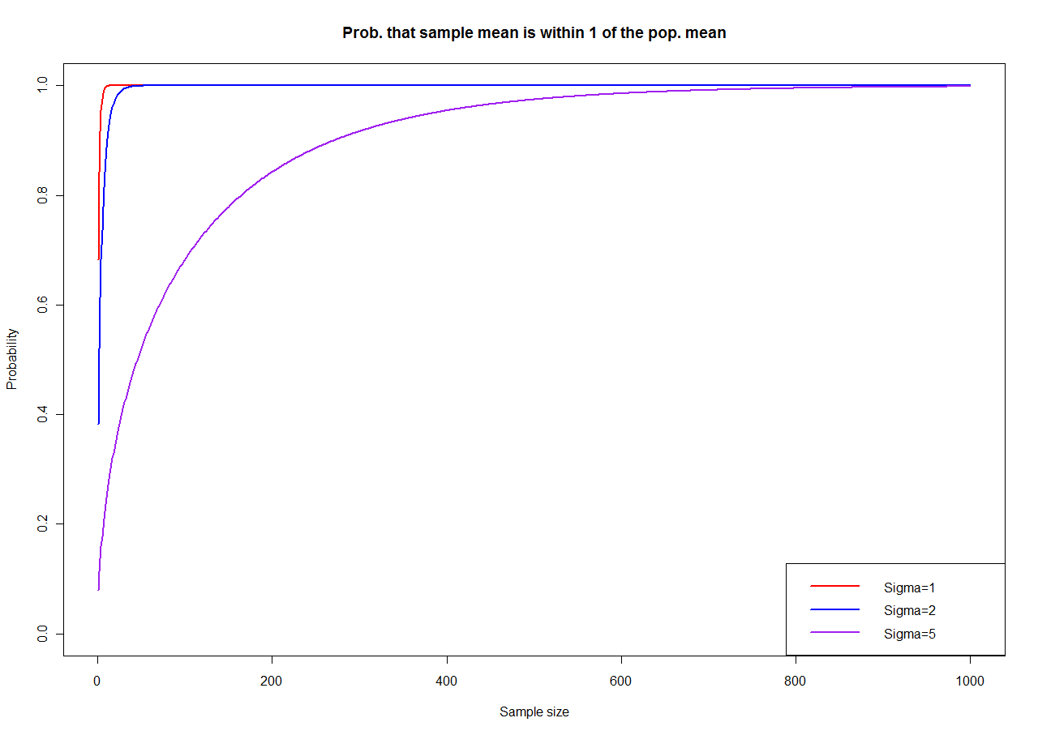

Slide 18
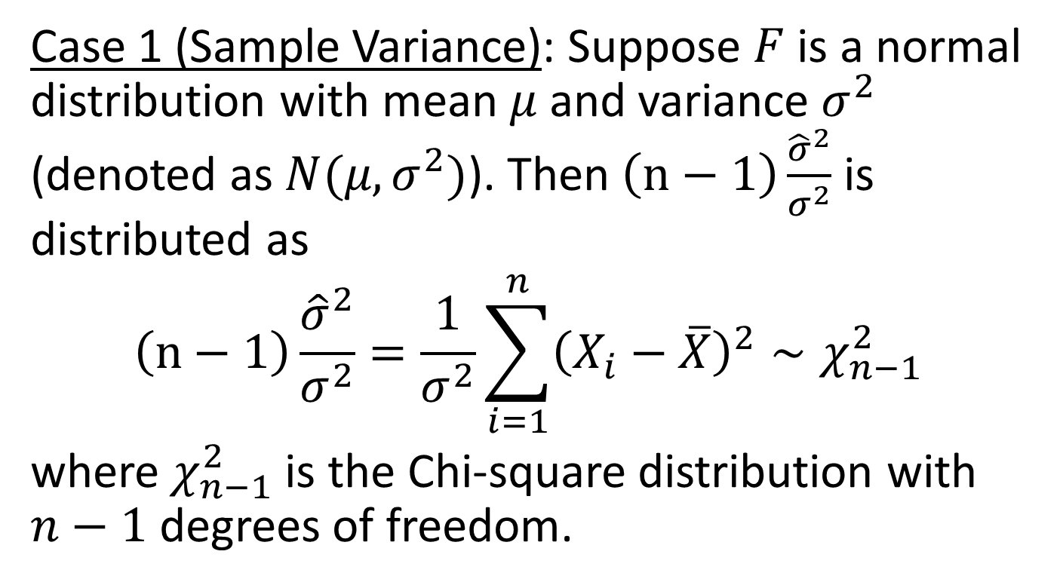
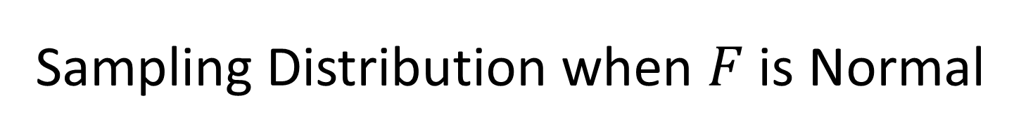
Sampling Distribution when $F$ is Normal
Case 1 (Sample Variance): Suppose $F$ is a normal distribution with mean $μ$ and variance $σ^{2}$ (denoted as $N(μ,σ^{2})$). Then $\left(n−1\right)\frac{{\hat{σ}}^{2}}{σ^{2}}$ is distributed as
$$\left(n−1\right)\frac{{\hat{σ}}^{2}}{σ^{2}}=\frac{1}{σ^{2}}\sum_{i=1}^{n}{{\left(X_{i}−\overline{X}\right)}^{2}∼χ_{n−1}^{2}}$$
where $χ_{n−1}^{2}$ is the Chi-square distribution with $n−1$ degrees of freedom.

Slide 19
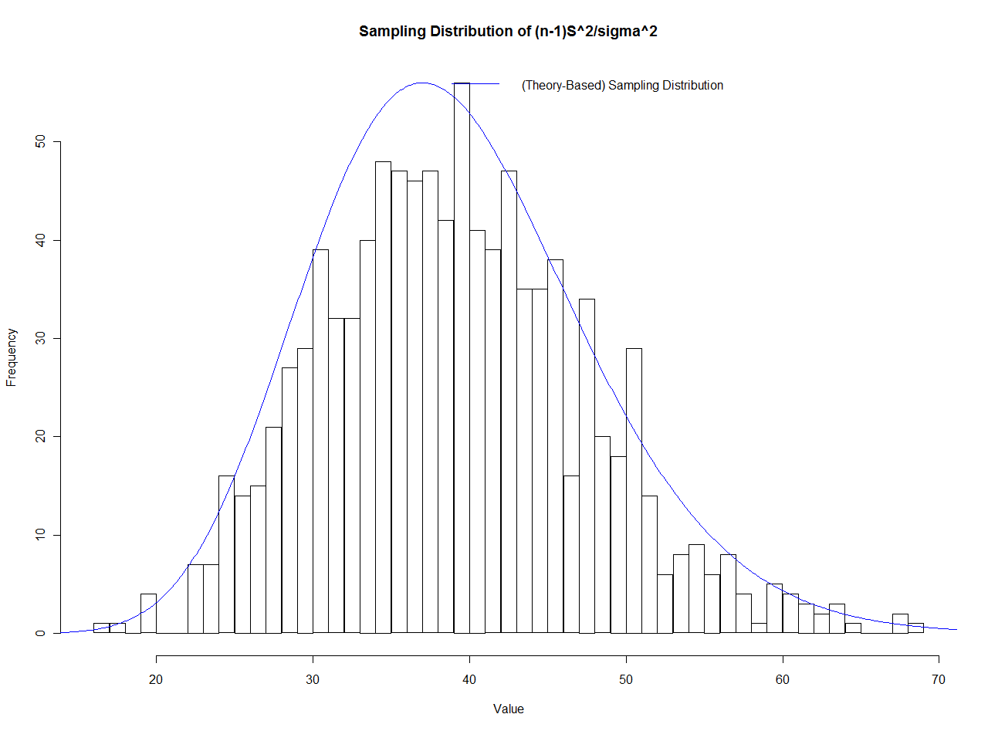

Slide 20
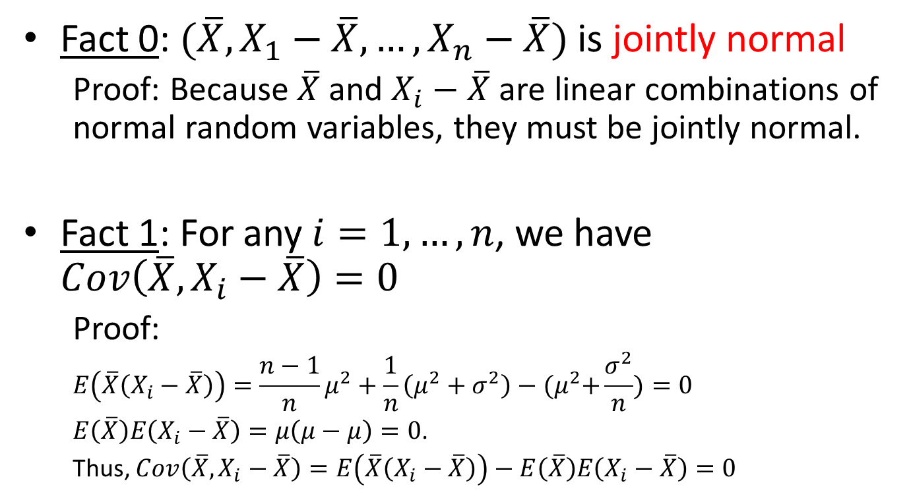
Some Preliminaries from Stat 430
Fact 0: $(\overline{X},X_{1}−\overline{X},…,X_{n}−\overline{X})$ is jointly normal
  Proof: Because $\overline{X}$ and $X_{i}−\overline{X}$ are linear combinations of normal random variables, they must be jointly normal.
Fact 1: For any $i=1,…,n$, we have $Cov\left(\overline{X},X_{i}−\overline{X}\right)=0$
  Proof:
  $$E\left(\overline{X}\left(X_{i}−\overline{X}\right)\right)=\frac{n−1}{n}μ^{2}+\frac{1}{n}\left(μ^{2}+σ^{2}\right)−{(μ}^{2}+\frac{σ^{2}}{n})=0$$
  $E\left(\overline{X}\right)E\left(X_{i}−\overline{X}\right)=μ\left(μ−μ\right)=0$.
  Thus, $Cov\left(\overline{X},X_{i}−\overline{X}\right)=E\left(\overline{X}\left(X_{i}−\overline{X}\right)\right)−E\left(\overline{X}\right)E\left(X_{i}−\overline{X}\right)=0$

Slide 21
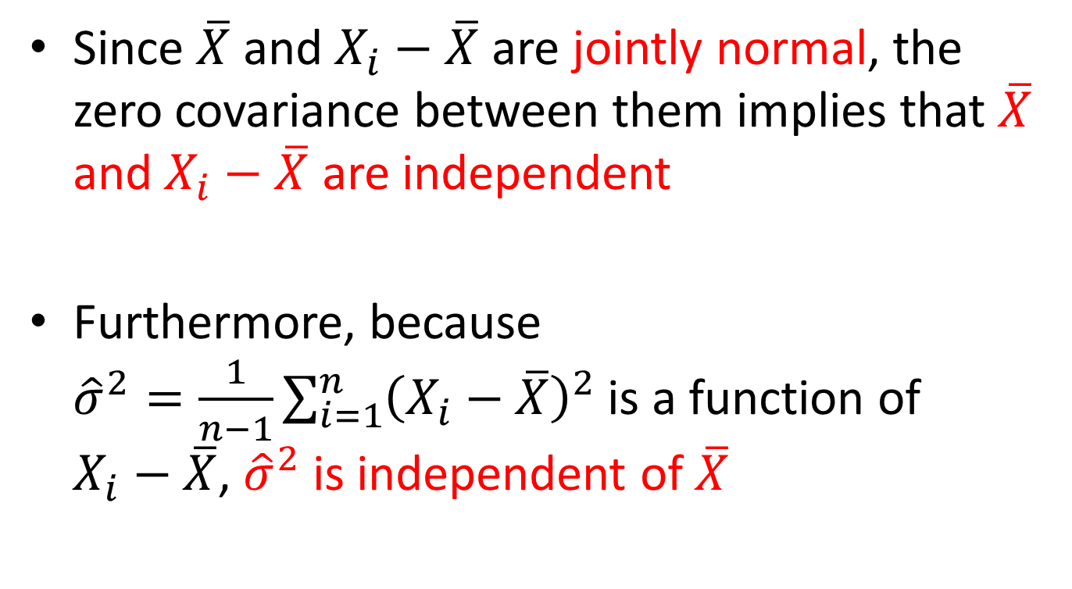
Since $\overline{X}$ and $X_{i}−\overline{X}$ are jointly normal, the zero covariance between them implies that $\overline{X}$ and $X_{i}−\overline{X}$ are independent
Furthermore, because ${\hat{σ}}^{2}=\frac{1}{n−1}\sum_{i=1}^{n}{{\left(X_{i}−\overline{X}\right)}^{2}}$ is a function of $X_{i}−\overline{X}$, ${\hat{σ}}^{2}$ is independent of $\overline{X}$

Slide 22
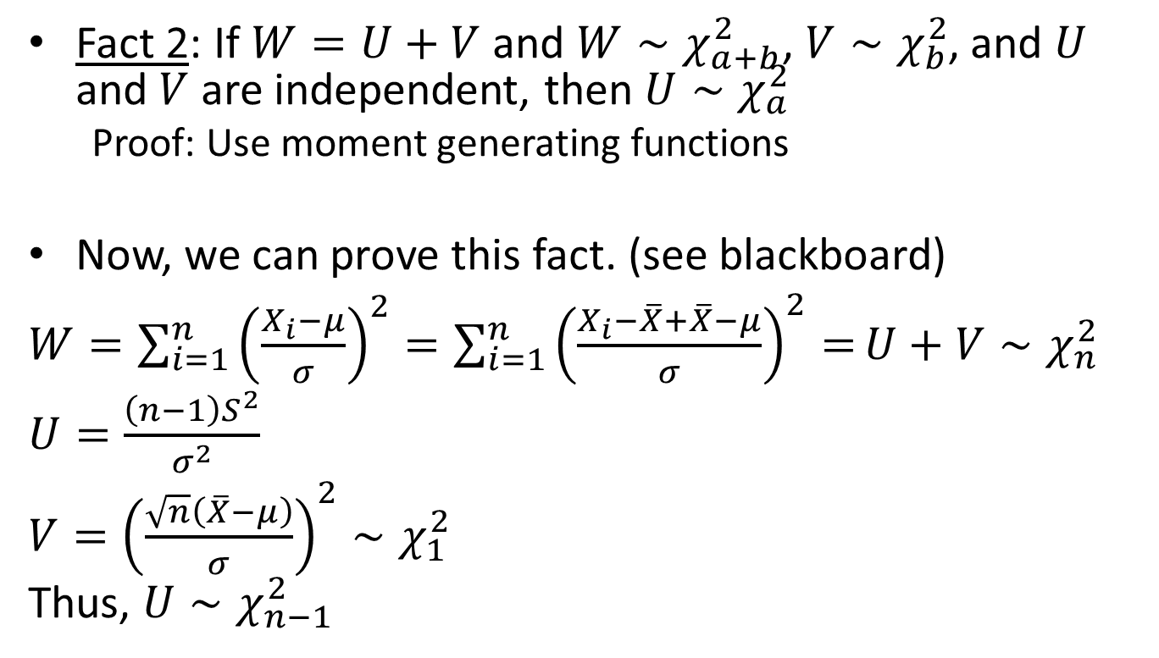
Fact 2: If $W=U+V$ and $W∼χ_{a+b}^{2}$, $V∼χ_{b}^{2}$, and $U$ and $V$ are independent, then $U∼χ_{a}^{2}$
  Proof: Use moment generating functions
Now, we can prove this fact. (see blackboard)
$W=\sum_{i=1}^{n}{{\left(\frac{X_{i}−μ}{σ}\right)}^{2}=\sum_{i=1}^{n}{{\left(\frac{X_{i}−\overline{X}+\overline{X}−μ}{σ}\right)}^{2}=}}U+V∼χ_{n}^{2}$
$U=\frac{\left(n−1\right)S^{2}}{σ^{2}}$
$V={\left(\frac{\sqrt{n}\left(\overline{X}−μ\right)}{σ}\right)}^{2}∼χ_{1}^{2}$
Thus, $U∼χ_{n−1}^{2}$

Slide 23
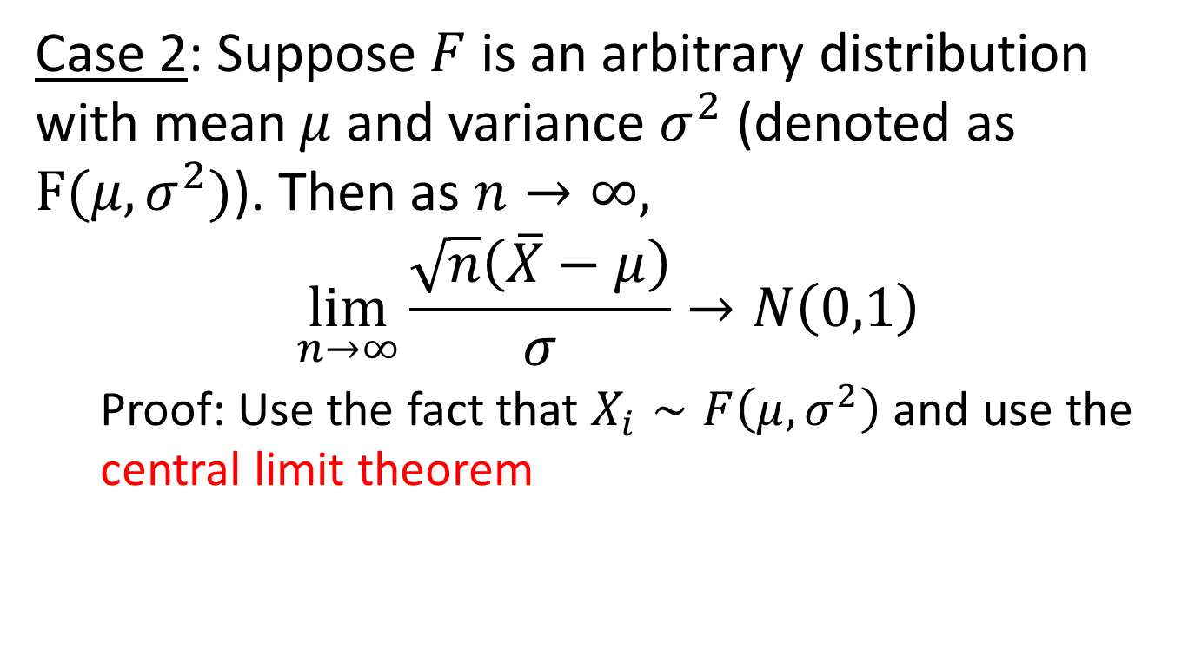

Sampling Distribution when $F$is not Normal
Case 2: Suppose $F$ is an arbitrary distribution with mean $μ$ and variance $σ^{2}$ (denoted as $F(μ,σ^{2})$). Then as $n→∞,$
$$\lim_{n→∞}{\frac{\sqrt{n}\left(\overline{X}−μ\right)}{σ}}→N\left(0,1\right)$$
  Proof: Use the fact that $X_{i}∼F\left(μ,σ^{2}\right)$ and use the central limit theorem

Slide 24
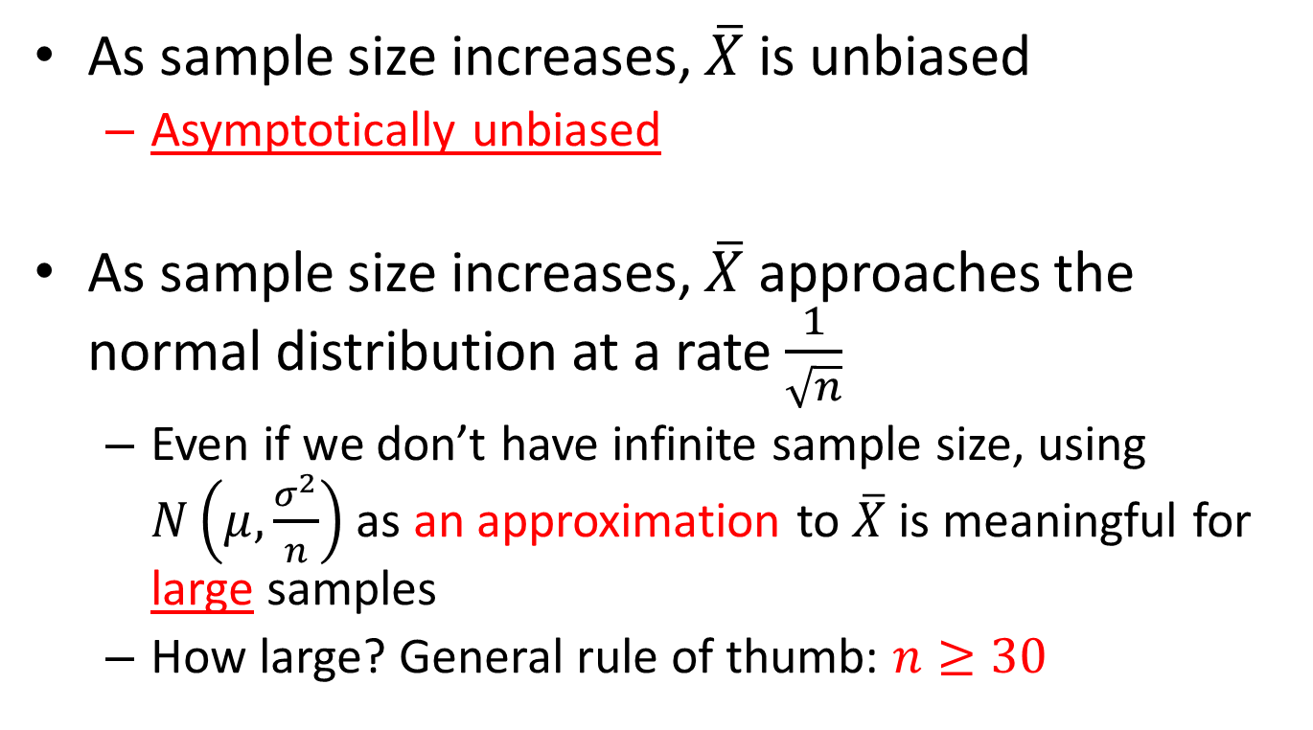
Properties
As sample size increases, $\overline{X}$ is unbiased
  Asymptotically unbiased
As sample size increases, $\overline{X}$ approaches the normal distribution at a rate $\frac{1}{\sqrt{n}}$
  Even if we don’t have infinite sample size, using $N\left(μ,\frac{σ^{2}}{n}\right)$ as an approximation to $\overline{X}$ is meaningful for large samples
  How large? General rule of thumb: $n≥30$

Slide 25
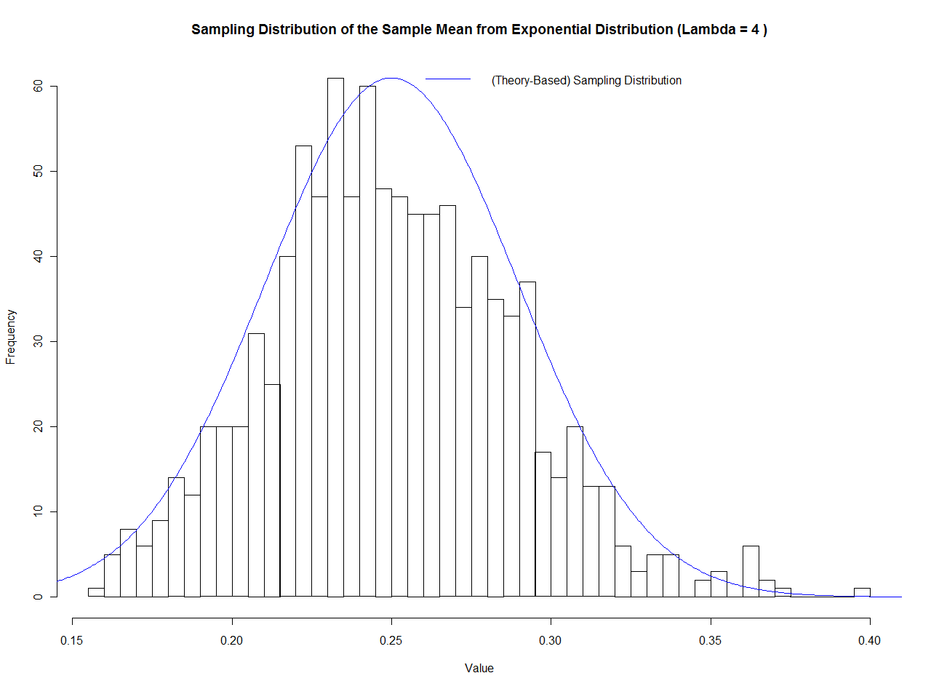
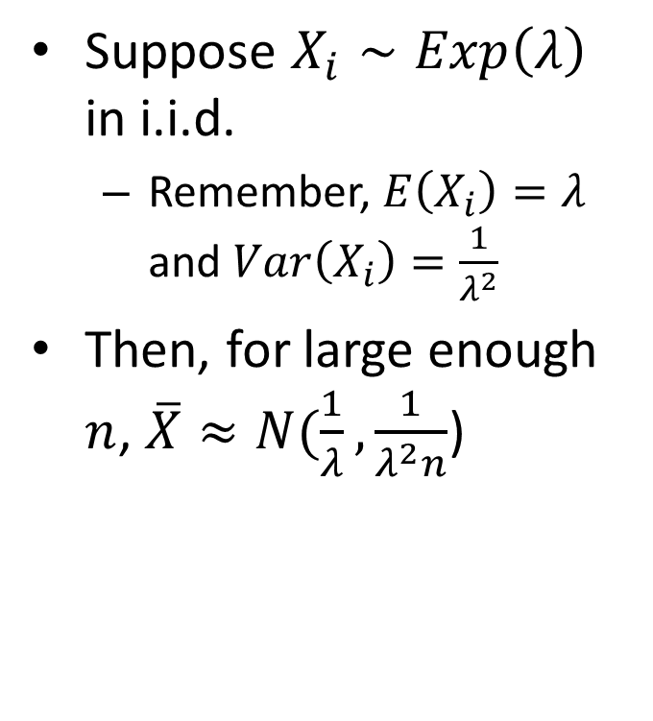
Example
Suppose $X_{i}∼Exp\left(λ\right)$ in i.i.d.
  Remember, $E\left(X_{i}\right)=λ$ and $Var\left(X_{i}\right)=\frac{1}{λ^{2}}$
Then, for large enough $n$, $\overline{X}≈N(\frac{1}{λ},\frac{1}{λ^{2}n}$)

Slide 26
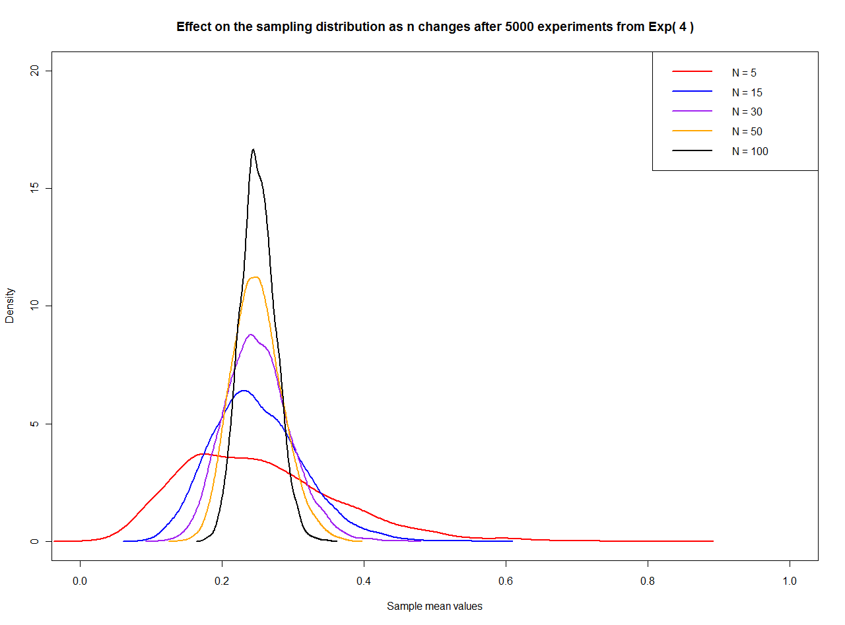

Slide 27
An Experiment

Slide 28
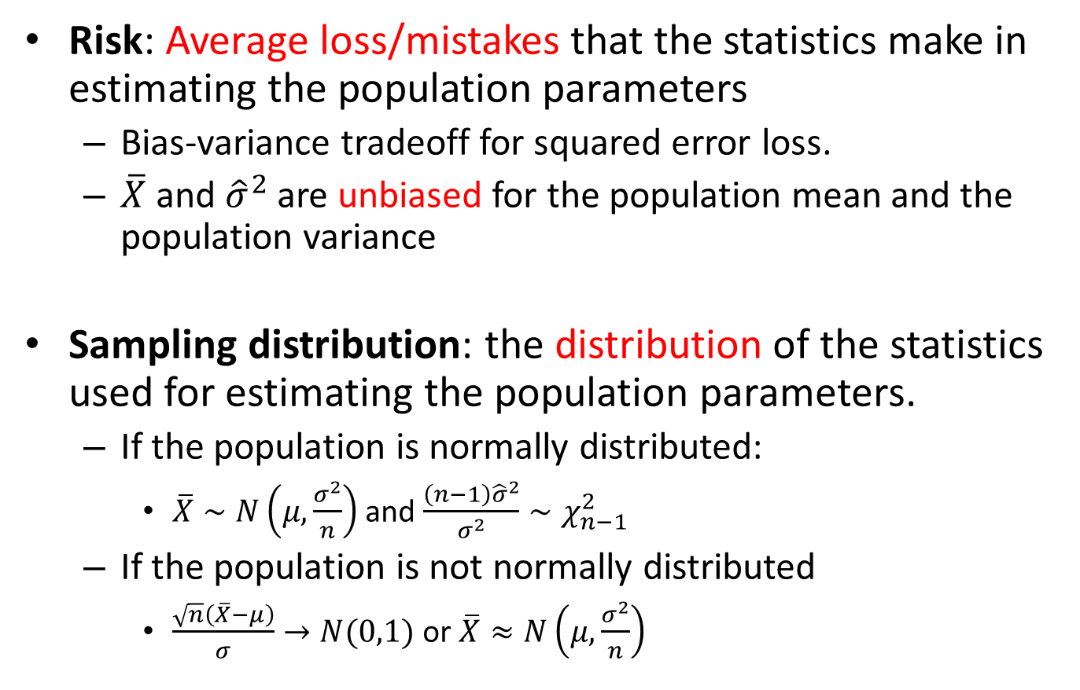
Lecture Summary
Risk: Average loss/mistakes that the statistics make in estimating the population parameters
  Bias-variance tradeoff for squared error loss.
  $\overline{X}$ and ${\hat{σ}}^{2}$ are unbiased for the population mean and the population variance
Sampling distribution: the distribution of the statistics used for estimating the population parameters.
  If the population is normally distributed:
    $\overline{X}∼N\left(μ,\frac{σ^{2}}{n}\right)$ and $\frac{\left(n−1\right){\hat{σ}}^{2}}{σ^{2}}∼χ_{n−1}^{2}$
  If the population is not normally distributed
    $\frac{\sqrt{n}\left(\overline{X}−μ\right)}{σ}→N(0,1)$ or $\overline{X}≈N\left(μ,\frac{σ^{2}}{n}\right)$

