Slide 1
Part D Opioids and the Physician Referral Network
Amir Alwan
Aditya Gore
Joseph Deutsch

Slide 2
Motivation
WI has a problem with prescription opioid abuse
A number of high profile cases in the last few years
The identification of fraudulent behavior is of great interest

Slide 3
Data
Two data sources:
1. Part D Medicare Data (2013)
16,000 NPIs in WI
$1.4 billion in spending
2. Physician Referral Network (2013)

Slide 4
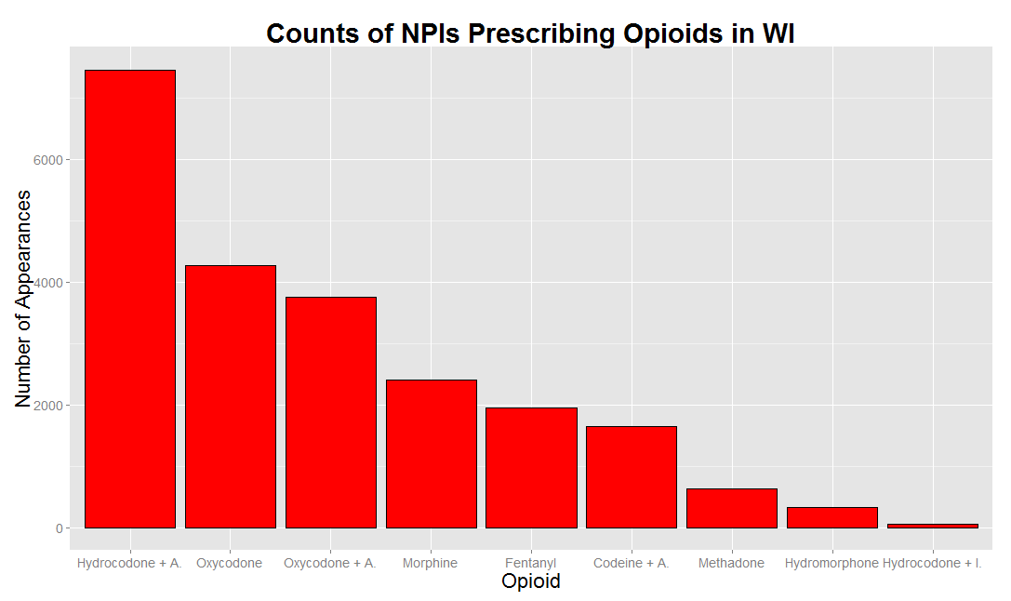
Opioids

Slide 5
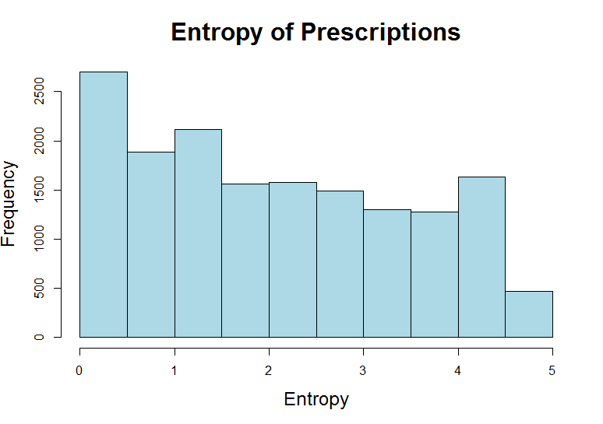

Entropy of Prescriptions
$$−\sum{p_{i}log⁡(p_{i}) }$$

Slide 6
Goal
Study opioid prescription behavior in WI
Compare graph based results with non-graph based

Slide 7
A Doctor’s Peers
Idea: compare a doctor to their peers
Peer definition 1:
doctors with same specialty in same city
Peer definition 2:
doctors with same specialty in same community of graph

Slide 8
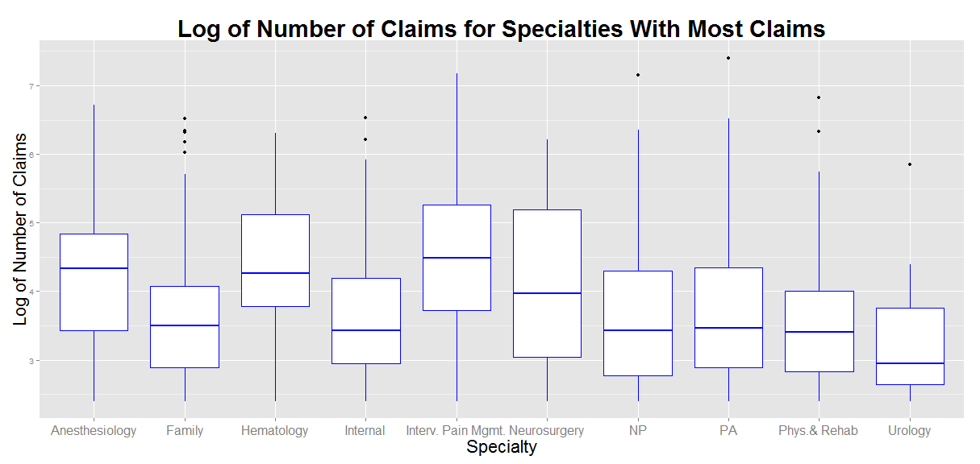
Investigating Peer 1

Slide 9
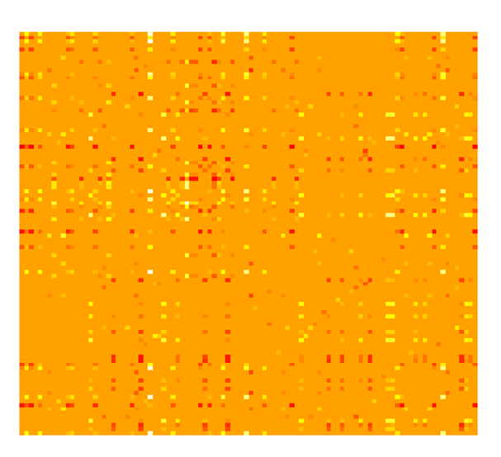
Investigating Peer 1

Slide 10
Future Work
Apply graph
based methodology
Compare definitions of peer
Check known fraud cases

