Slide 1
Bayesian QTL Mapping
Brian S. Yandell
University of Wisconsin-Madison
www.stat.wisc.edu/~yandell/statgen↑
UW-Madison, April 2010

Slide 2
outline
What is the goal of QTL study?
Bayesian vs. classical QTL study
Bayesian strategy for QTLs
model search using MCMC
  Gibbs sampler and Metropolis-Hastings
  reversible jump MCMC
model assessment
  Bayes factors & model averaging
analysis of hyper data
software for Bayesian QTLs

Slide 3
1. what is the goal of QTL study?
uncover underlying biochemistry
  identify how networks function, break down
  find useful candidates for (medical) intervention
  epistasis may play key role
  statistical goal: maximize number of correctly identified QTL
basic science/evolution
  how is the genome organized?
  identify units of natural selection
  additive effects may be most important (Wright/Fisher debate)
  statistical goal: maximize number of correctly identified QTL
select “elite” individuals
  predict phenotype (breeding value) using suite of characteristics (phenotypes) translated into a few QTL
  statistical goal: mimimize prediction error

Slide 4
advantages of multiple QTL approach
improve statistical power, precision
  increase number of QTL detected
  better estimates of loci: less bias, smaller intervals
improve inference of complex genetic architecture
  patterns and individual elements of epistasis
  appropriate estimates of means, variances, covariances
    asymptotically unbiased, efficient
  assess relative contributions of different QTL
improve estimates of genotypic values
  less bias (more accurate) and smaller variance (more precise)
  mean squared error = MSE = (bias)² + variance

Slide 5
Pareto diagram of QTL effects
major QTL on
linkage map
(modifiers)
major
QTL
minor
QTL
3
polygenes
2
4
1
5
Intuitive idea of ellipses:
Horizontal = significance
Vertical = support interval

Slide 6
check QTL in context of genetic architecture
scan for each QTL adjusting for all others
  adjust for linked and unlinked QTL
    adjust for linked QTL: reduce bias
    adjust for unlinked QTL: reduce variance
  adjust for environment/covariates
examine entire genetic architecture
  number and location of QTL, epistasis, GxE
  model selection for best genetic architecture

Slide 7
2. Bayesian vs. classical QTL study
classical study
  maximize over unknown effects
  test for detection of QTL at loci
  model selection in stepwise fashion
Bayesian study
  average over unknown effects
  estimate chance of detecting QTL
  sample all possible models
both approaches
  average over missing QTL genotypes
  scan over possible loci

Slide 8
QTL model selection: key players
observed measurements
  y = phenotypic trait
  m = markers & linkage map
  i = individual index (1,…,n)
missing data
  missing marker data
  q = QT genotypes
    alleles QQ, Qq, or qq at locus
unknown quantities
  λ = QT locus (or loci)
  μ = phenotype model parameters
  A = QTL model/genetic architecture
pr(q|m,λ,A) genotype model
  grounded by linkage map, experimental cross
  recombination yields multinomial for q given m
pr(y|q,μ,A) phenotype model
  distribution shape (assumed normal here)
  unknown parameters μ (could be non-parametric)
m
y
q
λ
μ
A
after
Sen Churchill (2001)

Slide 9
likelihood and posterior

Slide 10
Bayes posterior vs. maximum likelihood
(genetic architecture A = single QTL at λ)
LOD: classical Log ODds
  maximize likelihood over effects µ
  R/qtl scanone/scantwo: method = “em”
LPD: Bayesian Log Posterior Density
  average posterior over effects µ
  R/qtl scanone/scantwo: method = “imp”

Slide 11
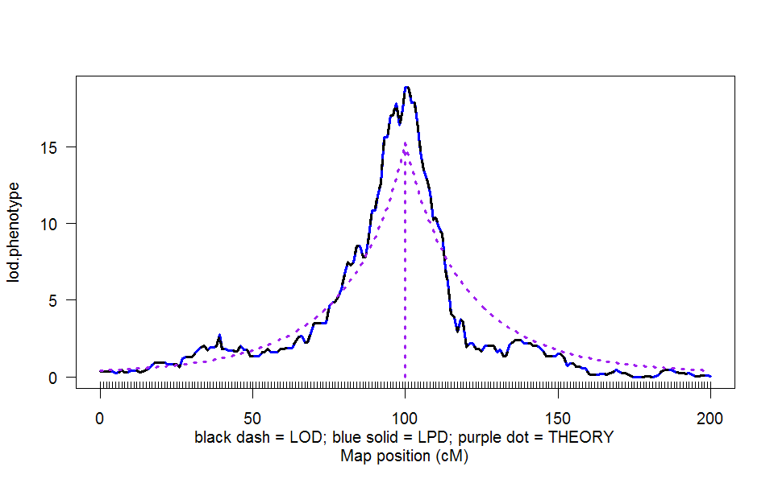
LOD & LPD: 1 QTL n.ind = 100, 1 cM marker spacing

Slide 12
Simplified likelihood surface
2-D for BC locus and effect
locus λ and effect Δ = µ₂ – µ₁
profile likelihood along ridge
  maximize likelihood at each λ for Δ
  symmetric in Δ around MLE given λ
weighted average of posterior
  average likelihood at each λ with weight p(Δ)
  how does prior p(Δ) affect symmetry?

Slide 13
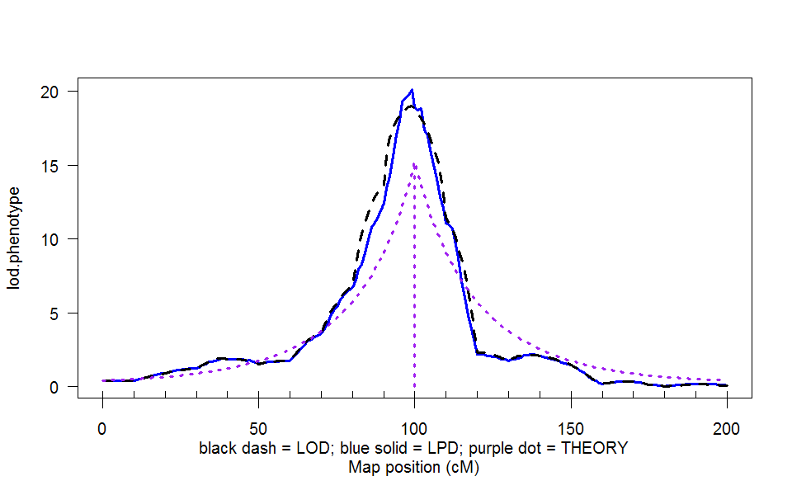
LOD & LPD: 1 QTL n.ind = 100, 10 cM marker spacing

Slide 14
likelihood and posterior
likelihood relates “known” data (y,m,q) to unknown values of interest (μ,λ,A)
  pr(y,q|m,μ,λ,A) = pr(y|q,μ,A) pr(q|m,λ,A)
  mix over unknown genotypes (q)
posterior turns likelihood into a distribution
  weight likelihood by priors
  rescale to sum to 1.0
  posterior = likelihood * prior / constant

Slide 15
marginal LOD or LPD
What is contribution of a QTL adjusting for all others?
  improvement in LPD due to QTL at locus λ
  contribution due to main effects, epistasis, GxE?
How does adjusted LPD differ from unadjusted LPD?
  raised by removing variance due to unlinked QTL
  raised or lowered due to bias of linked QTL
  analogous to Type III adjusted ANOVA tests
can ask these same questions using classical LOD
  see Broman’s newer tools for multiple QTL inference

Slide 16
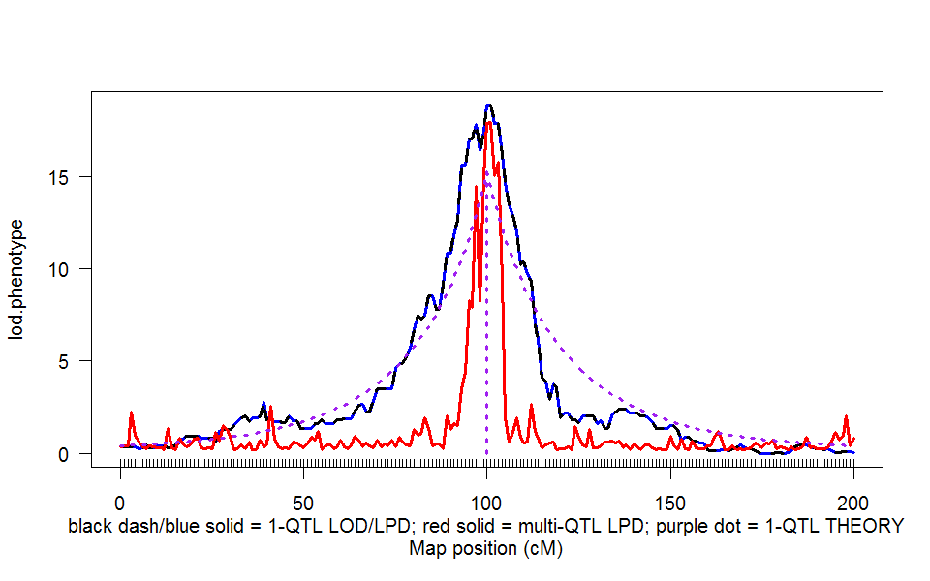
LPD: 1 QTL vs. multi-QTL marginal contribution to LPD from QTL at λ
1st QTL
2nd QTL
2nd QTL

Slide 17
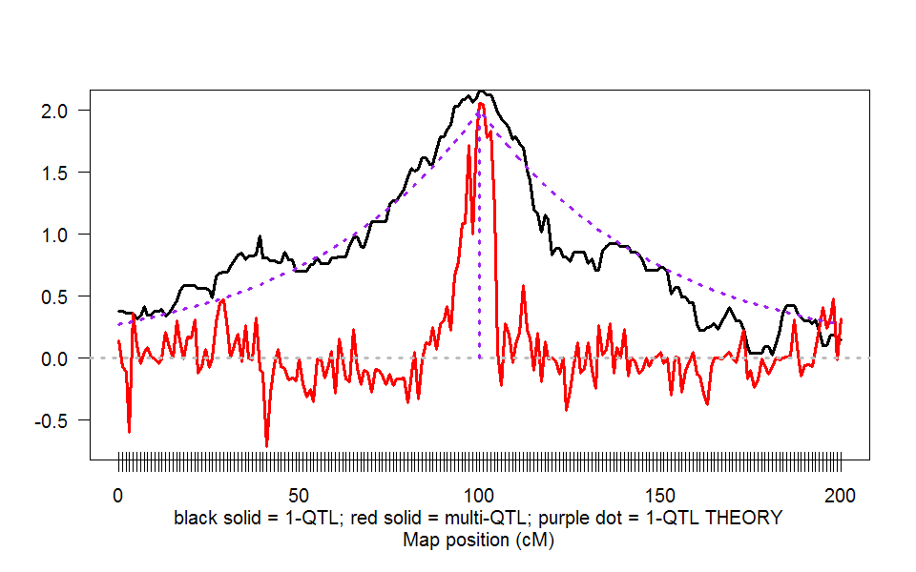
substitution effect: 1 QTL vs. multi-QTL single QTL effect vs. marginal effect from QTL at λ
1st QTL
2nd QTL
2nd QTL

Slide 18
3. Bayesian strategy for QTLs
augment data (y,m) with missing genotypes q
build model for augmented data
  genotypes (q) evaluated at loci (λ)
    depends on flanking markers (m)
  phenotypes (y) centered about effects (μ)
    depends on missing genotypes (q)
  λ and μ depend on genetic architecture (A)
    How complicated is model? number of QTL, epistasis, etc.
sample from model in some clever way
infer most probable genetic architecture
  estimate loci, their main effects and epistasis
  study properties of estimates

Slide 19
do phenotypes help to guess genotypes? posterior on QTL genotypes q
M41
λ
M214
what are probabilities
for genotype q
between markers?
all recombinants AA:AB
have 1:1 prior ignoring y
what if we use y?

Slide 20
posterior on QTL genotypes q
full conditional of q given data, parameters
  proportional to prior pr(q | m, λ )
    weight toward q that agrees with flanking markers
  proportional to likelihood pr(y|q,μ)
    weight toward q with similar phenotype values
  posterior balances these two
this is the E-step of EM computations

Slide 21
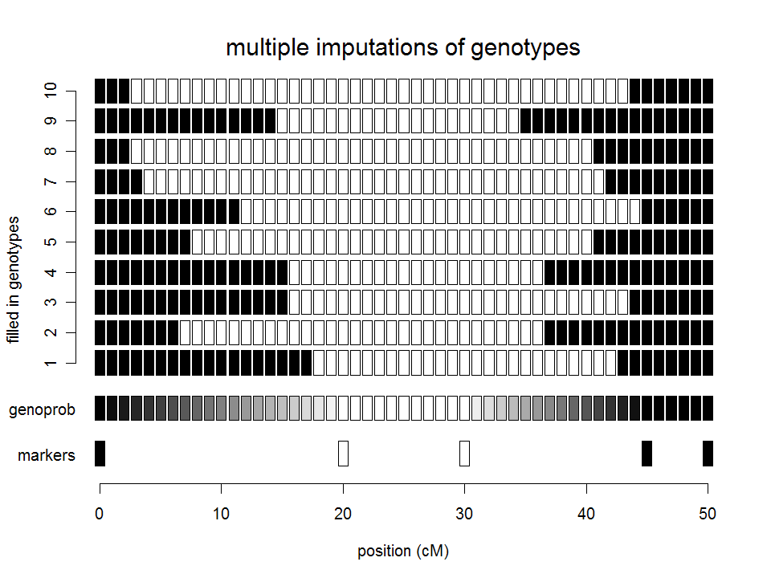

Slide 22
where are the genotypic means?
(phenotype mean for genotype q is μ_{q})
data means
prior mean
data mean
posterior means

Slide 23
prior & posteriors: genotypic means μ_{q}
prior for genotypic means
  centered at grand mean
  variance related to heritability of effect
    hyper-prior on variance (details omitted)
posterior
  shrink genotypic means toward grand mean
  shrink variance of genotypic mean
prior:
posterior:
shrinkage:

Slide 24
multiple QTL phenotype model
phenotype affected by genotype & environment
  E(y|q) = μ_{q} = β₀ + sum_{{j in H}} β_{j}(q)
  number of terms in QTL model H ≤ 2^{nqtl} (3^{nqtl} for F₂)
partition genotypic mean into QTL effects
  μ_{q} = β₀ + β₁(q₁) + β₂(q₂) + β₁₂(q₁,q₂)
  μ_{q} = mean + main effects + epistatic interactions
partition prior and posterior (details omitted)

Slide 25
QTL with epistasis
same phenotype model overview
partition of genotypic value with epistasis
partition of genetic variance & heritability

Slide 26
partition of multiple QTL effects
partition genotype-specific mean into QTL effects
  µ_{q} = mean + main effects + epistatic interactions
  µ_{q} = μ + β_{q} = μ + sum_{j in A} β_{qj}
priors on mean and effects
μ ~ N(μ₀, κ₀σ²) grand mean
β_{q} ~ N(0, κ₁σ²) model-independent genotypic effect
β_{qj} ~ N(0, κ₁σ²/|A|) effects down-weighted by size of A
determine hyper-parameters via empirical Bayes

Slide 27
Where are the loci λ on the genome?
prior over genome for QTL positions
  flat prior = no prior idea of loci
  or use prior studies to give more weight to some regions
posterior depends on QTL genotypes q
  pr(λ | m,q) = pr(λ) pr(q | m,λ) / constant
  constant determined by averaging
    over all possible genotypes q
    over all possible loci λ on entire map
no easy way to write down posterior

Slide 28
model fit with multiple imputation
(Sen and Churchill 2001)
pick a genetic architecture
  1, 2, or more QTL
fill in missing genotypes at ‘pseudomarkers’
  use prior recombination model
use clever weighting (importance sampling)
compute LPD, effect estimates, etc.

Slide 29
What is the genetic architecture A?
components of genetic architecture
  how many QTL?
  where are loci (λ)? how large are effects (µ)?
  which pairs of QTL are epistatic?
use priors to weight posterior
  toward guess from previous analysis
  improve efficiency of sampling from posterior
    increase samples from architectures of interest

Slide 30
4. QTL Model Search using MCMC
construct Markov chain around posterior
  want posterior as stable distribution of Markov chain
  in practice, the chain tends toward stable distribution
    initial values may have low posterior probability
    burn-in period to get chain mixing well
sample QTL model components from full conditionals
  sample locus λ given q,A (using Metropolis-Hastings step)
  sample genotypes q given λ,μ,y,A (using Gibbs sampler)
  sample effects μ given q,y,A (using Gibbs sampler)
  sample QTL model A given λ,μ,y,q (using Gibbs or M-H)

Slide 31
MCMC sampling of (λ,q,µ)
Gibbs sampler
  genotypes q
  effects µ
  not loci λ
Metropolis-Hastings sampler
  extension of Gibbs sampler
  does not require normalization
    pr( q | m ) = sum_{λ} pr( q | m, λ ) pr(λ )

Slide 32
Gibbs sampler idea
toy problem
  want to study two correlated effects
  could sample directly from their bivariate distribution
instead use Gibbs sampler:
  sample each effect from its full conditional given the other
  pick order of sampling at random
  repeat many times

Slide 33
Gibbs sampler samples: ρ = 0.6
N = 50 samples
N = 200 samples

Slide 34
Metropolis-Hastings idea
want to study distribution f(λ)
  take Monte Carlo samples
    unless too complicated
  take samples using ratios of f
Metropolis-Hastings samples:
  propose new value λ*
    near (?) current value λ
    from some distribution g
  accept new value with prob a
    Gibbs sampler: a = 1 always
f(λ)
g(λ–λ*)

Slide 35
Metropolis-Hastings samples
N = 200 samples
N = 1000 samples
narrow g
wide g
narrow g
wide g
λ
λ
λ
λ
histogram
histogram
histogram
histogram

Slide 36
MCMC realization
λ
λ
added twist: occasionally propose from whole domain

Slide 37
Multiple QTL Phenotype Model
E(y) = µ + β(q) = µ + XΓβ
  y = n phenotypes
  X = n×L design matrix
    in theory covers whole genome of size L cM
    X determined by genotypes and model space
    only need terms associated with q = n×n_{QTL} genotypes at QTL
  Γ = diag(γ) = genetic architecture
    γ = 0,1 indicators for QTLs or pairs of QTLs
    |γ| = Σγ = size of genetic architecture
    λ = loci determined implicitly by γ
  β = genotypic effects (main and epistatic)
  µ = reference

Slide 38
methods of model search
Reversible jump (transdimensional) MCMC
  sample possible loci (λ determines possible γ)
  collapse to model containing just those QTL
  bookkeeping when model dimension changes
Composite model with indicators
  include all terms in model: β and γ
  sample possible architecture (γ determines λ)
    can use LASSO-type prior for model selection
Shrinkage model
  set γ = 1 (include all loci)
  allow variances of β to differ (shrink coefficients to zero)

Slide 39
RJ-MCMC full conditional updates
map
X
traits
Y
genos
Q
locus
λ
effects
θ
γ
architecture

Slide 40
index architecture γ by number of QTL m
model changes with number of QTL
  analogous to stepwise regression if Q known
  use reversible jump MCMC to change number
    book keeping to compare models
    change of variables between models
what prior on number of QTL?
  uniform over some range
  Poisson with prior mean
  exponential with prior mean

Slide 41
reversible jump MCMC
consider known genotypes q at 2 known loci λ
  models with 1 or 2 QTL
M-H step between 1-QTL and 2-QTL models
  model changes dimension (via careful bookkeeping)
  consider mixture over QTL models H

Slide 42
Markov chain for number m
add a new locus
drop a locus
update current model
m
0
1
...
m-1
m
m+1

Slide 43
jumping QTL number and loci

Slide 44
RJ-MCMC updates
add
locus
1-b(m+1)-d(m)
b(m+1)
map
X
traits
Y
genos
Q
d(m)
loci
λ
effects
θ
drop locus

Slide 45
propose to drop a locus
1
2
3
…
m+1
choose an existing locus
  equal weight for all loci ?
  more weight to loci with small effects?
“drop” effect & genotypes at old locus
  adjust effects at other loci for collinearity
  this is reverse jump of Green (1995)
check acceptance …
  do not drop locus, effects & genotypes
  until move is accepted

Slide 46
propose to add a locus
0
λ₁
λ_{m+1}
λ₂
…
λ_{m}
L
propose a new locus
  uniform chance over genome
  actually need to be more careful (R van de Ven, pers. comm.)
    choose interval between loci already in model (include 0,L)
      probability proportional to interval length (λ₂–λ₁)/L
    uniform chance within this interval 1/(λ₂–λ₁)
  need genotypes at locus & model effect
innovate effect & genotypes at new locus
  draw genotypes based on recombination (prior)
    no dependence on trait model yet
  draw effect as in Green’s reversible jump
    adjust for collinearity: modify other parameters accordingly
check acceptance ...

Slide 47
sampling across QTL models A
0
λ₁
λ_{m+1}
λ₂
…
λ_{m}
L
action steps: draw one of three choices
update QTL model A with probability 1-b(A)-d(A)
  update current model using full conditionals
  sample QTL loci, effects, and genotypes
add a locus with probability b(A)
  propose a new locus along genome
  innovate new genotypes at locus and phenotype effect
  decide whether to accept the “birth” of new locus
drop a locus with probability d(A)
  propose dropping one of existing loci
  decide whether to accept the “death” of locus

Slide 48
acceptance of reversible jump
accept birth of new locus with probability
  min(1,A)
accept death of old locus with probability
  min(1,1/A)

Slide 49
acceptance of reversible jump
move probabilities
birth & death proposals
Jacobian between models
  fudge factor
  see stepwise regression example
m
m+1

Slide 50
reversible jump details
reversible jump MCMC details
  can update model with m QTL
  have basic idea of jumping models
  now: careful bookkeeping between models
RJ-MCMC & Bayes factors
  Bayes factors from RJ-MCMC chain
  components of Bayes factors

Slide 51
reversible jump idea
expand idea of MCMC to compare models
adjust for parameters in different models
  augment smaller model with innovations
  constraints on larger model
calculus “change of variables” is key
  add or drop parameter(s)
  carefully compute the Jacobian
consider stepwise regression
  Mallick (1995) & Green (1995)
  efficient calculation with Hausholder decomposition

Slide 52
model selection in regression
known regressors (e.g. markers)
  models with 1 or 2 regressors
jump between models
  centering regressors simplifies calculations

Slide 53
slope estimate for 1 regressor
recall least squares estimate of slope
note relation of slope to correlation

Slide 54
2 correlated regressors
slopes adjusted for other regressors

Slide 55
Gibbs Sampler for Model 1
mean
slope
variance

Slide 56
Gibbs Sampler for Model 2
mean
slopes
variance

Slide 57
updates from 2->1
drop 2nd regressor
adjust other regressor

Slide 58
updates from 1->2
add 2nd slope, adjusting for collinearity
adjust other slope & variance

Slide 59
model selection in regression
known regressors (e.g. markers)
  models with 1 or 2 regressors
jump between models
  augment with new innovation z

Slide 60
change of variables
change variables from model 1 to model 2
calculus issues for integration
  need to formally account for change of variables
  infinitessimal steps in integration (db)
  involves partial derivatives (next page)

Slide 61
Jacobian & the calculus
Jacobian sorts out change of variables
  careful: easy to mess up here!

Slide 62
geometry of reversible jump
a₂
a₂
a₁
a₁

Slide 63
QT additive reversible jump
a₂
a₂
a₁
a₁

Slide 64
credible set for additive
90% & 95% sets
based on normal
regression line
corresponds to
slope of updates
a₂
a₁

Slide 65
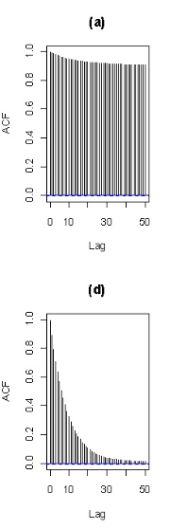
multivariate updating of effects
before
more computations when m > 2
avoid matrix inverse
  Cholesky decomposition of matrix
simultaneous updates
  effects at all loci
accept new locus based on
  sampled new genos at locus
  sampled new effects at all loci
also long-range positions updates
after

Slide 66
Gibbs sampler with loci indicators
partition genome into intervals
  at most one QTL per interval
  interval = 1 cM in length
  assume QTL in middle of interval
use loci to indicate presence/absence of QTL in each interval
  γ = 1 if QTL in interval
  γ = 0 if no QTL
Gibbs sampler on loci indicators
  see work of Nengjun Yi (and earlier work of Ina Hoeschele)

Slide 67
Bayesian shrinkage estimation
soft loci indicators
  strength of evidence for λ_{j} depends on variance of β_{j}
  similar to γ > 0 on grey scale
include all possible loci in model
  pseudo-markers at 1cM intervals
Wang et al. (2005 Genetics)
  Shizhong Xu group at U CA Riverside

Slide 68
epistatic interactions
model space issues
  Fisher-Cockerham partition vs. tree-structured?
  2-QTL interactions only?
  general interactions among multiple QTL?
  retain model hierarchy (include main QTL)?
model search issues
  epistasis between significant QTL
    check all possible pairs when QTL included?
    allow higher order epistasis?
  epistasis with non-significant QTL
    whole genome paired with each significant QTL?
    pairs of non-significant QTL?
Yi et al. (2005, 2007)

Slide 69
5. Model Assessment
balance model fit against model complexity
smaller model bigger model
model fit miss key features fits better
prediction may be biased no bias
interpretation easier more complicated
parameters low variance high variance
information criteria: penalize likelihood by model size
  compare IC = – 2 log L( model | data ) + penalty(model size)
Bayes factors: balance posterior by prior choice
  compare pr( data | model)

Slide 70
Bayes factors
ratio of model likelihoods
  ratio of posterior to prior odds for architectures
  average over unknown effects (µ) and loci (λ)
roughly equivalent to BIC
  BIC maximizes over unknowns
  BF averages over unknowns

Slide 71
issues in computing Bayes factors
BF insensitive to shape of prior on A
  geometric, Poisson, uniform
  precision improves when prior mimics posterior
BF sensitivity to prior variance on effects θ
  prior variance should reflect data variability
  resolved by using hyper-priors
    automatic algorithm; no need for user tuning
easy to compute Bayes factors from samples
  apply Bayes’ rule and solve for pr(y | m, A)
    pr(A | y, m) = pr(y | m, A) pr(A | m) / constant
    pr(data|model) = constant * pr(model|data) / pr(model)
  posterior pr(A | y, m) is marginal histogram

Slide 72
Bayes factors and genetic model A
|A| = number of QTL
  prior pr(A) chosen by user
  posterior pr(A|y,m)
    sampled marginal histogram
    shape affected by prior pr(A)
pattern of QTL across genome
gene action and epistasis
geometric

Slide 73
BF sensitivity to fixed prior for effects

Slide 74
BF insensitivity to random effects prior

Slide 75
marginal BF scan by QTL
compare models with and without QTL at λ
  average over all possible models
  estimate as ratio of samples with/without QTL
scan over genome for peaks
  2log(BF) seems to have similar properties to LPD

Slide 76
Bayesian model averaging
average summaries over multiple architectures
avoid selection of “best” model
focus on “better” models
examples in data talk later

Slide 77
6. analysis of hyper data
marginal scans of genome
  detect significant loci
  infer main and epistatic QTL, GxE
infer most probable genetic architecture
  number of QTL
  chromosome pattern of QTL with epistasis
diagnostic summaries
  heritability, unexplained variation

Slide 78
marginal scans of genome
LPD and 2log(BF) “tests” for each locus
estimates of QTL effects at each locus
separately infer main effects and epistasis
  main effect for each locus (blue)
  epistasis for loci paired with another (purple)
    identify epistatic QTL in 1-D scan
    infer pairing in 2-D scan

Slide 79
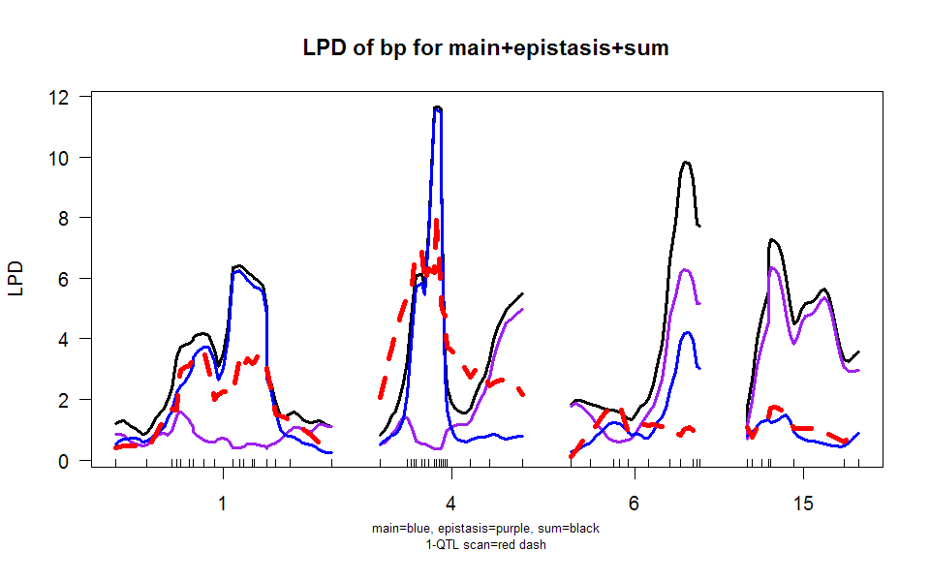
hyper data: scanone

Slide 80
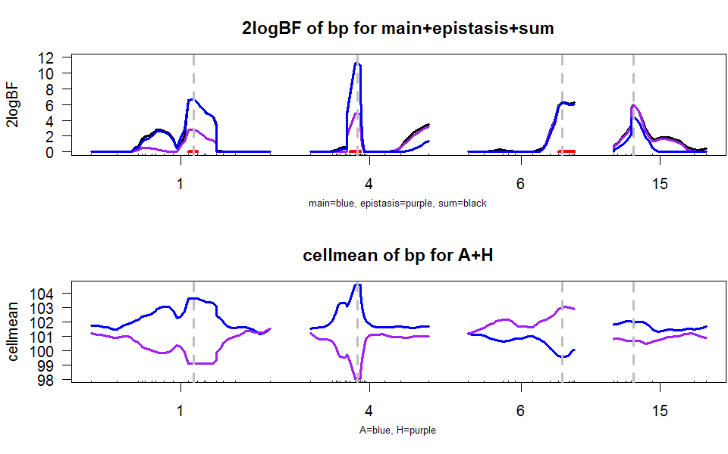
2log(BF) scan with 50% HPD region

Slide 81
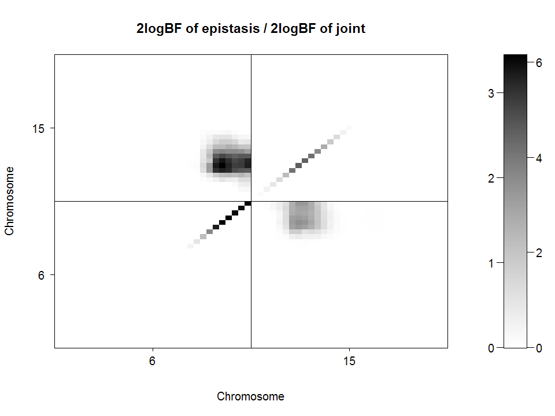
2-D plot of 2logBF: chr 6 & 15

Slide 82
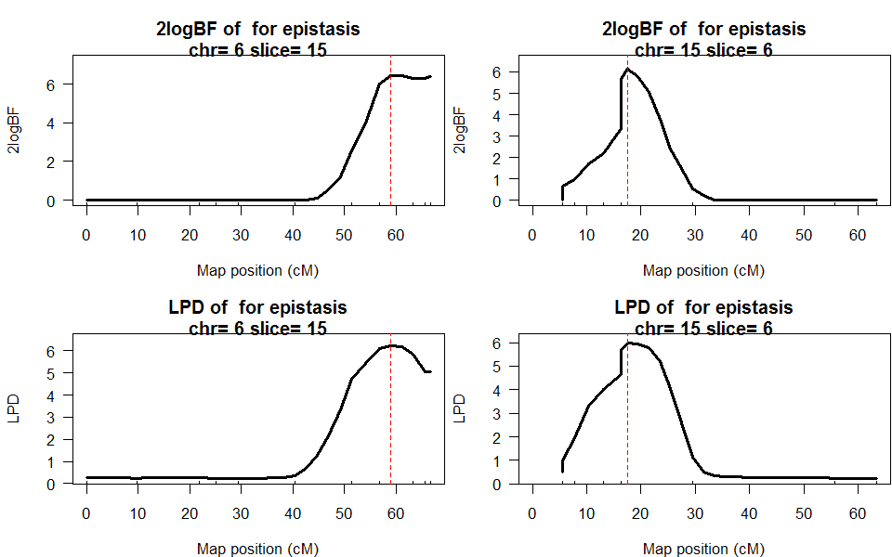
1-D Slices of 2-D scans: chr 6 & 15

Slide 83
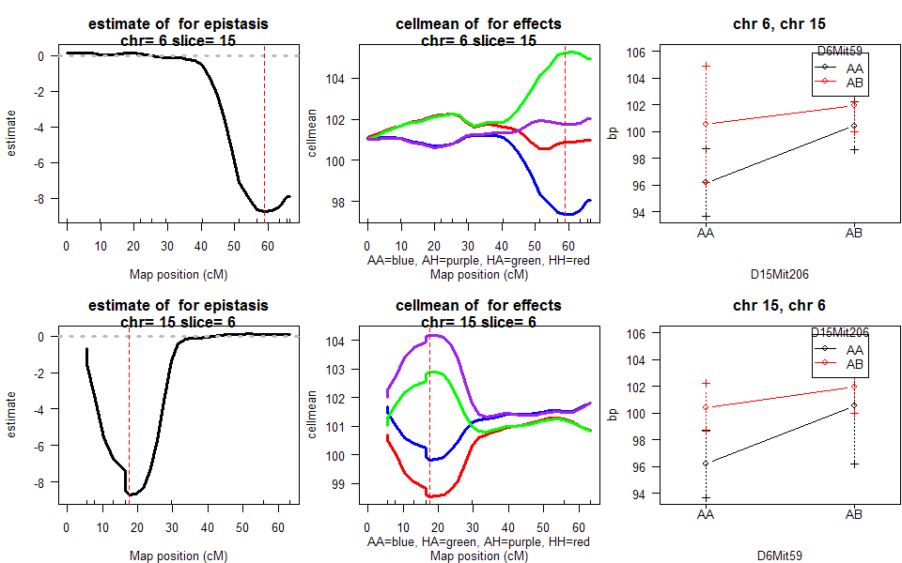
1-D Slices of 2-D scans: chr 6 & 15

Slide 84
What is best genetic architecture?
How many QTL?
What is pattern across chromosomes?
examine posterior relative to prior
  prior determined ahead of time
  posterior estimated by histogram/bar chart
  Bayes factor ratio = pr(model|data) / pr(model)

Slide 85
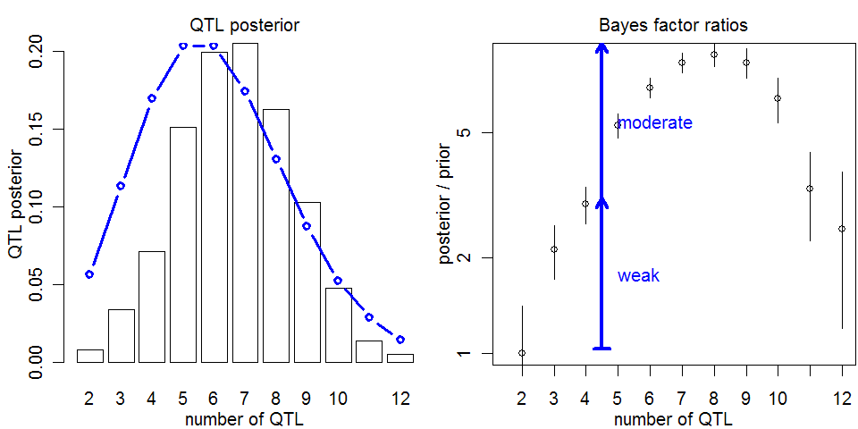
How many QTL? posterior, prior, Bayes factor ratios
prior
strength
of evidence
MCMC
error

Slide 86
most probable patterns
nqtl posterior prior bf bfse
1,4,6,15,6:15 5 0.03400 2.71e-05 24.30 2.360
1,4,6,6,15,6:15 6 0.00467 5.22e-06 17.40 4.630
1,1,4,6,15,6:15 6 0.00600 9.05e-06 12.80 3.020
1,1,4,5,6,15,6:15 7 0.00267 4.11e-06 12.60 4.450
1,4,6,15,15,6:15 6 0.00300 4.96e-06 11.70 3.910
1,4,4,6,15,6:15 6 0.00300 5.81e-06 10.00 3.330
1,2,4,6,15,6:15 6 0.00767 1.54e-05 9.66 2.010
1,4,5,6,15,6:15 6 0.00500 1.28e-05 7.56 1.950
1,2,4,5,6,15,6:15 7 0.00267 6.98e-06 7.41 2.620
1,4 2 0.01430 1.51e-04 1.84 0.279
1,1,2,4 4 0.00300 3.66e-05 1.59 0.529
1,2,4 3 0.00733 1.03e-04 1.38 0.294
1,1,4 3 0.00400 6.05e-05 1.28 0.370
1,4,19 3 0.00300 5.82e-05 1.00 0.333

Slide 87
what is best estimate of QTL?
find most probable pattern
  1,4,6,15,6:15 has posterior of 3.4%
estimate locus across all nested patterns
  Exact pattern seen ~100/3000 samples
  Nested pattern seen ~2000/3000 samples
estimate 95% confidence interval using quantiles
chrom locus locus.LCL locus.UCL n.qtl
247 1 69.9 24.44875 95.7985 0.8026667
245 4 29.5 14.20000 74.3000 0.8800000
248 6 59.0 13.83333 66.7000 0.7096667
246 15 19.5 13.10000 55.7000 0.8450000

Slide 88
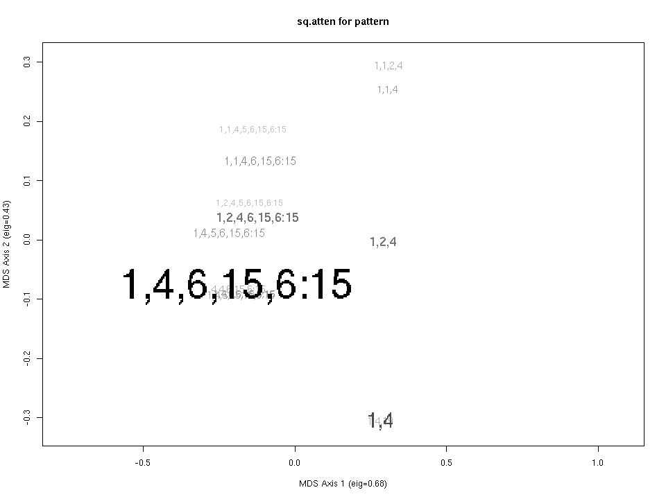
how close are other patterns?
size & shade ~ posterior
distance between patterns
  sum of squared attenuation
  match loci between patterns
  squared attenuation = (1-2r)²
  sq.atten in scale of LOD & LPD
multidimensional scaling
  MDS projects distance onto 2-D
  think mileage between cities

Slide 89
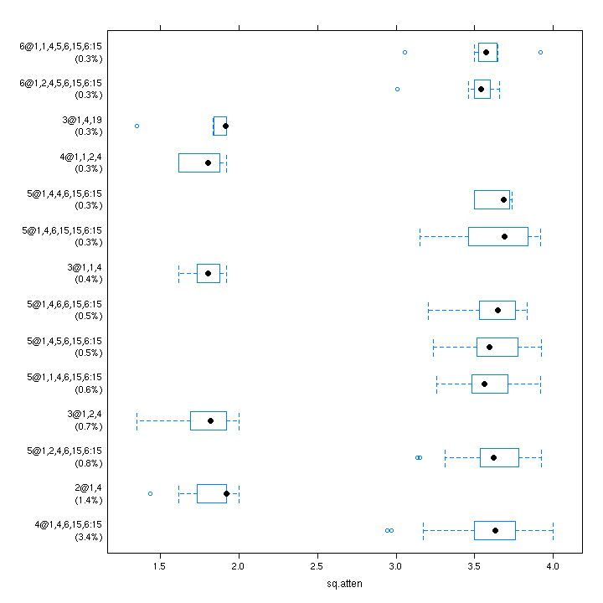
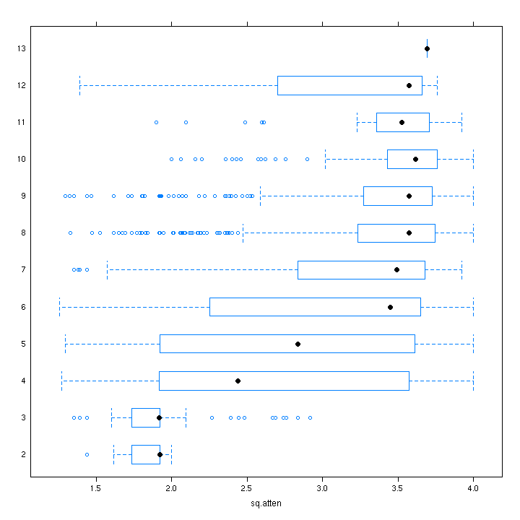
how close are other patterns?

Slide 90
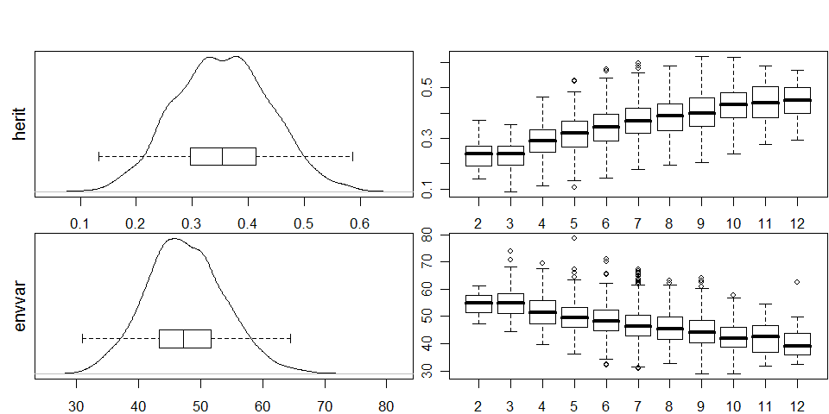
diagnostic summaries

Slide 91
7. Software for Bayesian QTLs
R/qtlbim
publication
  CRAN release Fall 2006
  Yandell et al. (2007 Bioinformatics)
properties
  cross-compatible with R/qtl
  epistasis, fixed & random covariates, GxE
  extensive graphics

Slide 92
R/qtlbim: software history
Bayesian module within WinQTLCart
  WinQTLCart output can be processed using R/bim
Software history
  initially designed (Satagopan Yandell 1996)
  major revision and extension (Gaffney 2001)
  R/bim to CRAN (Wu, Gaffney, Jin, Yandell 2003)
  R/qtlbim total rewrite (Yandell et al. 2007)

Slide 93
other Bayesian software for QTLs
R/bim*: Bayesian Interval Mapping
  Satagopan Yandell (1996; Gaffney 2001) CRAN
  no epistasis; reversible jump MCMC algorithm
  version available within WinQTLCart (statgen.ncsu.edu/qtlcart)
R/qtl*
  Broman et al. (2003 Bioinformatics) CRAN
  multiple imputation algorithm for 1, 2 QTL scans & limited mult-QTL fits
Bayesian QTL / Multimapper
  Sillanpää Arjas (1998 Genetics) www.rni.helsinki.fi/~mjs
  no epistasis; introduced posterior intensity for QTLs
(no released code)
  Stephens & Fisch (1998 Biometrics)
  no epistasis
R/bqtl
  C Berry (1998 TR) CRAN
  no epistasis, Haley Knott approximation
* Jackson Labs (Hao Wu, Randy von Smith) provided crucial technical support

Slide 94
many thanks
Karl Broman
Jackson Labs
Gary Churchill
Hao Wu
Randy von Smith
U AL Birmingham
David Allison
Nengjun Yi
Tapan Mehta
Samprit Banerjee
Ram Venkataraman
Daniel Shriner
Tom Osborn
David Butruille
Marcio Ferrera
Josh Udahl
Pablo Quijada
Alan Attie
Jonathan Stoehr
Hong Lan
Susie Clee
Jessica Byers
Mark Keller
Michael Newton
Hyuna Yang
Daniel Sorensen
Daniel Gianola
Liang Li
my students
Jaya Satagopan
Fei Zou
Patrick Gaffney
Chunfang Jin
Elias Chaibub
W Whipple Neely
Jee Young Moon
USDA Hatch, NIH/NIDDK (Attie), NIH/R01 (Yi, Broman)

