Slide 1
data @ uw brian.yandell@wisc.edu
team research aims
learning objectives
technology
& tools
wide data

Slide 2
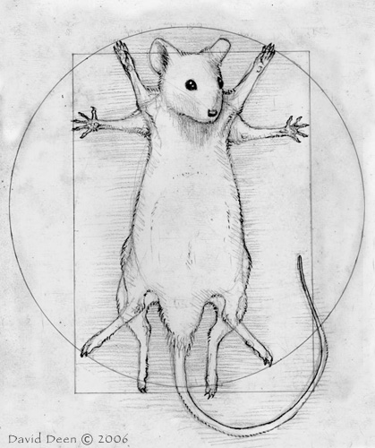
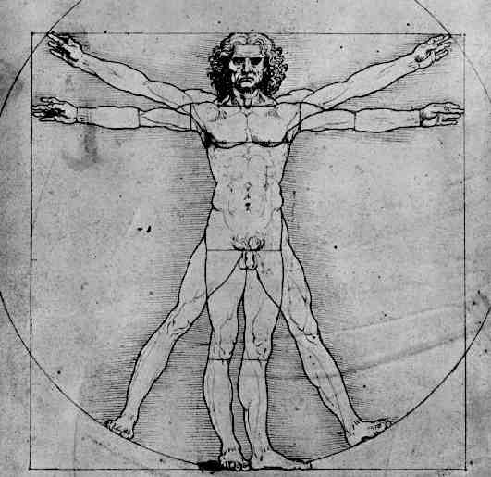
team research aims
mouse
genome scan
zoom in
sample
workflow
compare
allele scan
DNA contrast
extract
features
human

Slide 3
tools workflow
domain
community
developer
community
web / app
view
python/flask
web framework
CL access
GNapi
connects
tools
GN
runs tools
R/intermediate
ONL Beacon
cores
Guix
manages packages
R/qtl2
JAX
cluster cores
UW
CHCT
cores
julia/Sen
UW
data
UT
data
JAX
data

Slide 4
qtl2 tasks
develop GNapi (Prins, Broman, Sen)
  data extraction tools created
  data upload, workflow tools needed
redesign qtl2 packages to use GNapi (Broman, Yandell)
  data extraction, upload, etc.
  CC and DO mouse SQL information
  doqtl2 pipeline
develop auxiliary qtl2 packages (Broman, Yandell)
  qtl2ggplot, qtl2shiny, qtl2feature
  qtl2d3plot
rethink qtl2 data architecture (Broman, Yandell, Sen)
  small master data object
  data source indirection
  rethink genotype probability object?

Slide 5
learning objectives
training next generation of young scientists
  scalable integrative models
  disease risk and treatment
develop digital learning modules
  blended / flipped learning environments
  data & software carpentry
  gateway to intermediate to advanced skills
  reproducible research in teams

