Slide 1
Expression Modules
Brian S. Yandell (with slides from Steve Horvath, UCLA, and
Mark Keller, UW-Madison)

Slide 2
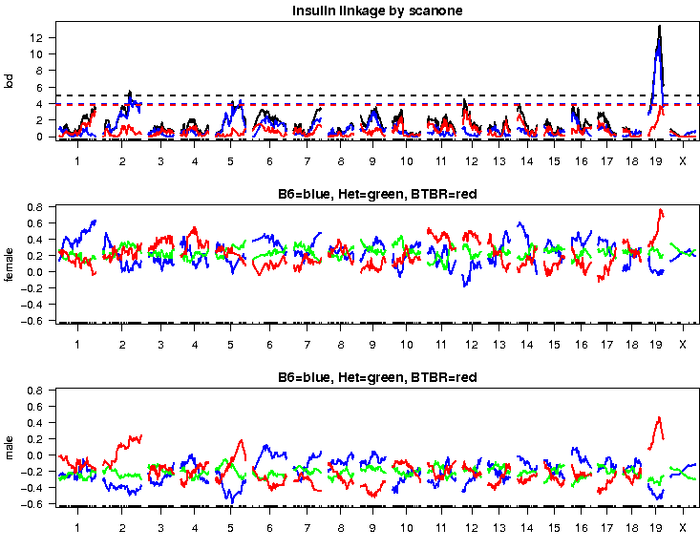
Weighted models for insulin
Detected by scanone
# transcripts that match
weighted insulin model
in each of 4 tissues:
tissue | # transcripts
Islet | 1984
Adipose | 605
Liver | 485
Gastroc | 404
Detected by Ping’s multiQTL model

Slide 3
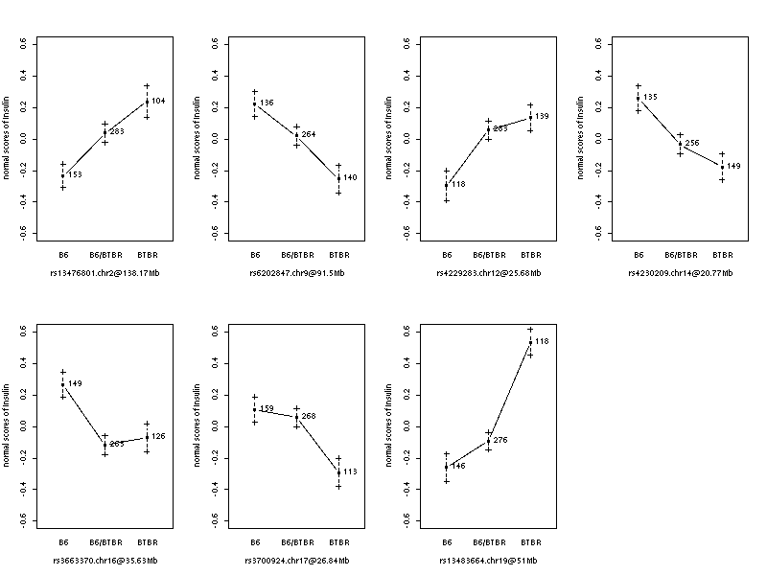
insulin main effects
Ping Wang
Chr 2
Chr 9
Chr 12
Chr 14
Chr 16
Chr 17
Chr 19
How many islet
transcripts show
this same genetic
dependence at
these loci?

Slide 4
Expression Networks
Zhang & Horvath (2005) www.genetics.ucla/edu/labs/horvath/CoexpressionNetwork
organize expression traits using correlation
adjacency
connectivity
topological
overlap

Slide 5
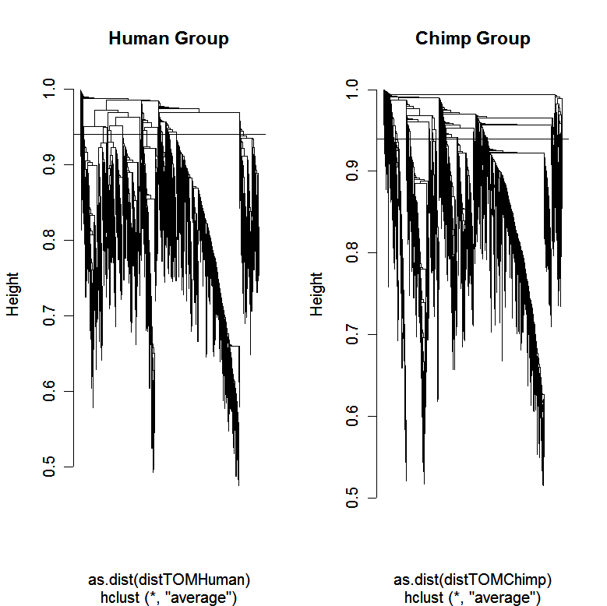
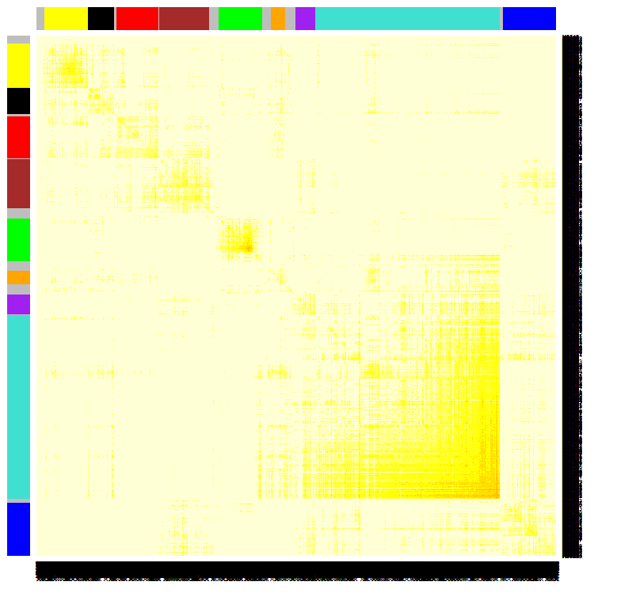
Using the topological overlap matrix (TOM) to cluster genes
  modules correspond to branches of the dendrogram
TOM plot
Genes correspond to rows and columns
TOM matrix
Hierarchical
clustering
dendrogram
Module:
Correspond
to branches

Slide 6
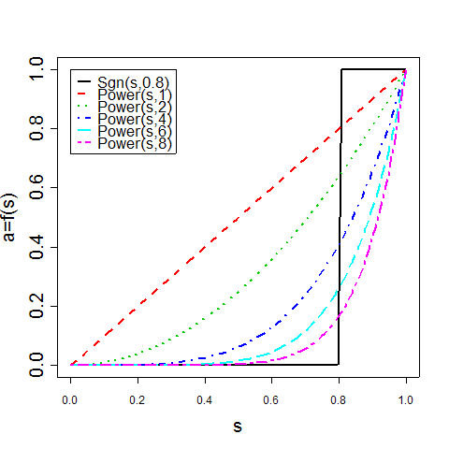
module traits highly correlated
adjacency attenuates correlation
can separate positive, negative correlation
summarize module
  eigengene
  weighted average of traits
relate module
  to clinical traits
  map eigengene
www.genetics.ucla/edu/labs/horvath/CoexpressionNetwork

Slide 7
advantages of Horvath modules
emphasize modules (pathways) instead of individual genes
  Greatly alleviates the problem of multiple comparisons
  ~20 module comparisons versus 1000s of gene comparisons
intramodular connectivity k_{i} finds key drivers (hub genes)
  quantifies module membership (centrality)
  highly connected genes have an increased chance of validation
module definition is based on gene expression data
  no prior pathway information is used for module definition
  two modules (eigengenes) can be highly correlated
unified approach for relating variables
  compare data sets on same mathematical footing
scale-free: zoom in and see similar structure

Slide 8
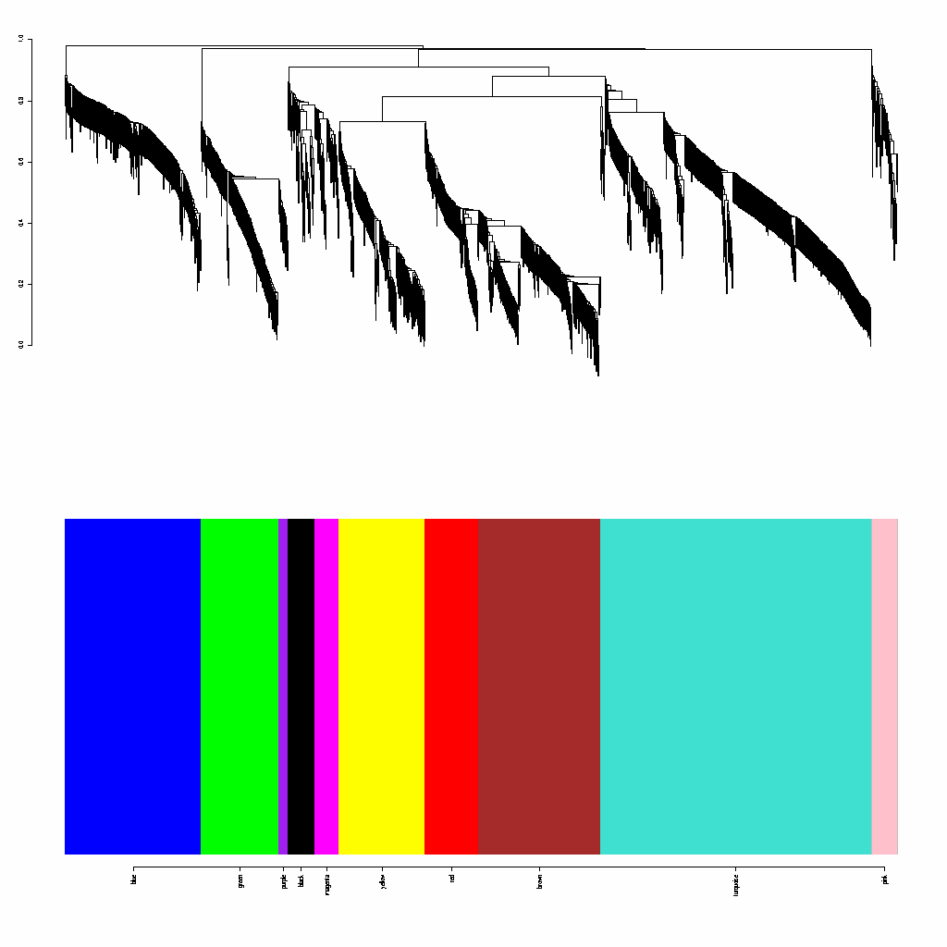
modules for 1984 transcripts with similar genetic architecture as insulin
Ping Wang
contains the insulin trait

Slide 9
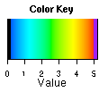
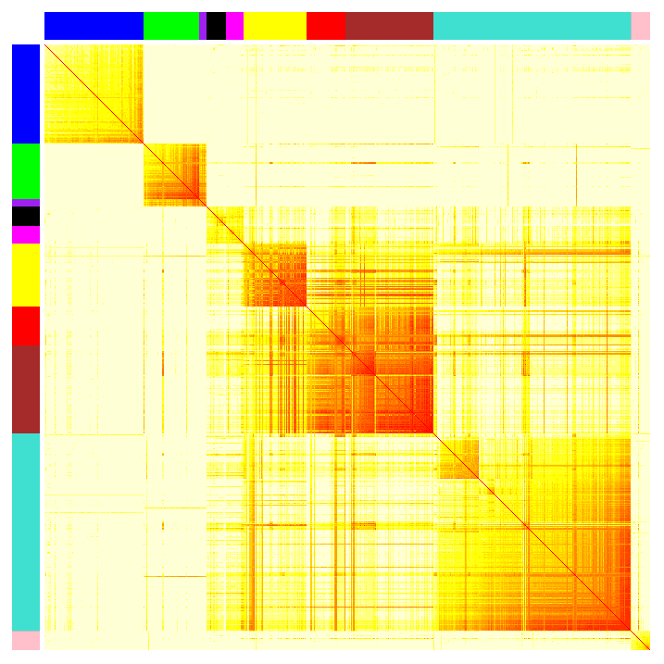
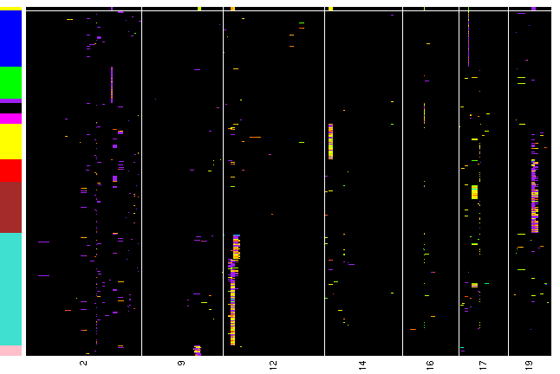
Islet – modules
17
2
16
14
19
12
9
chromosomes
Insulin trait

Slide 10
Islet – enrichment for modules
Module | Pvalue | Qvalue | Count | Size | Term
BLUE | 0.0005 | 0.0463 | 30 | 1068 | biosynthetic process
 | 0.0006 | 0.0470 | 18 | 511 | cellular lipid metabolic process
 | 0.0009 | 0.0507 | 11 | 241 | lipid biosynthetic process
 | 0.0012 | 0.0593 | 19 | 590 | lipid metabolic process
GREEN | 0.0008 | 0.0457 | 4 | 76 | phosphate transport
 | 0.0055 | 0.0970 | 2 | 20 | intermediate filament-based process
 | 0.0056 | 0.0970 | 10 | 707 | ion transport
PURPLE | 0.0011 | 0.0165 | 7 | 2769 | nucleobase, nucleoside, nucleotide and nucleic acid metabolic process
BLACK | 0.0078 | 0.0138 | 2 | 68 | sensory perception of sound
MAGENTA | 2.54E-05 | 0.0011 | 7 | 313 | cell cycle process
 | 0.0001 | 0.0040 | 5 | 179 | microtubule-based process
 | 0.0004 | 0.0040 | 5 | 225 | mitotic cell cycle
 | 0.0005 | 0.0040 | 5 | 228 | M phase
 | 0.0006 | 0.0040 | 5 | 239 | cell division
 | 0.0009 | 0.0041 | 5 | 266 | cell cycle phase
 | 0.0011 | 0.0041 | 4 | 162 | mitosis
 | 0.0012 | 0.0041 | 4 | 163 | M phase of mitotic cell cycle
YELLOW | 0.0026 | 0.0675 | 7 | 281 | cell projection organization and biogenesis
 | 0.0026 | 0.0675 | 7 | 281 | cell part morphogenesis
 | 0.0026 | 0.0675 | 7 | 281 | cell projection morphogenesis
RED | 0.0017 | 0.0619 | 2 | 13 | steroid hormone receptor signaling pathway
 | 0.0026 | 0.0619 | 5 | 200 | reproductive process
BROWN | 0.0057 | 0.1442 | 4 | 96 | response to pheromone
TURQUOISE | 0.0002 | 0.0830 | 17 | 279 | enzyme linked receptor protein signaling pathway
 | 0.0003 | 0.0830 | 10 | 115 | morphogenesis of an epithelium
 | 0.0003 | 0.0830 | 7 | 57 | morphogenesis of embryonic epithelium
 | 0.0004 | 0.0830 | 40 | 1021 | anatomical structure morphogenesis
PINK | 0.0004 | 0.0608 | 2 | 14 | vesicle organization and biogenesis
 | 0.0092 | 0.0612 | 4 | 384 | regulation of apoptosis
Insulin
chromosomes

Slide 11
www.geneontology.org
ontologies
  Cellular component (GOCC)
  Biological process (GOBP)
  Molecular function (GOMF)
hierarchy of classification
  general to specific
  based on extensive literature search, predictions
prone to errors, historical inaccuracies

Slide 12
Bayesian causal phenotype network incorporating genetic variation and biological knowledge
Brian S Yandell, Jee Young Moon
University of Wisconsin-Madison
Elias Chaibub Neto, Sage Bionetworks
Xinwei Deng, VA Tech

Slide 13
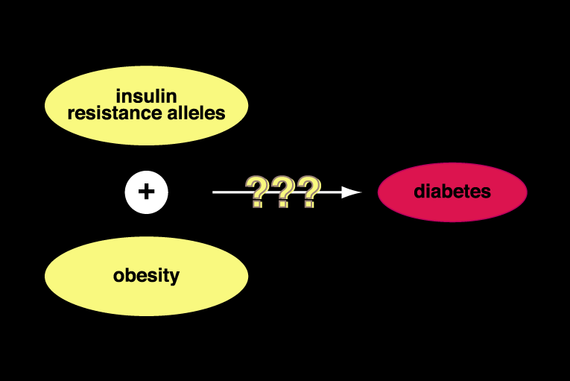
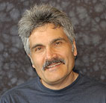
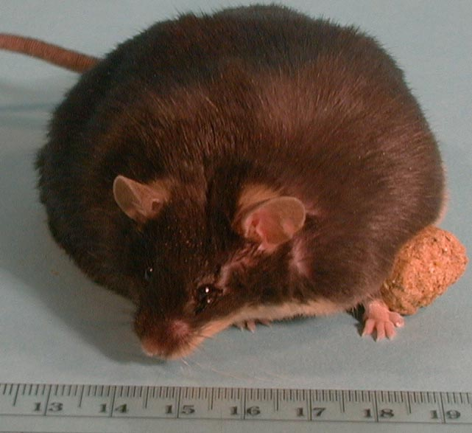
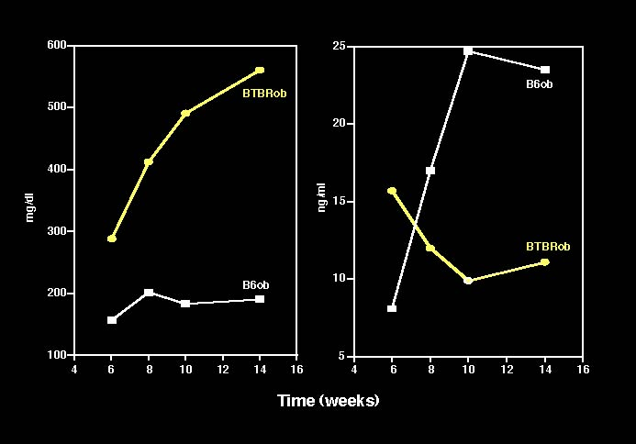
BTBR mouse is
insulin resistant
B6 is not
make both obese…
Alan Attie
Biochemistry
glucose
insulin
(courtesy AD Attie)‏

Slide 14
bigger picture
how do DNA, RNA, proteins, metabolites regulate each other?
regulatory networks from microarray expression data
  time series measurements or transcriptional perturbations
  segregating population: genotype as driving perturbations
goal: discover causal regulatory relationships among phenotypes
use knowledge of regulatory relationships from databases
  how can this improve causal network reconstruction?

Slide 15
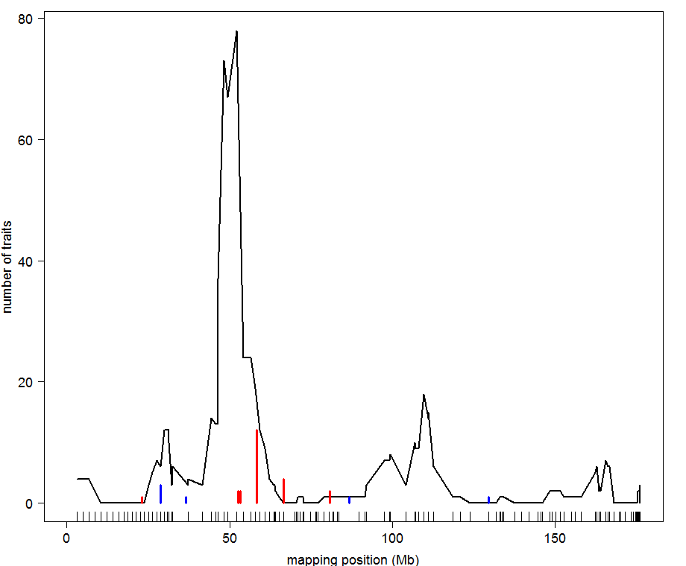
BxH ApoE-/- chr 2: hotspot
x% threshold
on number of traits
DNA→local gene→distant genes
Data: Ghazalpour et al.(2006) PLoS Genetics

Slide 16
causal model selection choices in context of larger, unknown network
focal trait
target trait
causal
focal trait
target trait
reactive
focal trait
target trait
correlated
focal trait
target trait
uncorrelated

Slide 17
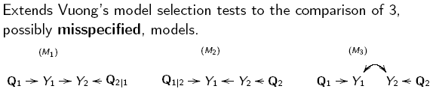
causal architecture references
BIC: Schadt et al. (2005) Nature Genet
CIT: Millstein et al. (2009) BMC Genet
Aten et al. Horvath (2008) BMC Sys Bio
CMST: Chaibub Neto et al. (2010) PhD thesis
  Chaibub Neto et al. (2012) Genetics (in review)

Slide 18
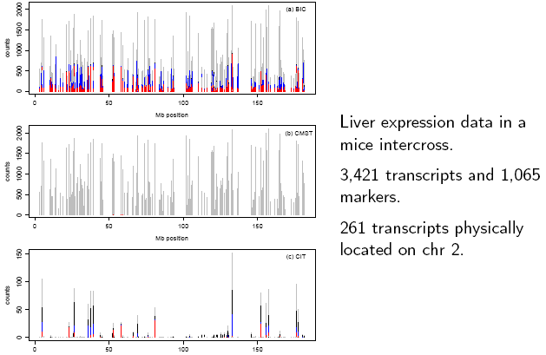
BxH ApoE-/- study
Ghazalpour et al. (2008)
PLoS Genetics

Slide 19
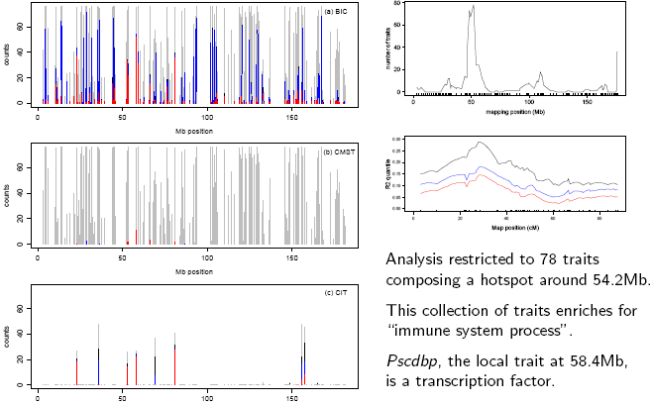

Slide 20
QTL-driven directed graphs
given genetic architecture (QTLs), what causal network structure is supported by data?
R/qdg available at www.github.org/byandell
references
  Chaibub Neto, Ferrara, Attie, Yandell (2008) Inferring causal phenotype networks from segregating populations. Genetics 179: 1089-1100. [doi:genetics.107.085167]
  Ferrara et al. Attie (2008) Genetic networks of liver metabolism revealed by integration of metabolic and transcriptomic profiling. PLoS Genet 4: e1000034. [doi:10.1371/journal.pgen.1000034]

Slide 21
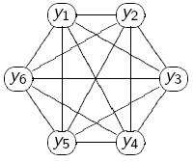
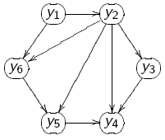
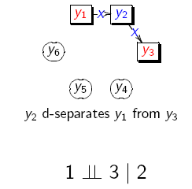
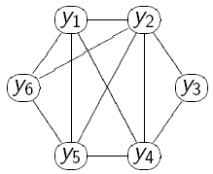
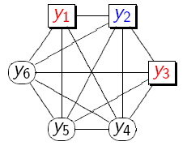
partial correlation (PC) skeleton
correlations
true graph
1st order partial correlations
drop edge

Slide 22
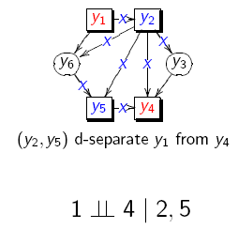
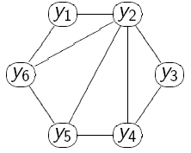
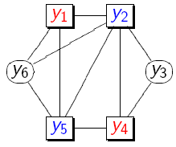
partial correlation (PC) skeleton
true graph
1st order partial correlations
2nd order partial correlations
drop edge

Slide 23
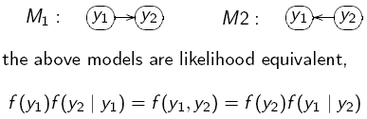
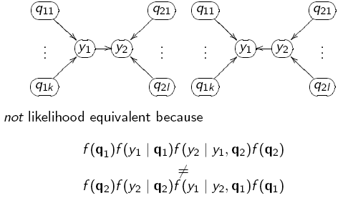
edge direction: which is causal?
due to QTL

Slide 24

test edge direction using LOD score

Slide 25
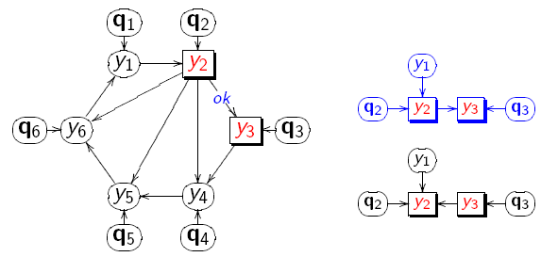
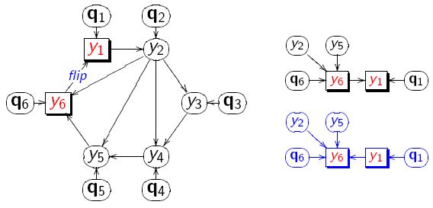
reverse edges
using QTLs
true graph

Slide 26
causal graphical models in systems genetics
What if genetic architecture and causal network are unknown? jointly infer both using iteration
Chaibub Neto, Keller, Attie, Yandell (2010) Causal Graphical Models in Systems Genetics: a unified framework for joint inference of causal network and genetic architecture for correlated phenotypes. Ann Appl Statist 4: 320-339. [doi:10.1214/09-AOAS288]
R/qtlnet available from www.github.org/byandell
Related references
  Schadt et al. Lusis (2005 Nat Genet); Li et al. Churchill (2006 Genetics); Chen Emmert-Streib Storey(2007 Genome Bio); Liu de la Fuente Hoeschele (2008 Genetics); Winrow et al. Turek (2009 PLoS ONE); Hageman et al. Churchill (2011 Genetics)

Slide 27
Basic idea of QTLnet
iterate between finding QTL and network
genetic architecture given causal network
  trait y depends on parents pa(y) in network
  QTL for y found conditional on pa(y)
    Parents pa(y) are interacting covariates for QTL scan
causal network given genetic architecture
  build (adjust) causal network given QTL
  each direction change may alter neighbor edges

Slide 28
missing data method: MCMC
known phenotypes Y, genotypes Q
unknown graph G
want to study Pr(Y | G, Q)
break down in terms of individual edges
  Pr(Y|G,Q) = sum of Pr(Y_{i} | pa(Y_{i}), Q)
sample new values for individual edges
  given current value of all other edges
repeat many times and average results

Slide 29
MCMC steps for QTLnet
propose new causal network G
  with simple changes to current network:
  change edge direction
  add or drop edge
find any new genetic architectures Q
  update phenotypes when parents pa(y) change in new G
compute likelihood for new network and QTL
  Pr(Y | G, Q)
accept or reject new network and QTL
  usual Metropolis-Hastings idea

Slide 30
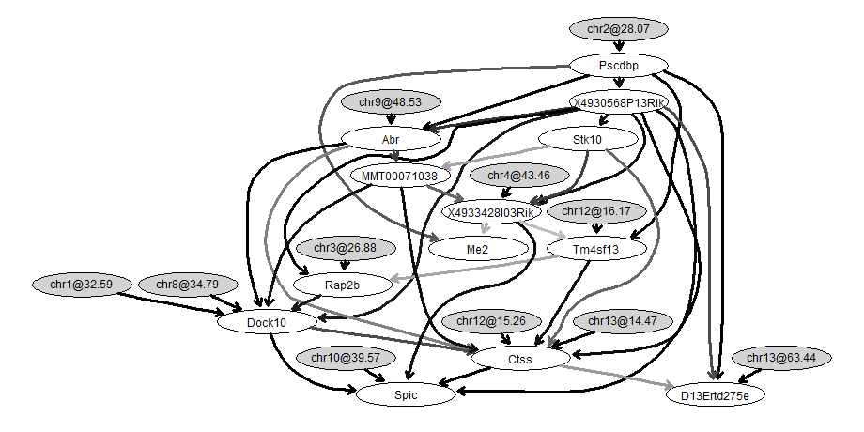
BxH ApoE-/- causal network for transcription factor Pscdbp
causal trait
work of
Elias Chaibub Neto
Data: Ghazalpour et al.(2006) PLoS Genetics

Slide 31
scaling up to larger networks
reduce complexity of graphs
  use prior knowledge to constrain valid edges
  restrict number of causal edges into each node
make task parallel: run on many machines
  pre-compute conditional probabilities
  run multiple parallel Markov chains
rethink approach
  LASSO, sparse PLS, other optimization methods

Slide 32
graph complexity with node parents
pa1
pa1
pa2
pa3
node
node
of1
of2
of3
of1
of2
of3

Slide 33
parallel phases for larger projects
Phase 1: identify parents
Phase 2: compute BICs
BIC = LOD – penalty
all possible parents to all nodes
Phase 3: store BICs
Phase 4: run Markov chains
Phase 5: combine results
1
…
2.1
2.2
2.b
3
…
4.m
4.1
4.2
5

Slide 34
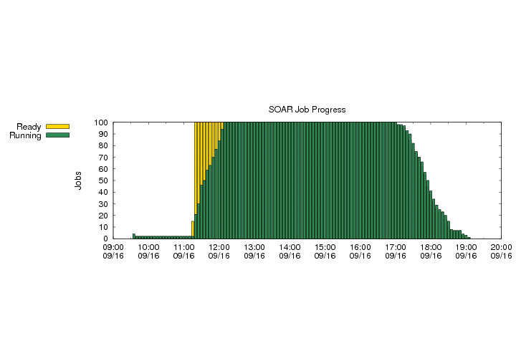
parallel implementation
R/qtlnet available at www.github.org/byandell
Condor cluster: chtc.cs.wisc.edu
  System Of Automated Runs (SOAR)
    ~2000 cores in pool shared by many scientists
    automated run of new jobs placed in project
Phase 2
Phase 4

Slide 35
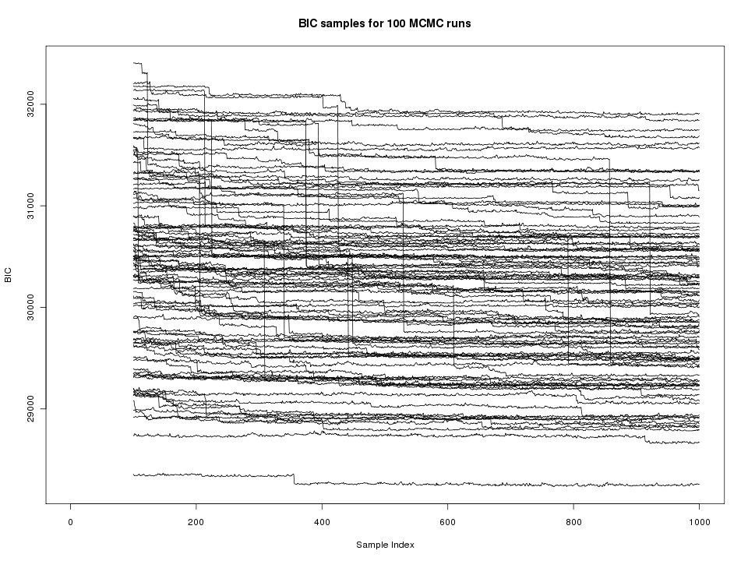
single edge updates
burnin
100,000 runs

Slide 36
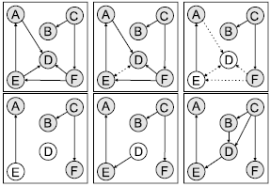
neighborhood edge reversal
select edge
drop edge
identify parents
orphan nodes
reverse edge
find new parents
Grzegorczyk M. and Husmeier D. (2008) Machine Learning 71 (2-3), 265-305.

Slide 37
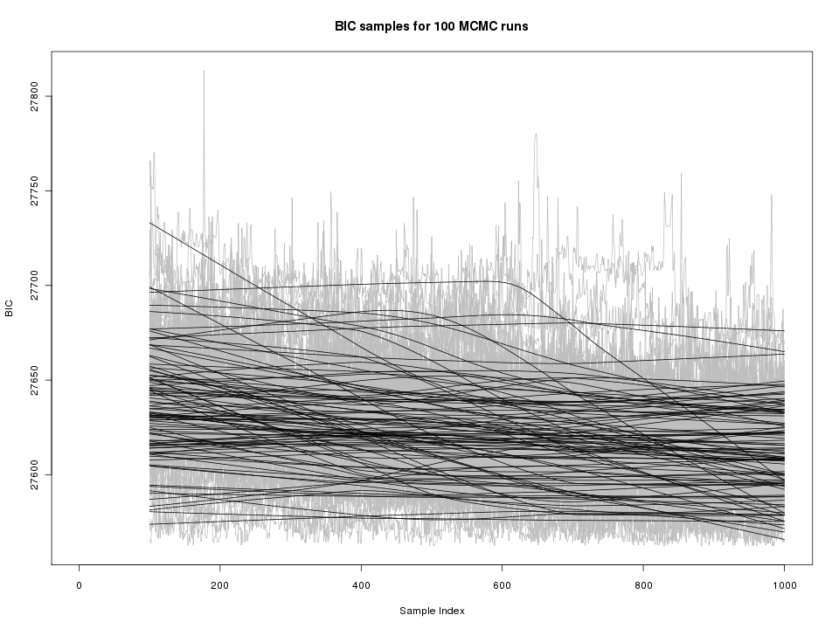
neighborhood for reversals only
burnin
100,000 runs

Slide 38
how to use functional information?
functional grouping from prior studies
  may or may not indicate direction
  gene ontology (GO), KEGG
  knockout (KO) panels
  protein-protein interaction (PPI) database
  transcription factor (TF) database
methods using only this information
priors for QTL-driven causal networks
  more weight to local (cis) QTLs?

Slide 39
modeling biological knowledge
infer graph G_{Y} from biological knowledge B
  Pr(G_{Y} | B, W) = exp( – W * |B–G_{Y}|) / constant
  B = prob of edge given TF, PPI, KO database
    derived using previous experiments, papers, etc.
  G_{Y} = 0-1 matrix for graph with directed edges
W = inferred weight of biological knowledge
  W=0: no influence; W large: assumed correct
  P(W|B) = φ exp(- φ W) exponential
Werhli and Husmeier (2007) J Bioinfo Comput Biol

Slide 40
combining eQTL and bio knowledge
probability for graph G and bio-weights W
  given phenotypes Y, genotypes Q, bio info B
Pr(G, W | Y, Q, B) = c Pr(Y|G,Q)Pr(G|B,W,Q)Pr(W|B)
  Pr(Y|G,Q) is genetic architecture (QTLs)
    using parent nodes of each trait as covariates
  Pr(G|B,W,Q) = Pr(G_{Y}|B,W) Pr(G_{Q→Y}|Q)
    Pr(G_{Y}|B,W) relates graph to biological info
    Pr(G_{Q→Y}|Q) relates genotype to phenotype
Moon JY, Chaibub Neto E, Deng X, Yandell BS (2011) Growing graphical models to infer causal phenotype networks. In Probabilistic Graphical Models Dedicated to Applications in Genetics. Sinoquet C, Mourad R, eds. (in review)

Slide 41
encoding biological knowledge B transcription factors, DNA binding (causation)
p = p-value for TF binding of i→j
truncated exponential (λ) when TF i→j
uniform if no detection relationship
Bernard, Hartemink (2005) Pac Symp Biocomp

Slide 42
encoding biological knowledge B protein-protein interaction (association)
post odds = prior odds * LR
use positive and negative gold standards
Jansen et al. (2003) Science

Slide 43
encoding biological knowledge B gene ontology(association)
GO = molecular function, processes of gene
sim = maximum information content across common parents of pair of genes
Lord et al. (2003) Bioinformatics

Slide 44
MCMC with pathway information
sample new network G from proposal R(G*|G)
  add or drop edges; switch causal direction
sample QTLs Q from proposal R(Q*|Q,Y)
  e.g. Bayesian QTL mapping given pa(Y)
accept new network (G*,Q*) with probability
A = min(1, f(G,Q|G*,Q*)/ f(G*,Q*|G,Q))
  f(G,Q|G*,Q*) = Pr(Y|G*,Q*)Pr(G*|B,W,Q*)/R(G*|G)R(Q*|Q,Y)
sample W from proposal R(W*|W)
accept new weight W* with probability …

Slide 45
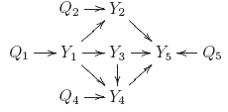
ROC curve simulation open =
QTLnet closed = phenotypes only

Slide 46
integrated ROC curve
2x2: genetics pathways probability classifier ranks true > false edges
= accuracy of B

Slide 47
weight on biological knowledge
incorrect
non-informative
correct

Slide 48
yeast data—partial success
26 genes
36 inferred edges
dashed: indirect (2)
starred: direct (3)
missed (39)
reversed (0)
Data: Brem, Kruglyak (2005) PNAS

Slide 49
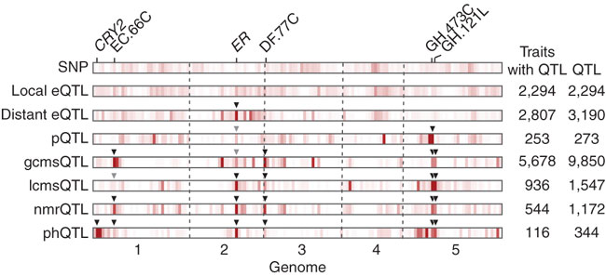
phenotypic buffering of molecular QTL
Fu et al. Jansen (2009 Nature Genetics)

Slide 50
limits of causal inference
Computing costs already discussed
Noisy data leads to false positive causal calls
  Unfaithfulness assumption violated
  Depends on sample size and omic technology
  And on graph complexity (d = maximal path length i→j)
  Profound limits
Uhler C, Raskutti G, Buhlmann P, Yu B (2012 in prep) Geometry of faithfulness assumption in causal inference.
Yang Li, Bruno M. Tesson, Gary A. Churchill, Ritsert C. Jansen (2010) Critical reasoning on causal inference in genome-wide linkage and association studies. Trends in Genetics 26: 493-498.

Slide 51
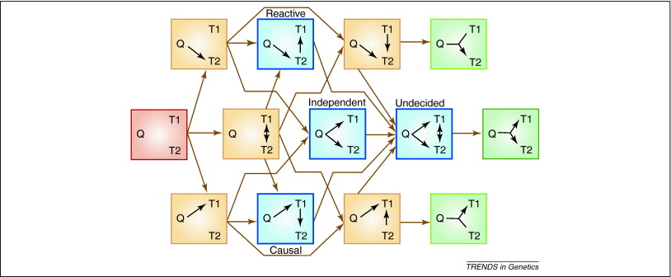
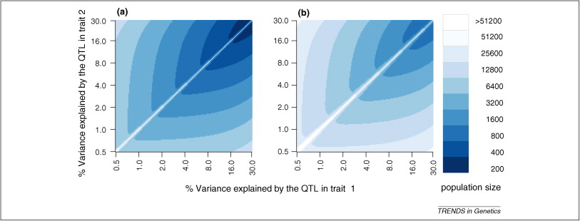
sizes for reliable causal inference genome wide linkage & association
Li, Tesson, Churchill, Jansen (2010) Trends in Genetics

Slide 52
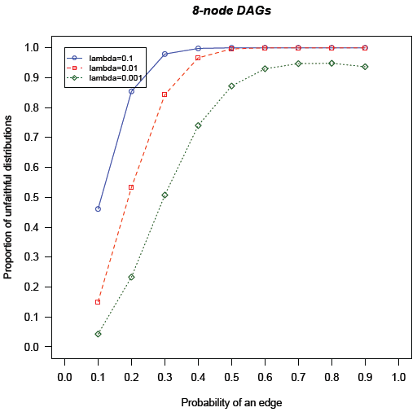
limits of causal inference unfaithful: false positive edges λ =min|cor(Y_{i},Y_{j})| λ=c•sqrt(dp/n) d=max degree p=# nodes n=sample size
Uhler, Raskutti, Buhlmann, Yu (2012 in prep)

Slide 53
Thanks!
Grant support
  NIH/NIDDK 58037, 66369
  NIH/NIGMS 74244, 69430
  NCI/ICBP U54-CA149237
  NIH/R01MH090948
Collaborators on papers and ideas
  Alan Attie & Mark Keller, Biochemistry
  Karl Broman, Aimee Broman, Christina Kendziorski

