Slide 1
Breaking Up is Hard to Do: Migrating R Project to CHTC
Brian S. Yandell
UW-Madison
22 November 2013

Slide 2
Topics in this talk
science
Fisher permutation on correlated tests & traits
DAG causal tests using genetics
mechanics of scaling up calculations
rewrite R for parallel steps
organize shell scripts to schedule jobs
process results

Slide 3
••• hotspots •••

Slide 4
hotspot permutation test (Breitling et al. Jansen 2008 PLoS Genetics)
for original dataset and each permuted set:
set single trait LOD threshold T
use Churchill-Doerge (1994) permutations
count number of traits (N) with LOD above T
count for every locus (marker or pseudomarker)
smooth counts if markers are dense
find count with at most 5% of permuted sets above (critical value) as count threshold
conclude original counts above threshold are real

Slide 5
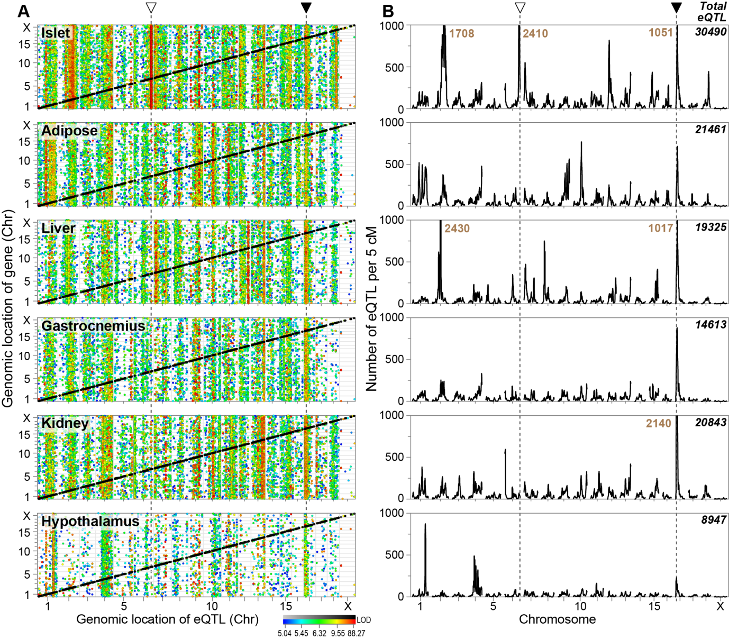
Genetic architecture of gene expression in 6 tissues.
A Tissue-specific panels illustrate the relationship between the genomic location of a gene (y-axis) to where that gene’s mRNA shows an eQTL (LOD > 5), as a function of genome position (x-axis). Circles represent eQTLs that showed either cis-linkage (black) or trans-linkage (colored) according to LOD score. Genomic hot spots, where many eQTLs map in trans, are apparent as vertical bands that show either tissue selectivity (e.g., Chr 6 in the islet, ) or are present in all tissues (e.g., Chr 17, ). B The total number of eQTLs identified in 5 cM genomic windows is plotted for each tissue; total eQTLs for all positions is shown in upper right corner for each panel. The peak number of eQTLs exceeding 1000 per 5 cM is shown for islets (Chrs 2, 6 and 17), liver (Chrs 2 and 17) and kidney (Chr 17).

Slide 6
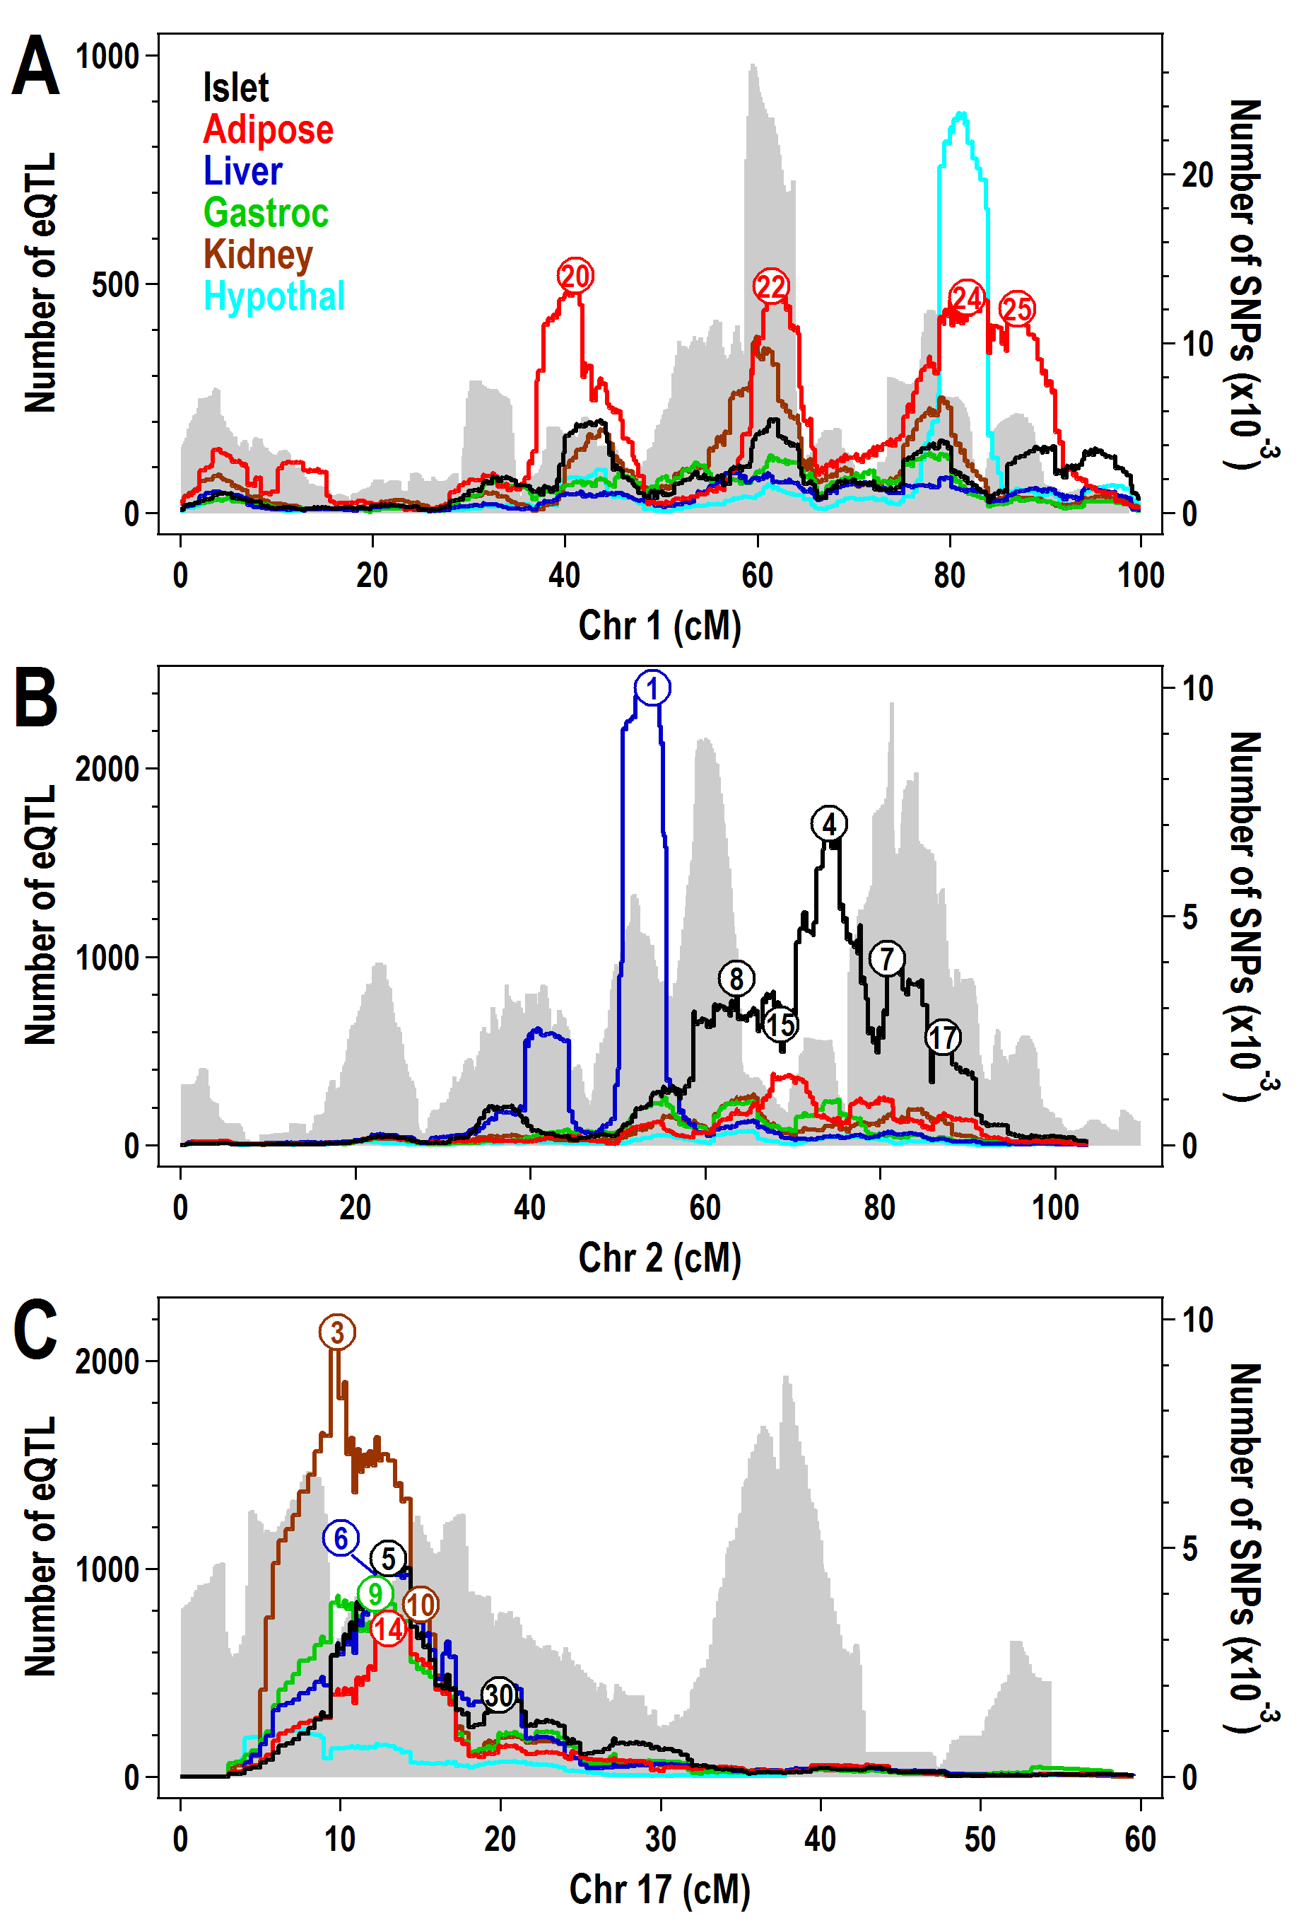
Tissue-specific hotspots with eQTL and SNP architecture
Are these hotspots real?

Slide 7
Single trait permutation threshold T Churchill Doerge (1994)
Null distribution of max LOD
Permute single trait separate from genotype
Find max LOD over genome
Repeat 1000 times
Find 95% permutation threshold T
Identify interested peaks above T in data
Controls genome-wide error rate (GWER)
Chance of detecting at least on peak above T

Slide 8
Single trait permutation schema
genotypes
phenotype
LOD over genome
max LOD
1. shuffle phenotypes to break QTL
2. repeat 1000 times and summarize

Slide 9
Hotspot count threshold N(T) Breitling et al. Jansen (2008)
Null distribution of max count above T
Find single-trait 95% LOD threshold T
Find max count of traits with LODs above T
Repeat 1000 times
Find 95% count permutation threshold N
Identify counts of LODs above T in data
Locus-specific counts identify hotspots
Controls GWER in some way

Slide 10
Hotspot permutation schema
LOD at each locus
for each phenotype
over genome
genotypes
phenotypes
count LODs at locus
over threshold T
max count N over genome
1. shuffle phenotypes by row to break QTL, keep correlation
2. repeat 1000 times and summarize

Slide 11
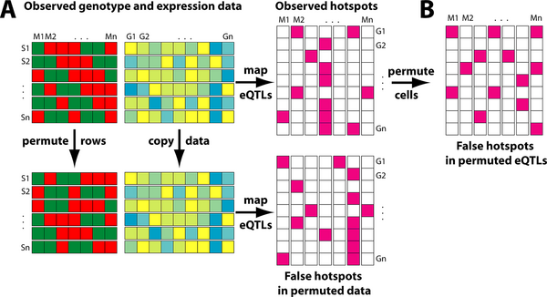
permutation across traits (Breitling et al. Jansen 2008 PLoS Genetics)
right way
wrong way
strain
break correlation
between markers
and traits
but
preserve correlation
among traits
marker
gene expression

Slide 12
Yeast study
120 individuals
6000 traits
250 markers
1000 permutations
1.8 * 10^10 linear models
doable (barely) on a laptop

Slide 13
Mouse study
500 individuals
30,000 traits * 6 tissues
2000 markers
1000 permutations
1.8 * 10^13 linear models
1000 x more than yeast study
need to parallelize

Slide 14
••• CHTC mechanics •••

Slide 15
CHTC mechanics
figure out how to do small scale science
R code, then R package
diagram flow
Refactor code to scale up
Small scale tests
Ramp up

Slide 16
why automate?
Evolution of data
code breaks
code improves (and breaks again)
data breaks (typos, mistakes, etc.)
data improves (new results, altered database)
big data is not static
metadata is key
versions, annotation, ...

Slide 17
figure out how to do small scale science
build R code pieces
use Rproject or emacs or …
organize as R package
read “Writing R Extensions” many times
document, document, document
## comments in code at all steps
use prompt() and create function manual pages
include error checking with clear messages
write vignette/markdown of example run

Slide 18
diagram flow
calculations for one set of data
one trait: anova tests across many predictors
predictor = genotype at chromosome location
test statistic = log likelihood = LOD score
repeat for 1000s of traits (= molecular signals)
record test statistic distribution for each predictor
only need tail distribution
maybe only number of traits above threshold
find maximum by quantile across anova statistics
do same for multiple (1000s) of permutations
estimate permutation distribution (quantiles)

Slide 19
refactor code to scale up
overview mechanics
have simple calls at top for later scheduling needs
put parallel functions in their own file
document, document, document for you and others
parallel.qtlhot(phase, index, …, dirpath=“.”)
one master function to guide phases
each phase has needed arguments, etc.
dirpath useful for testing, but use “.” for CHTC sandboxes
parallel.error(number, phase, index)
write “RESULT.phase.index” file with number
parallel.message(number)
output informative message (0 = “OK”)
qtlhot.phaseN(dirpath, index, …)
N = phase number
called by parallel.qtlhot(), hidden from user except N=0

Slide 20
parallel phases qtlhot.phaseN(dirpath, index, …)
0: initialization (for scheduling before CHTC)
1: setup objects needed in phase 2 (one processor)
read raw data
create useful stuff (random sequence for index?)
write Phase1.RData object
2: map phase: parallel permutation (send to CHTC sandboxes)
load Phase1.RData object
permute or otherwise shuffle as needed using index
do calculations for one set of data
write Phase2.index.RData objects
3: reduce phase: merge permutations (one processor)
load Phase1.RData object
loop through Phase2.*.RData objects
write Phase3.RData object

Slide 21
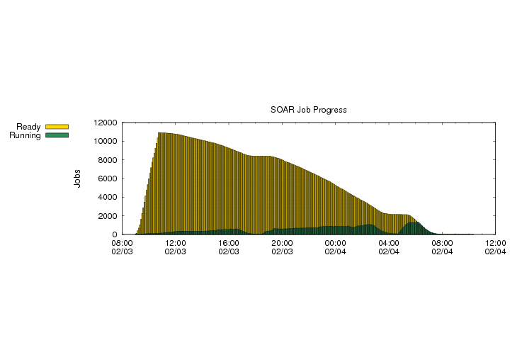
CHTC use: one “small” project
Open Science Grid Glidein Usage (4 feb 2012)
group hours percent
1 BMRB 10710.3 73.49%
2 Biochem_Attie 3660.2 25.11%
3 Statistics_Wahba 178.5 1.22%

Slide 22
art of map phase
want CHTC runs that are ~2 hours
if longer, break up into smaller chunks
keep track of randomization sequence, etc.
build merge into R code or DAGman scheme
if shorter, combine sets as series
1000 runs of 10 sets rather than 10,000 small runs
use R code to organize objects as needed

Slide 23
art of reduce phase
each map phase run may have sizeable object
you have subtle summaries needed across runs
you don’t yet know what you want to save
summarize but don’t throw out checkpoints
test each phase as you go in modular way
when satisfied, remove big unneeded objects
save space on submit node (fills quickly)
decide what you need to keep longer term
can often rerun CHTC if need to reproduce stuff

Slide 24
phase 0 CHTC initialization
use a script! document steps!
./R --no-save --args islet Male m2 < SOAR.args0.R
may have to combine multiple data sources
reduce object size to minimal needed
create local folder with subfolders for CHTC
move objects into place
copy folder to submit node
submit job to CHTC

Slide 25
initialization script
./R --no-save --args islet Male m2 < SOAR.args0.R
Contents of SOAR.args0.R:
args <- commandArgs(TRUE)
tissue <- args[1]
subset.sex <- args[2]
runnum <- args[3]
## SOAR.phase0.R does the initialization
source(”SOAR.phase0.R")

Slide 26
post-CHTC processing
use a script! document steps!
keep track of CHTC submit job ID
check that final object is there
have backup plan to do phase 3 offline
load Phase3.RData object
do post-processing, plots, summaries
save useful stuff

Slide 27
post-processing script
./R --no-save --args islet Male m2 209 < SOAR.args1.R
Contents of SOAR.args1.R:
args <- commandArgs(TRUE)
tissue <- args[1]
subset.sex <- args[2]
runnum <- args[3]
job <- args[4]
## SOAR.post.R does the post processing
source(”SOAR.post.R")

Slide 28
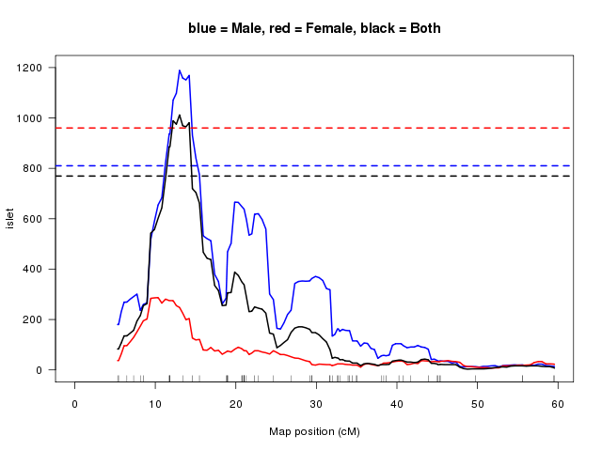
Breitling Method
MSRC5
2012 © Yandell
28
Notes:
28

Slide 29
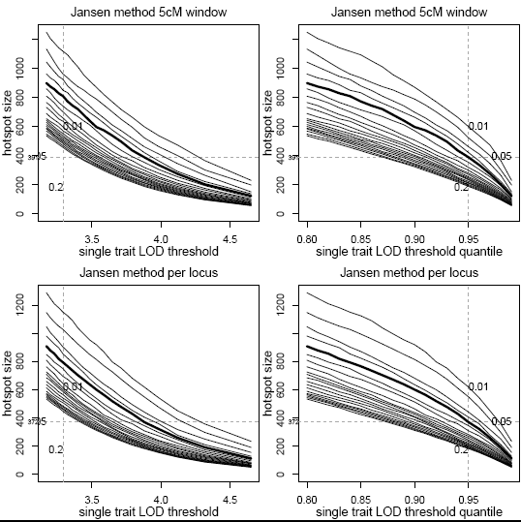
Brietling et al (2008) hotspot size thresholds from permutations

Slide 30
quality vs. quantity in hotspots (Chaibub Neto et al. 2012 Genetics)
detect single trait with very large LOD
control FWER across genome and all traits
find small hotspots with very significant traits
all traits have large LODs at same locus
maybe one strongly disrupted signal pathway?
use sliding LOD threshold across hotspot sizes
small LOD threshold (~4) for large hotspots
large LOD threshold (~8) for small hotspots

Slide 31
rethinking the approach
For a hotspots of size N, what threshold T(N) is just large enough to declare 5% significance?
N = 1 (single trait)
What threshold T(1) is needed to declare any single peak significant?
valid across all traits and whole genome
Chaibub Neto E, Keller MP, Broman AF, Attie AD, Jansen RC, Broman KW, Yandell BS, Quantile-based permutation thresholds for QTL hotspots. Genetics (tent. accepted).

Slide 32
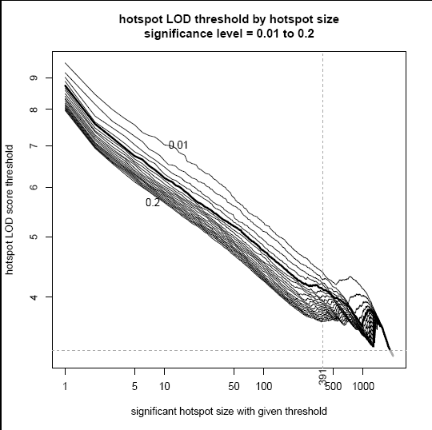
Chaibub Neto sliding LOD thresholds
single trait
significant
50-trait hotspot
significant

Slide 33
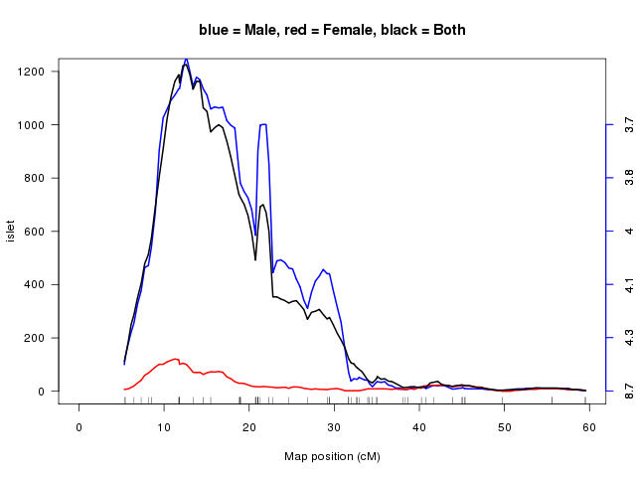
sliding LOD method

Slide 34
••• causal networks •••

Slide 35
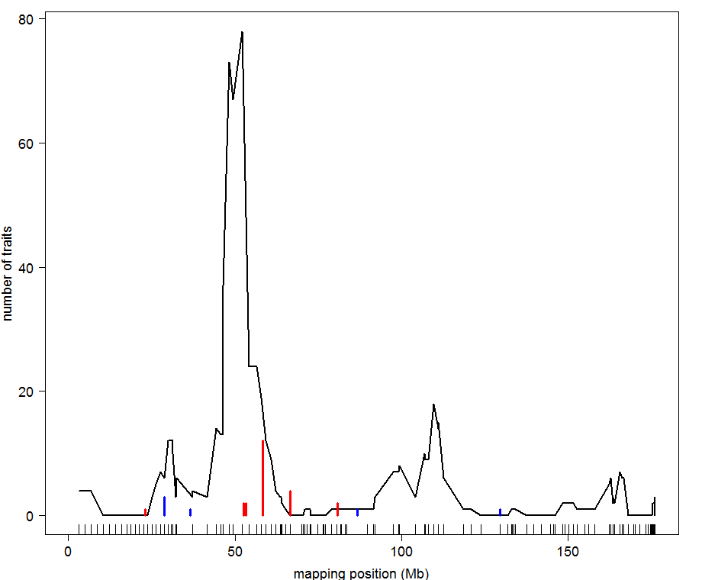
BxH ApoE-/- chr 2: causal architecture
hotspot
12 causal calls

Slide 36
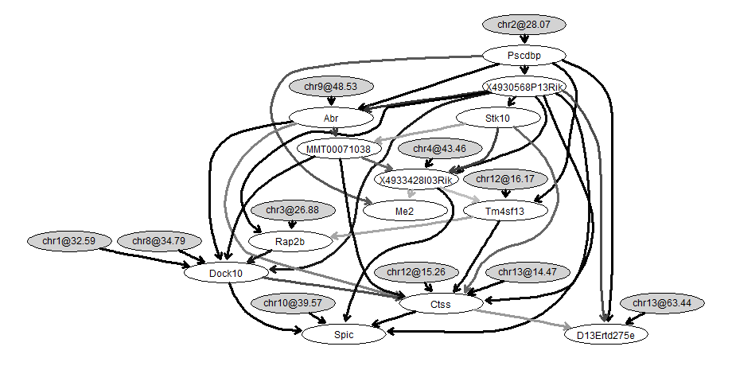
BxH ApoE-/- causal network for transcription factor Pscdbp
causal trait
unpublished work of
Elias Chaibub Neto

Slide 37
basic idea of QTLnet
iterate between finding QTL and network
genetic architecture given causal network
trait y depends on parents pa(y) in network
QTL for y found conditional on pa(y)
Parents pa(y) are interacting covariates for QTL scan
causal network given genetic architecture
build (adjust) causal network given QTL
each direction change may alter neighbor edges

Slide 38
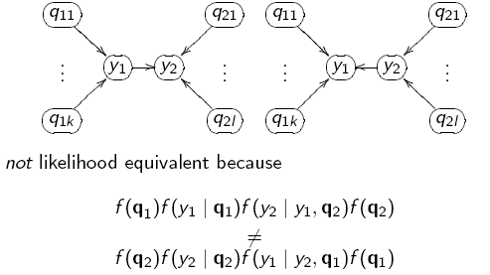
edge direction: which is causal?
due to QTL

Slide 39
graph complexity with node parents
pa1
pa1
pa2
pa3
node
node
of1
of2
of3
of1
of2
of3

Slide 40
how many node parents?
how many edges per node? (fan-in)
few parents directly affect one node
many offspring affected by one node
BIC computations by maximum number of parents
# 3 4 5 6 all
10 1,300 2,560 3,820 4,660 5,120
20 23,200 100,720 333,280 875,920 10.5M
30 122,700 835,230 4.40M 18.6M 16.1B
40 396,800 3.69M 26.7M 157M 22.0T
50 982,500 11.6M 107M 806M 28.1Q

Slide 41
BIC computation
each trait (node) has a linear model
Y ~ QTL + pa(Y) + other covariates
BIC = LOD – penalty
BIC balances data fit to model complexity
penalty increases with number of parents
limit complexity by allowing only 3-4 parents

Slide 42
parallel phases for larger projects
1
Phase 1: identify parents
Phase 2: compute BICs
Phase 3: store BICs
Phase 4: run Markov chains
Phase 5: combine results
…
2.1
2.2
2.b
3
…
4.m
4.1
4.2
5

Slide 43
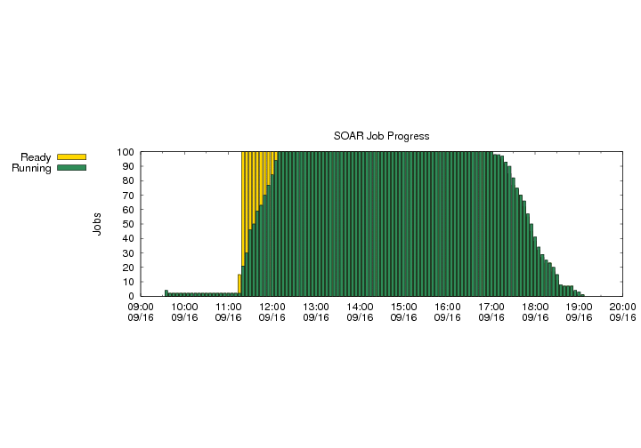
parallel implementation
R/qtlnet available at www.github.org/byandell
Condor cluster: chtc.cs.wisc.edu
System Of Automated Runs (SOAR)
~2000 cores in pool shared by many scientists
automated run of new jobs placed in project
Phase 2
Phase 4

Slide 44
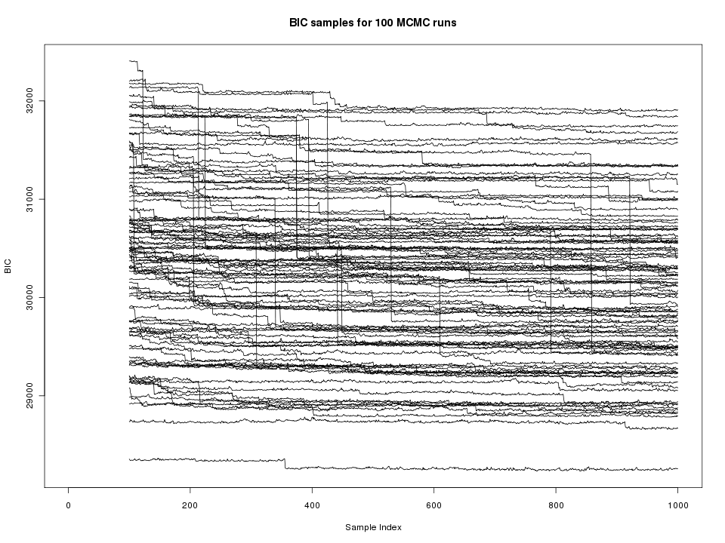
single edge updates
burnin
100,000 runs

Slide 45
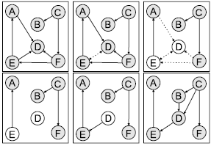
neighborhood edge reversal
select edge
drop edge
identify parents
orphan nodes
reverse edge
find new parents
Grzegorczyk M. and Husmeier D. (2008) Machine Learning 71 (2-3), 265-305.

Slide 46
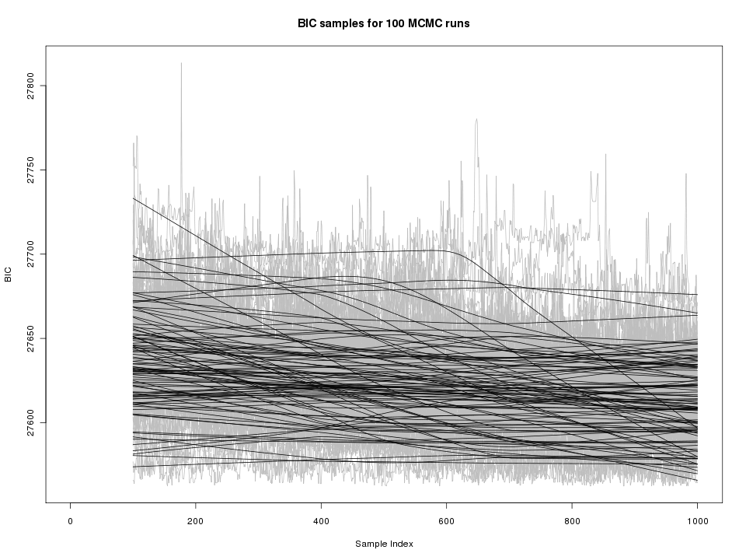
neighborhood for reversals only
burnin
100,000 runs

