Slide 1
Computational Infrastructure
for Systems Genetics Analysis
Brian Yandell, UW-Madison
high-throughput analysis of systems data
enable biologists & analysts to share tools
UW-Madison: Yandell,Attie,Broman,Kendziorski
Jackson Labs: Churchill
U Groningen: Jansen,Swertz
UC-Denver: Tabakoff
LabKey: Igra

Slide 2
collaborative
portal
(LabKey)
systems genetics portal
(PhenoGen)
iterate many times
get data (GEO, Sage)
view results
(R graphics,
GenomeSpace tools)
run pipeline
(CLIO,XGAP,HTDAS)

Slide 3
analysis pipeline acts on objects (extends concept of GenePattern)
input
pipeline
output
settings
checks

Slide 4
pipeline is composed of many steps
I
A
B
I’
A’
combine datasets
C
compare methods
O
E
D
O’
E’
D’
alternative path

Slide 5
causal model selection choices in context of larger, unknown network
focal trait
target trait
causal
focal trait
target trait
reactive
focal trait
target trait
correlated
focal trait
target trait
uncorrelated

Slide 6
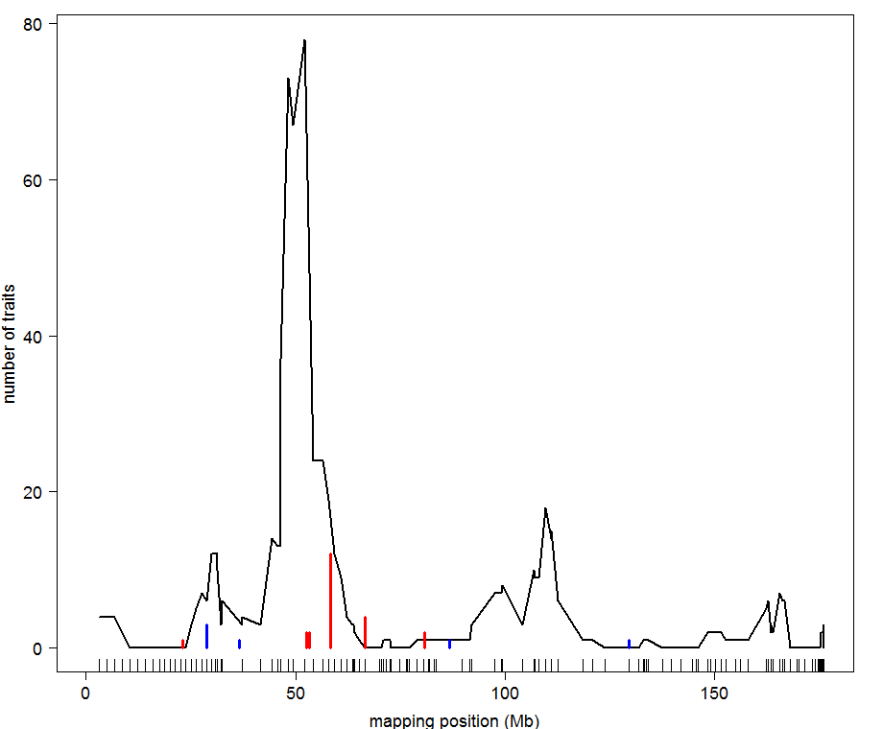
BxH ApoE-/- chr 2: causal architecture
hotspot
12 causal calls

Slide 7
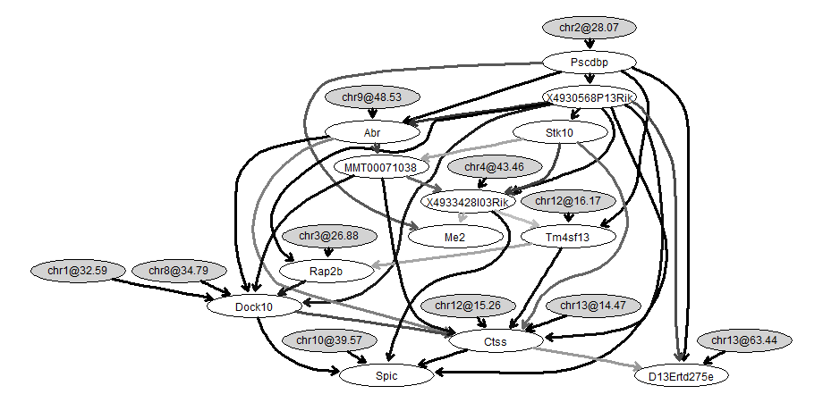
BxH ApoE-/- causal network for transcription factor Pscdbp
causal trait
work of
Elias Chaibub Neto

Slide 8
collaborative
portal
(LabKey)
systems genetics portal
(PhenoGen)
iterate many times
get data
(GEO, Sage)
view results
(R graphics,
GenomeSpace tools)
update
periodically
run pipeline
(CLIO,XGAP,HTDAS)
develop analysis methods & algorithms
byandell@wisc.edu

Slide 9
input
pipeline
output
settings
checks
preserve
history
package
raw
code
R&D

Slide 10
Model/View/Controller (MVC) software architecture
isolate domain logic from input and presentation
permit independent development, testing, maintenance
Controller
Input/response
View
render for interaction
system actions
Model
domain-specific logic
user changes

Slide 11
perspectives for building a community
where disease data and models are shared
Benefits of wider access to datasets and models:
1- catalyze new insights on disease & methods
2- enable deeper comparison of methods & results
Lessons Learned:
1- need quick feedback between biologists & analysts
2- involve biologists early in development
3- repeated use of pipelines leads to
documented learning from experience
increased rigor in methods
Challenges Ahead:
1- stitching together components as coherent system
2- ramping up to ever larger molecular datasets

Slide 12
www.stat.wisc.edu/~yandell/statgen byandell@wisc.edu
UW-Madison
Alan Attie
Christina Kendziorski
Karl Broman
Mark Keller
Andrew Broman
Aimee Broman
YounJeong Choi
Elias Chaibub Neto
Jee Young Moon
John Dawson
Ping Wang
NIH Grants DK58037, DK66369, GM74244, GM69430 , EY18869
Jackson Labs (HTDAS)
Gary Churchill
Ricardo Verdugo
Keith Sheppard
UC-Denver (PhenoGen)
Boris Tabakoff
Cheryl Hornbaker
Laura Saba
Paula Hoffman
Labkey Software
Mark Igra
U Groningen (XGA)
Ritsert Jansen
Morris Swertz
Pjotr Pins
Danny Arends
Broad Institute
Jill Mesirov
Michael Reich

Slide 13
Systems Genetics Analysis Platform
Brian Yandell, UW-Madison
high-throughput analysis of systems data
enable biologists & analysts to share tools
UW-Madison: Attie, Broman,Kendziorski
Jackson Labs: Churchill
U Groningen: Jansen, Swertz
UC-Denver: Tabakoff
LabKey: Igra
hotspot
causal trait

