Slide 1
Computational Infrastructure
for Systems Genetics Analysis
Brian Yandell, UW-Madison
high-throughput analysis of systems data
enable biologists & analysts to share tools
UW-Madison: Yandell,Attie,Broman,Kendziorski
Jackson Labs: Churchill
U Groningen: Jansen,Swertz
UC-Denver: Tabakoff
LabKey: Igra

Slide 2
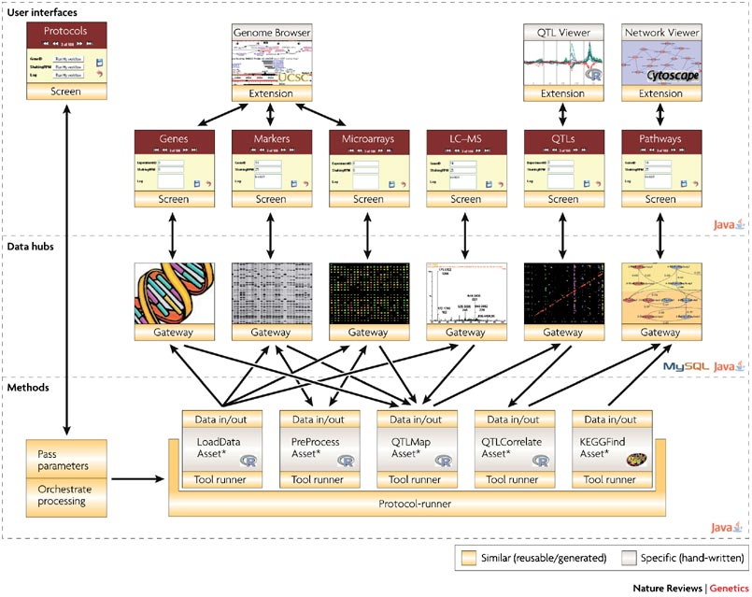

Slide 3
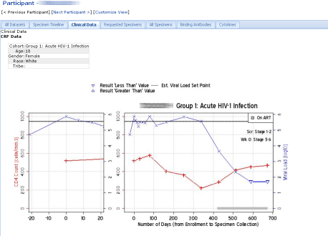
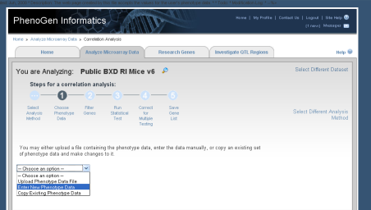
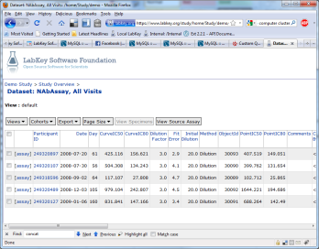
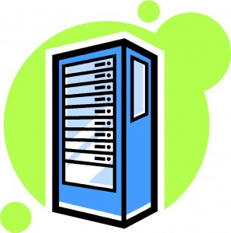
typical workflow (from Mark Igra, LabKey)
1
2
Configure Analysis
4
Review results, repeat steps 2-4 as required
Transfer files.
Bio-Web Server
3
Run analysis and load results
Database
Storage
File
Storage
Cluster

Slide 4
collaborative
portal
(LabKey)
systems genetics portal
(PhenoGen)
iterate many times
get data (GEO, Sage)
view results
(R graphics,
GenomeSpace tools)
run pipeline
(CLIO,XGAP,HTDAS)

Slide 5
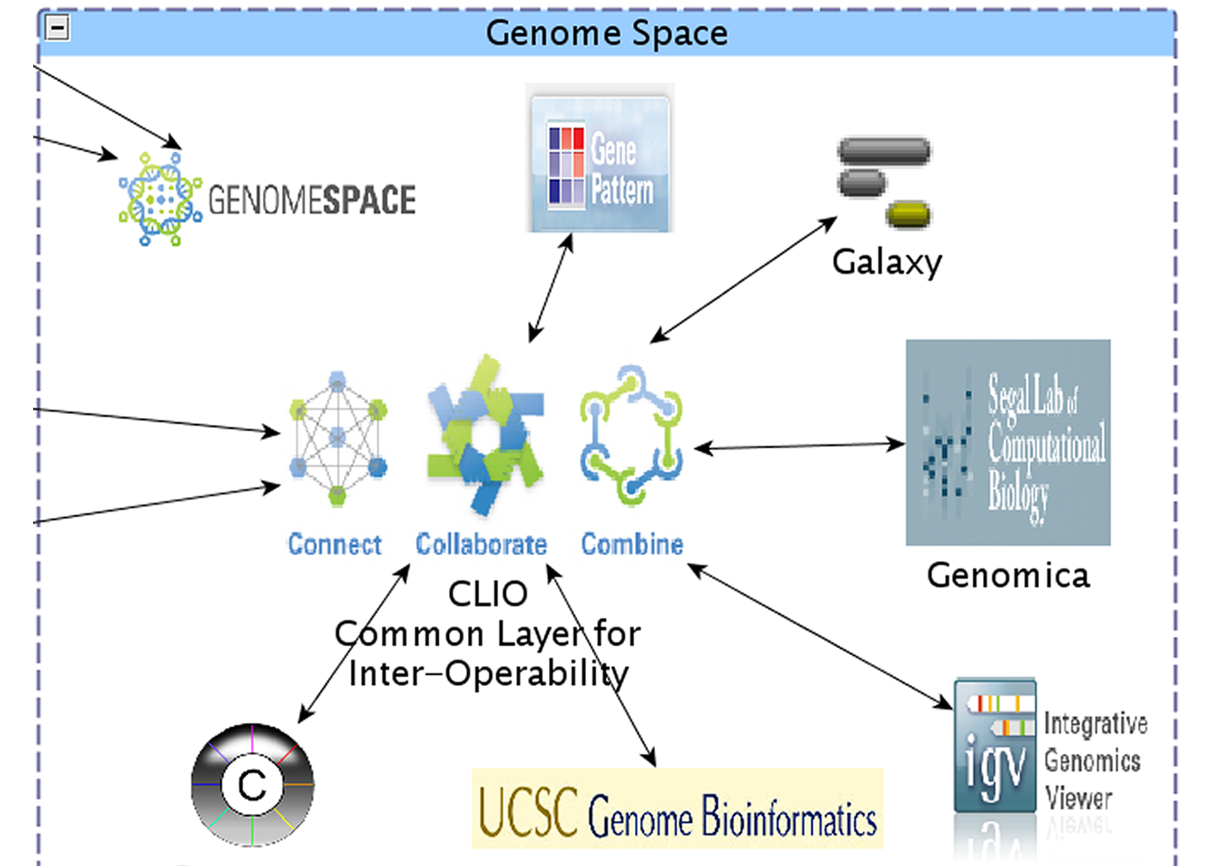

Slide 6
data access model
Sage Commons
Company X
closed
limited
open
proprietary
internal
collaboration
in progress
patent issues
published
shared

Slide 7
analysis pipeline acts on objects
(extends concept of GenePattern)
input
pipeline
output
settings
checks

Slide 8
pipeline is composed of many steps
i
A
B
C
o
E
D
D’

Slide 9
causal model selection choices in context of larger, unknown network
focal trait
target trait
causal
focal trait
target trait
reactive
focal trait
target trait
correlated
focal trait
target trait
uncorrelated

Slide 10
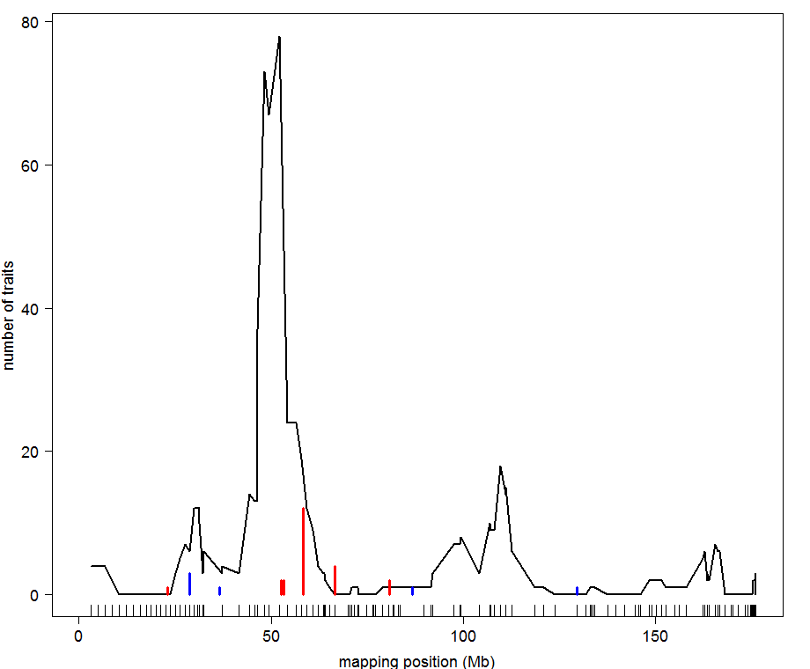
BxH ApoE-/- chr 2: causal architecture
hotspot
12 causal calls

Slide 11
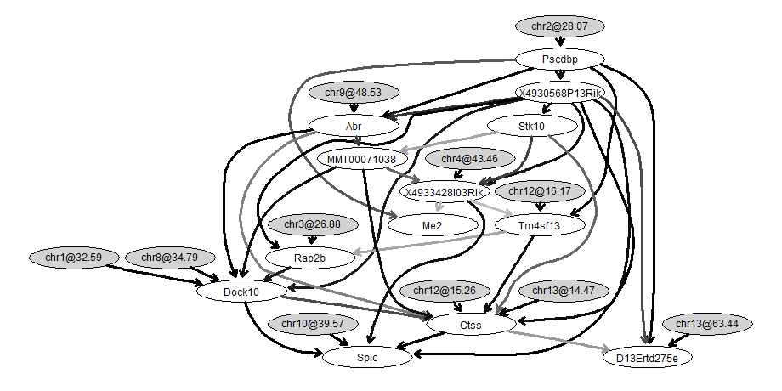
BxH ApoE-/- causal network for transcription factor Pscdbp
causal trait

Slide 12
collaborative
portal
(LabKey)
systems genetics portal
(PhenoGen)
iterate many times
get data
(GEO, Sage)
view results
(R graphics,
GenomeSpace tools)
update
periodically
run pipeline
(CLIO,XGAP,HTDAS)
develop analysis models & algorithms
byandell@wisc.edu

Slide 13
platform for biologists and analysts
create and extend pipeline steps
share algorithms
  public library
  private authentication
compare methods on one platform
combine data from multiple studies

Slide 14
R&D
raw
code
version
control
system
input
pipeline
output
settings
checks

Slide 15
Model/View/Controller (MVC) software architecture
isolate domain logic from input and presentation
permit independent development, testing, maintenance
Controller
Input/response
View
render for interaction
system actions
Model
domain-specific logic
user changes

Slide 16
perspectives for building a community
where disease data and models are shared
Benefits of wider access to datasets and models:
1- catalyze new insights on disease & methods
2- enable deeper comparison of methods & results
Lessons Learned:
1- need quick feedback between biologists & analysts
2- involve biologists early in development
3- repeated use of pipelines leads to
documented learning from experience
increased rigor in methods
Challenges Ahead:
1- stitching together components as coherent system
2- ramping up to ever larger molecular datasets

Slide 17
www.stat.wisc.edu/~yandell/statgen byandell@wisc.edu
UW-Madison
  Alan Attie
  Christina Kendziorski
  Karl Broman
  Mark Keller
  Andrew Broman
  Aimee Broman
  YounJeong Choi
  Elias Chaibub Neto
  Jee Young Moon
  John Dawson
  Ping Wang
  NIH Grants DK58037, DK66369, GM74244, GM69430 , EY18869
Jackson Labs (HTDAS)
  Gary Churchill
  Ricardo Verdugo
  Keith Sheppard
UC-Denver (PhenoGen)
  Boris Tabakoff
  Cheryl Hornbaker
  Laura Saba
  Paula Hoffman
Labkey Software
  Mark Igra
U Groningen (XGA)
  Ritsert Jansen
  Morris Swertz
  Pjotr Pins
  Danny Arends
Broad Institute
  Jill Mesirov
  Michael Reich

Slide 18
Systems Genetics Analysis Platform
Brian Yandell, UW-Madison
high-throughput analysis of systems data
enable biologists & analysts to share tools
UW-Madison: Attie, Broman,Kendziorski
Jackson Labs: Churchill
U Groningen: Jansen, Swertz
UC-Denver: Tabakoff
LabKey: Igra
hotspot
causal trait

